Slide 1
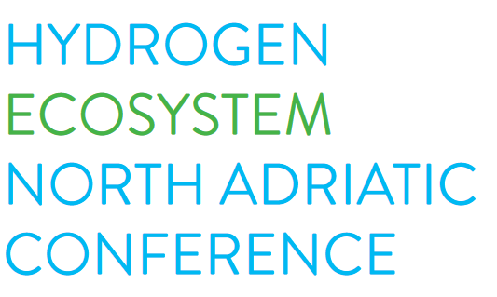



Greening the island of Cres - the role of hydrogen
Ugo Toić, OTRA
14/11/2024 Nova Gorica

Slide 2
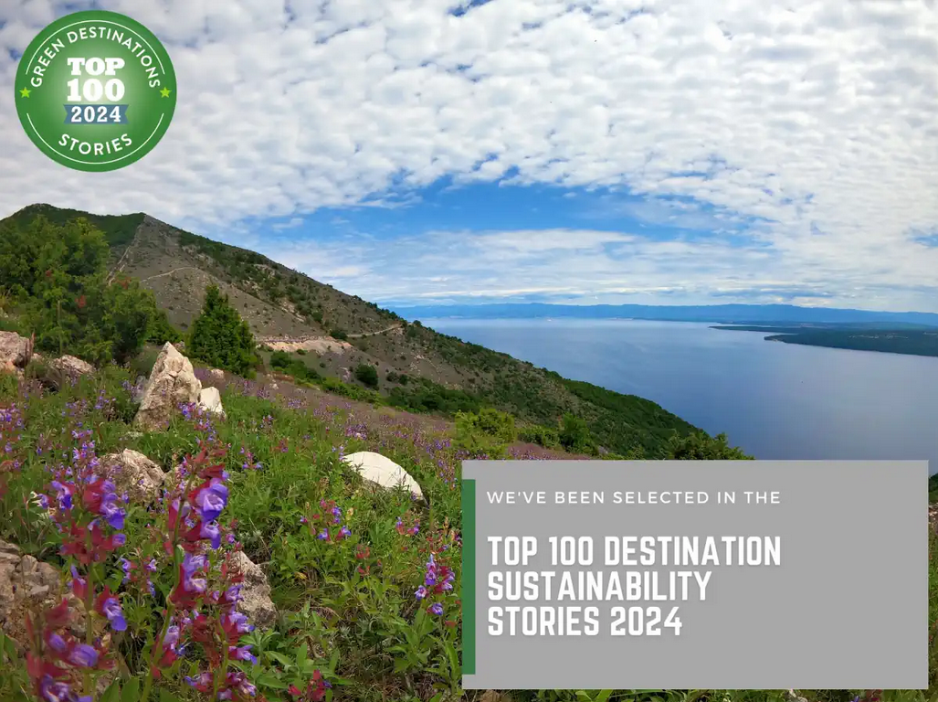
Notes:
Those of you who have been lucky to visit Cres know that the island is very green, thanks to its rich vegetation. Both Cres and Lošinj are investing a lot to become also recognized and labelled as sustainable green tourist destinations and energy transition initiatives can help a lot.

Slide 3
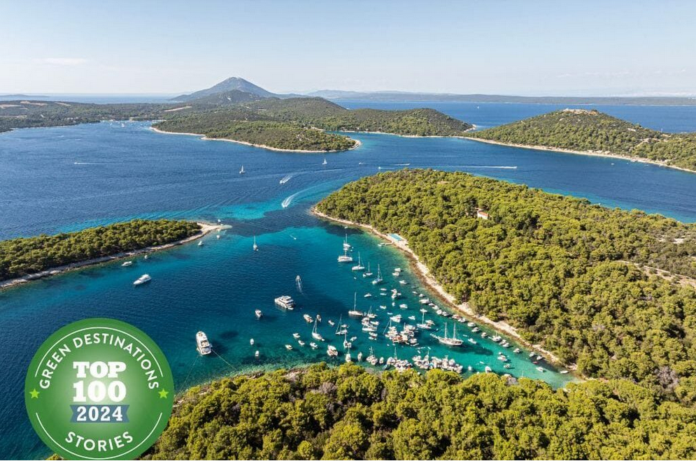

Slide 4

Cres-Lošinj Among 6 pioneering islands that
received TA to write
the Clean Energy Transition Agenda (CETA)
VISION 2030
The Cres-Lošinj archipelago is smart and energy self-sufficient; the local community is energy literate and actively involved in the energy transition, which will enable carbon neutrality (complete decarbonisation) by 2040.
Notes:
In 2019 the Cres-Lošinj archipelago was selected by the Clean Energy for EU island Secretariat as one of the 6 pioneering islands that will receive technical assistance to write its Clean Energy Transition Agenda.
As you see, our vision relays a lot on community engagement.

Slide 5
CETA pillars
Electricity production
Cooling / heating
Road transport
Maritime transport
Awareness raising
Notes:
Our CETA is based on four pillars:
Electricity production
Cooling / heating
Road transport
Maritime transport
As horizontal topic we have awareness raising and stakeholders’ engagement

Slide 6













PROJECTS
Notes:
Since 2019 we have been engaged in many different projects and initiatives

Slide 7

















PARTNERS
Notes:
either as partners or associated partners, testbed or pilot area providers, followers, … collaborating with different national and international partners. Namely, many of them prefer to test some solutions on island which are used as small laboratories, a sort of testing grounds.

Slide 8



From waste to green Hydrogen
Green Electricity
Green Hydrogen
Carbon Credits
Activated Carbon
Biochar
Carbon Black
All Plastics
Biomass-type Waste
11 M €
Municipal Waste
Wastewater sludge
SMO Solar Process is the first solar powered, energy-autonomous waste processor transforming carbon-based waste into competitively priced Clean Hydrogen and Energy and Carbon Products, offering a dynamic carbon sink for climate change mitigation.
Notes:
The CETA proposed to solve the problem of the bio waste by using a biogas plant but the prefeasibility study shoed that there is not enough raw material of a sustainable implementation of such technology. We got in touch with the company Active Solera which proposed to use an innovative technology can process all organic waste, not only biomass, into green hydrogen. The Town of Cres, through its waste management company, will have to take care of the proper preparation of the waste that will be used by the processing plant and will need capital form different sources.

Slide 9

Notes:
Having envisaged a stable source of green hydrogen we have started to think of using it to decarbonise the road transport, first of all for trucks used by our waste and water management companies.

Slide 10
Notes:
Several months ago, the Town of Cres was invited by Ecubes to join the North Adriatic Hydrogen Valey with a project that will install on the island an innovative clean hydrogen infrastructure with the ultimate goal to develop and put in operation a hydrogen hydrofoil highspeed foot passenger catamaran that would connect Cres with Rijeka. We have seen it as an opportunity to step also into the decarbonisation of the maritime transport.

Slide 11
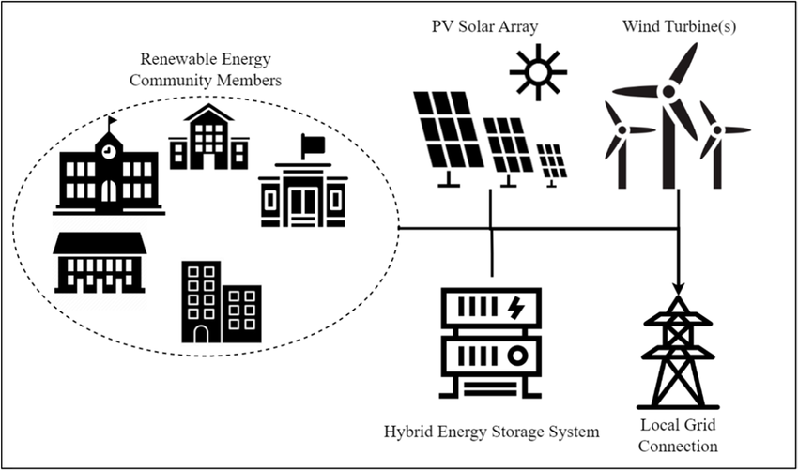
Notes:
Since the Town of Cres is investing significant efforts to set up an energy community that would enable the public organizations, business companies and citizens to share the electricity among each other,

Slide 12











16 M €
Notes:
the hydrogen infrastructure consisting of electrolysers, innovative storage solutions with the possibility to transport the H2, the refuelling stations and the fuel cells would certainly add new values to the entire ecosystem and would offer new technical and business model solutions that can be complementary to the existing one.

Slide 13
OUR NEEDS
Capacity building
Financing
PPP
Notes:
The fiscal capacity of the town of Cres, as well as the crowdfunding potential of the local community are limited and therefore we need …

Slide 14
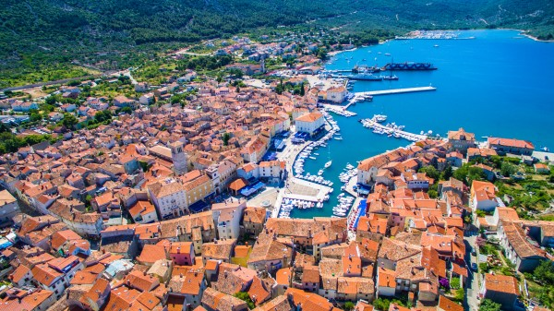
Thank you!
Questions?
Ugo Toić
ugo@pplr-otokcres.info
M: +385 91 2229943

Slide 15


