Slide 1
Example of application of LCA in green hydrogen production
Samantha Gandini
Nova Gorica – 13th November 2024
* Image courtesy of Iren

Slide 2
Broader Context
Greenhouse gases are responsible for hold heat within the atmosphere and for this reason, they are accountable for climate changes. Greenhouse gases production is regulated by various legislations.
One of the sources affecting mainly GHG emissions is the energy sector. For this reason, governments are funding projects for the installation of renewables plants aimed at diversifying energy supplies.
In this context, hydrogen plays a significant role in this transition due to its diverse applications, ranging from an alternative fuel to a carrier for transporting green energy.
45 %
of renewables in the EU mix by 2030
10 million tonnes¹
of hydrogen produced in EU and imported to EU by 2030
300 b€
founded by Recovery and Resilience Facility for RES
1 million tonnes²
Oman’ target for hydrogen production by 2030
Source¹: https://energy.ec.europa.eu/topics/energy-systems-integration/hydrogen_en
Source²: https://www.iea.org/reports/renewable-hydrogen-from-oman
Notes:
Tecnologie atte a ridurre le emission di gas serra che sono regolamentati dalle seguenti legislazioni:
Conferenza nazioni unite sul clima → imposto il target del net zero entro il 2050 a cui poi si sono allineate tutte le nazioni negli anni successivi
In particolare

Slide 3
Scope of the study
Evaluate from an environmental and economical point of view, differences between hydrogen import from MENA region to Italy and the domestic production in Italy.
Technical basis of design
LCA Analysis
Cost Analysis
RES plants capacity
Electricity production
Hydrogen production
Losses and boil-off
Available data gathering
LCA software
Emissions for 1 kg CO₂ eq./kg H₂
Losses and boil-off
CAPEX/OPEX identification
LCOE calculation
LCOH calculation for each process
Notes:
Quantità diverse di idrogeno → mettere direttamente qui

Slide 4
Scenarios analysed
Hydrogen import from Oman
75 t H₂ /d
Boil-off recirculation
4.3 GWh/d
78.4 t H₂/d
77.36 t H₂ /d
Wind plant 200 MW
PV plant 700 MW
Powered by Italian grid green electricity
PEM 560 MW
80 ton/day
20 days storage
Ship 1500 ton
20 days storage
Renewable energy production
Electrolysis
Liquefaction
Storage
Shipping
Storage
Regasification
Hydrogen domestic production in Italy
Hydrogen production in Italy is four times lower than Oman scenario
20 t H₂ /d
1.5 GWh/d
22.1 t H₂/d
21.7 t H₂ /d
Green electricity acquired by grid
PV plant 200 MW
Powered by Italian grid green electricity
PEM 160 MW
20 ton/day
1 day storage
2 Trucks with 5 ton
1 day storage
Renewable energy production
Electrolysis
Liquefaction
Storage
Shipping
Storage
Regasification
Notes:
Quantità diverse di idrogeno → mettere direttamente qui

Slide 5
Life Cycle Assessment (LCA)
Processes considered in the environmental analysis
RES plants
Electrolysis
Liquefaction
Storage
Shipping
Regasification
Photovoltaic plant construction
Wind plant construction
Hydropower plant construction
Electrolyser construction
Electrolyser operation
Liquefaction plant construction
Liquefaction plant operation
Storage tank construction
Ship:
Fuel consumption
Ship construction
Port facilities
Truck:
Fuel consumption
Truck construction
Road maintenance
Regasification plant construction
Regasification plant operation
Plant capacity
Panel efficiency
Irradiance
Plant capacity
Plant capacity
Tank capacity
No changes
Plant capacity

Slide 6
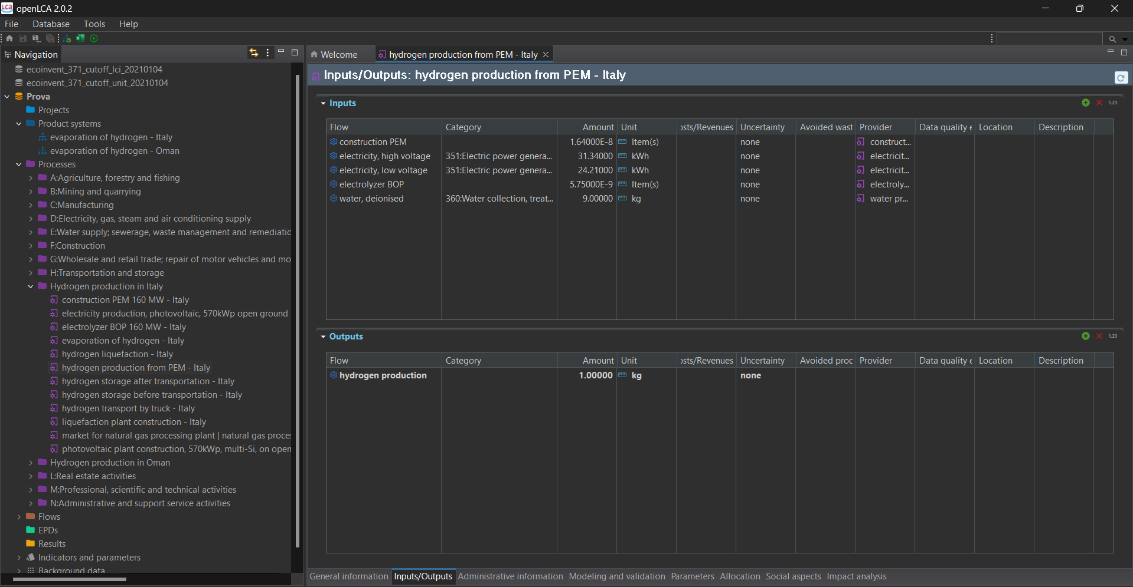
Focusing on LCA
Software
Database
Interesting results

Slide 7
Assumptions for cost analysis
Costs considered in the economic analysis
Sensitivity analysis
Capital costs, multiplied for the capital recovery factor (CRF)
Operational & Maintenance costs (O&M)
Energy costs, evaluated by calculating the Levelized cost of electricity for both scenarios (LCOE)
Replacement costs (REPLEX), multiplied for a factor that included the replacement year
r is the discount rate and t is the lifetime horizon
Land Costs
Discount rate variation
Variation in capital costs for installation of RES plants
$$LCOH= \frac{\left(capital costs∗CRF\right)+ O\&M costs+energy costs+(replex costs∗CRP)}{average annual hydrogen yield}$$
$CRF=\frac{r{(1+r)}^{n}}{[{\left(1+r\right)}^{n}−1]} FFR= \frac{r{(1+r)}^{n}}{[{\left(1+r\right)}^{n}−1]}∗\frac{1}{{(1+r)}^{t}}$
N.B. FFR = factor for replacement is not a common acronym but it has been used in this case to point at the CRF multiplied for a factor that considers the year of replacement

Slide 8
Losses among the supply chain
Power PV and wind plant
Electrolysis Losses
Liquefaction Losses
Electrolysis
Shipping boil-off gas
Storage boil-off gas
Oman scenario
Liquefaction
Storage
Shipping
Storage
Regasification
83 %
60 %
54 %
54 %
50.3 %
50.1 %
50.1 %
H₂
10 %
6 %
Saved Electricity
Green electricity acquired by the grid at the final delivery point in Italy
Power PV and grid
Electrolysis Losses
Liquefaction Losses
Shipping boil-off gas
Storage boil-off gas
Electrolysis
Italy scenario
boil-off gas
Liquefaction
Storage
Shipping
Storage
Regasification
80 %
60 %
49 %
48.8 %
48.6 %
48.4 %
48.4 %
0.1 %
H₂
11 %
8.9 %
0.1 %
Saved Electricity
Green electricity acquired by the grid at the final delivery point in Italy
Notes:
Losses among the supply chain

Slide 9
Life Cycle Assessment (LCA) Results
Carbon footprint of both scenarios (kg CO₂-eq./kg H₂)
Carbon footprint of electrolysis (kg CO₂-eq./kg H₂)
2.60 kg CO₂-eq./kg H₂
2.13 kg CO₂-eq./kg H₂

Slide 10
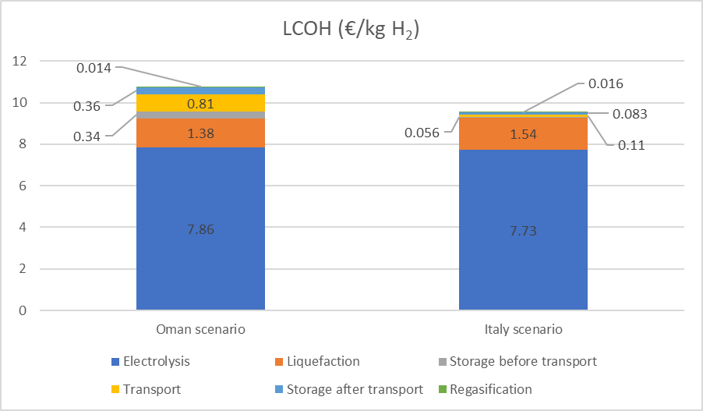
Levelized Cost of Hydrogen (LCOH) Results
LCOH for both scenarios (€/kg H₂ )
Sensitivity analysis
9.26 €/kg H₂
8.56 €/kg H₂
PV costs for installation:
Oman: 1300 €/kW
Italy: 970 €/kW
Notes:
Acronimo da mettere lungo

Slide 11
Considerations and Discussion
There are several factors to be considered in order to evaluate properly the results of the analysis:
1
Uncertainties in LCA and costs assumed data
2
Different quantities of hydrogen produced and transported between scenarios
27 kton/year in Oman scenario
7.3 kton/year in Italy scenario
3
Hydrogen could be used directly on the production site in Italy scenario
LCA
1.74 kg CO₂-eq./kg H₂
Economic
7.73 €/kg H₂
Notes:
Uncertainties in LCA data due to:
Unavailability of similar hydrogen processes → e.g. storage and transportation processes did not include materials for cryogenics liquids
Impacts of locations → e.g. water from desalinization plants in Oman has an impact of 5-6 kg CO₂/m³ while in Italy of 0.30 kg CO₂/m³
Economic analysis:
Uncertainties in cost estimation related to hydrogen processes such as liquefaction and regasification processes that have been estimated on LNG bases or limited hydrogen plants available
Lack of data related to locations

Slide 12
Digital models for H₂ distribution
Thank you
Samantha Gandini
samantha.gandini@studenti.units.it
Image credits: elaborated from https://www.ufihydrogen.com/it/

