Slide 1



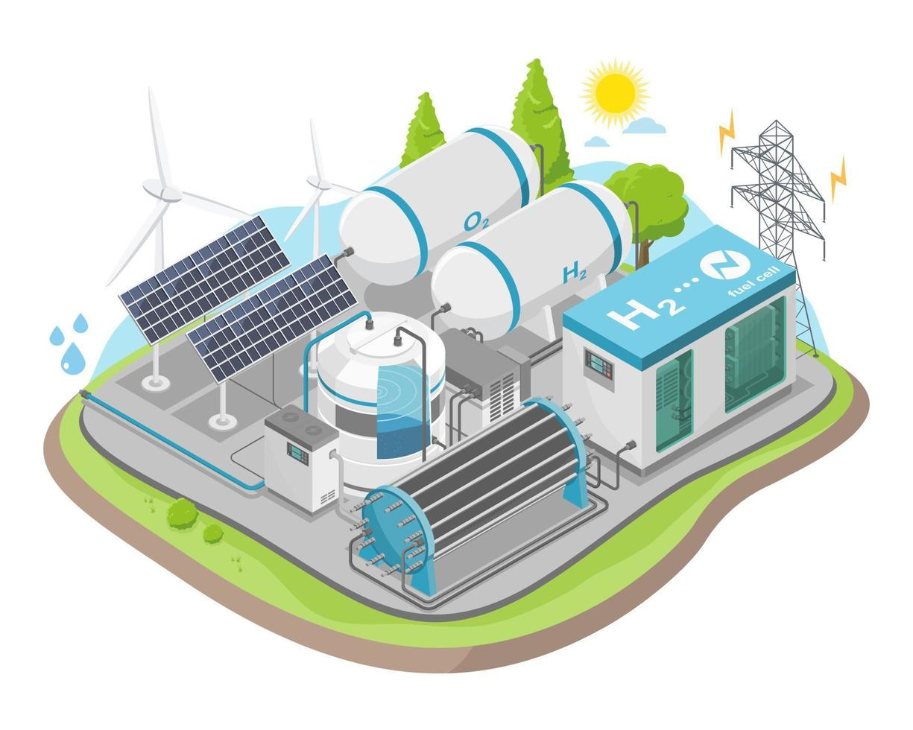





Digitalization
in the hydrogen value chain
Data collection
Control
Monitoring
Federico Del Mondo
Nova Gorica – 13th November 2024
Optimiaztion
Analysis
Simulation
Notes:
How digitalization support the energy plants and in particular in this case a hydrogen production and reconversion plant
Some key tools the digitalization provide to us

Slide 2

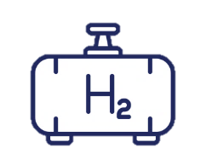








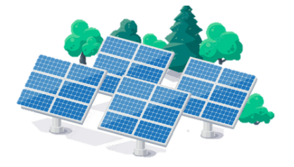
The importance of digitalization in the hydrogen value chain
Example of efficiency losses along the hydrogen value chain
36 Electricity production
60 Compression
/ storage
H₂
-
- 40%
67 Hydrogen
production
H₂
+
95 Electric energy
distribution
24 Fuel cell
losses
- 10%
- 30%
- 5%
Other end uses
7 Storage
losses
Electricity production from RES sources
28 Electrolyser
losses
5 Transmission
losses
Notes:
Starting from the sankey diagram presented before by professor Taccani, we can see that we have to increase the efficiency of the value chain to gain more attraction about hydrogen and to increase the it’s economic availability

Slide 3
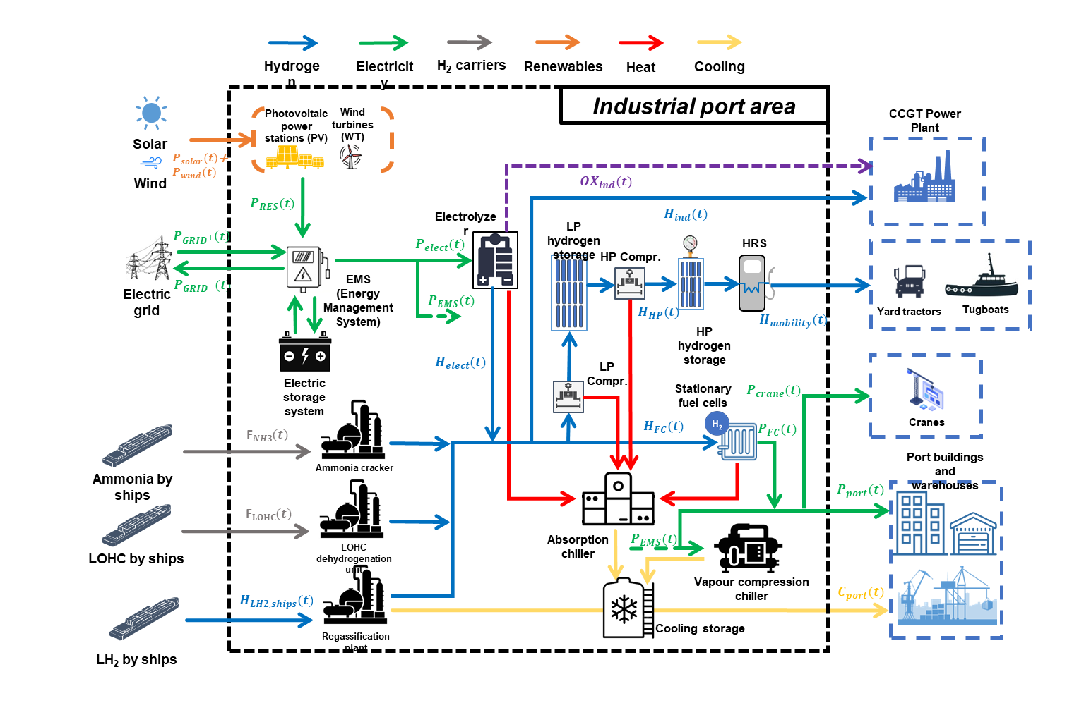
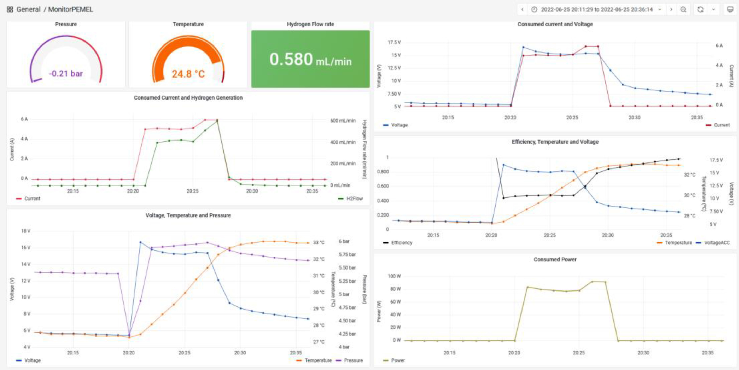
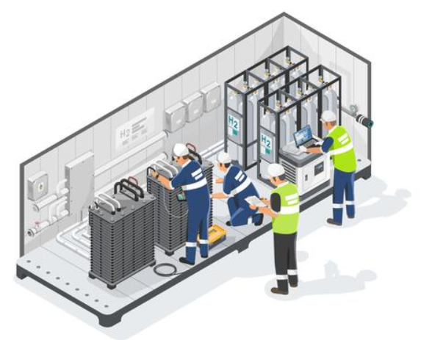
Integrating Digitalization in Design, Operation, and Maintenance Phases
Design
Operation
Maintenance
Development of a virtual environment for testing plant configurations. Increment of design robustness, comprehensive energy efficiency analysis, and strategic allocation resource.
Development of graphical interfaces for operational monitoring, real-time data processing and analysis for performance monitoring. Adaptive feedback control on operational parameters.
Analysis of equipment health and predicting failures. Identification of potential issues, minimization of downtimes and improving safety. Maintenance scheduling and cost breakdown.
Notes:
Integration of digital models within the different phases of the deveopment of an energy system
Starting from the design phase now I will present some digital models that we have developed internally in our research group to investigate about optimization of energy systems

Slide 4
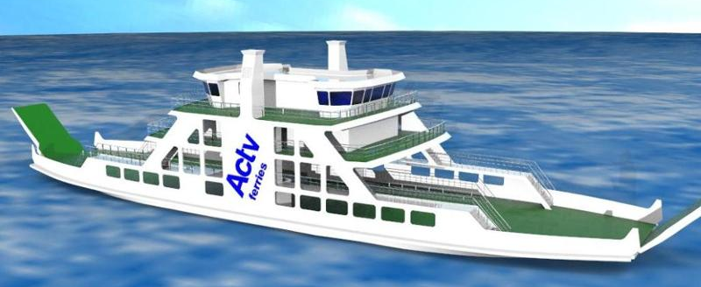

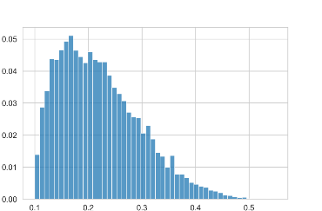
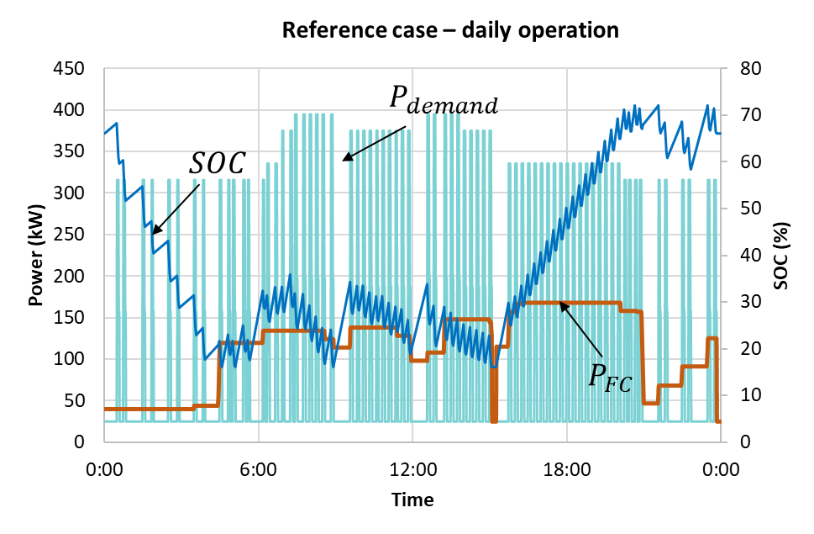
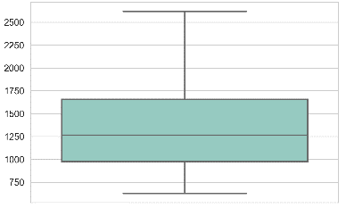
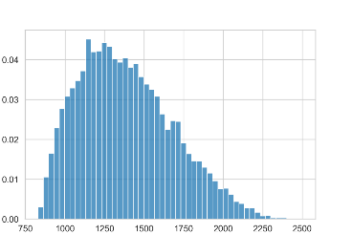
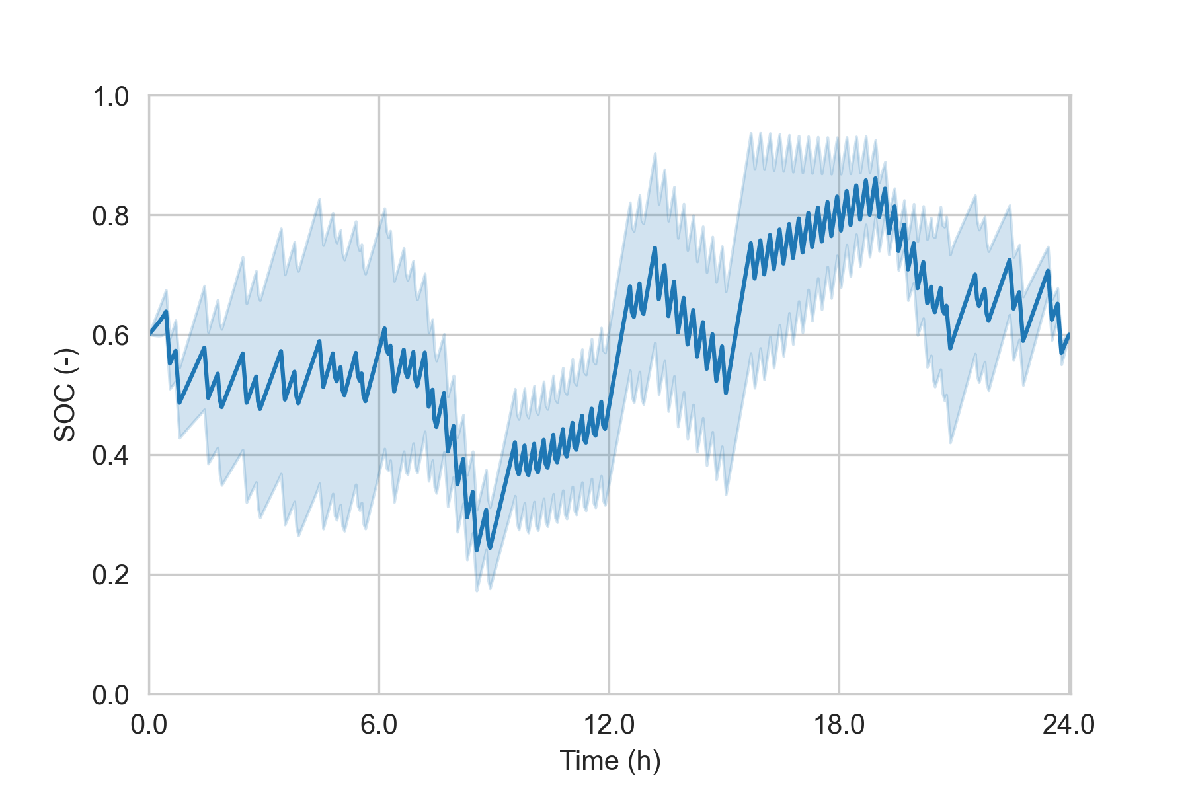
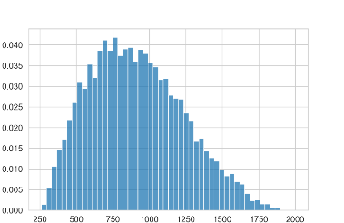
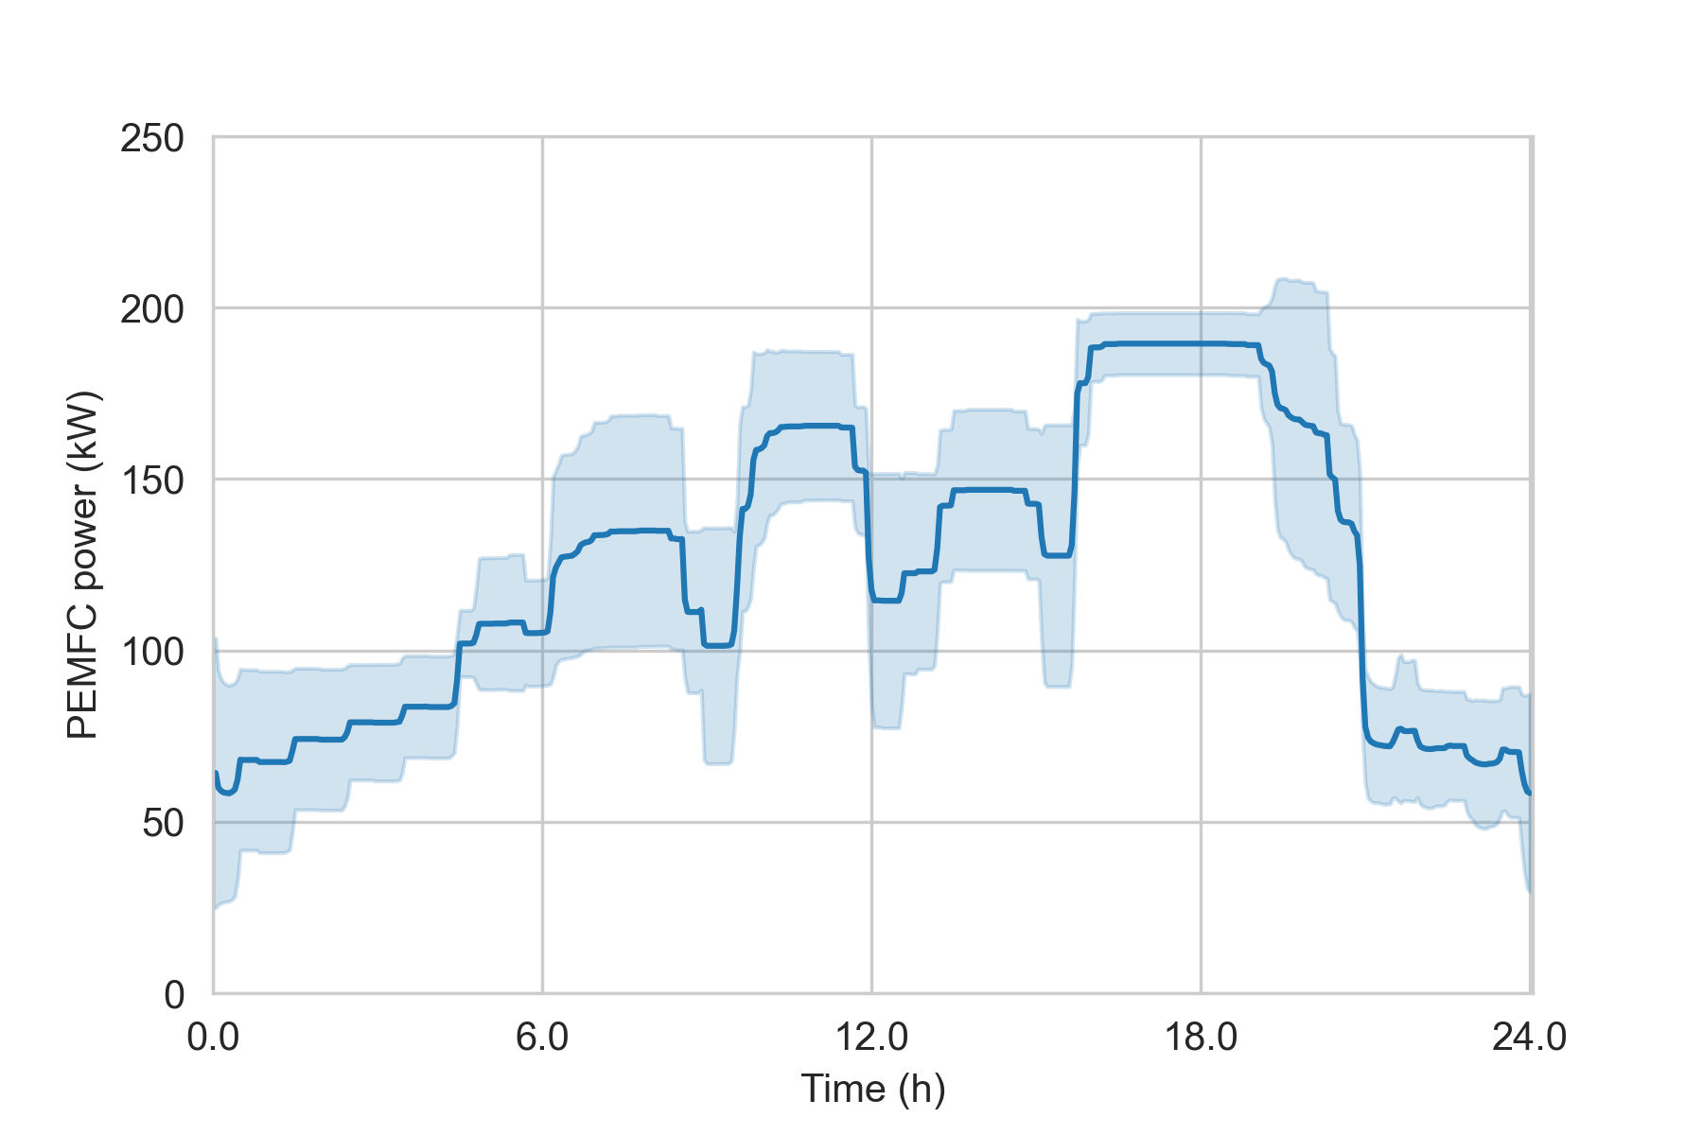
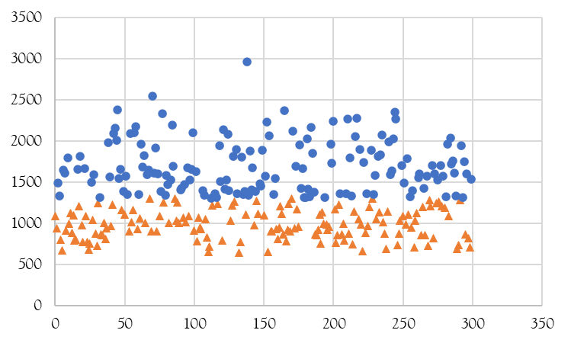
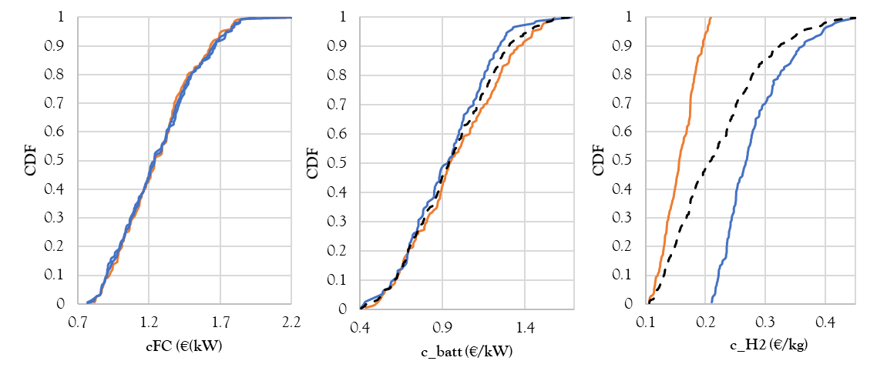
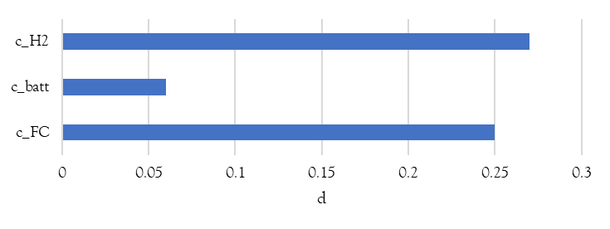
Digital models for hybrid fuel cells and battery system
Phase 1
MILP design optimization
Min FC degradation
PEMFC
Objective
2 x 100 kW
Min cost
LIB
310 kWh
Phase 3
Phase 2
Uncertainty characterization of input parameters
Two-layers MILP operation optimization
Uncertain optimization output
https://nuovavenezia.gelocal.it/venezia/cronaca/2022/12/18/news/lido_venezia_gara_trasporti_ferry_boat-12419903/
One day operation optimization
FC cost
LIB and PEMFC cumulative degradation at t_{j}
Ageing dependent layer
Cost
Start
t_{j}=0
H₂ cost
t_{j} = t_{j}+1
yes
SOH
>80%
SOC
LIB cost
Time dependent layer
no
Stop the optimization
FC operation
C. Dall'Armi, D. Pivetta, R. Taccani, Uncertainty analysis of the optimal health-conscious operation of a hybrid PEMFC coastal ferry, International Journal of Hydrogen Energy, Volume 47, Issue 21, 2022, https://doi.org/10.1016/j.ijhydene.2021.10.271.
Notes:
As an example, the model here presented has been develop to investigate the economic aspects of a ferry with an hybrid system propulsion
In the first phase based on ferry operational chaachteristics, the hybrid system has been designed with the goal of minimize the cost of the system and the fuel cell degradation
Then in the second phase different scenarios of the degradation of the system from year 1 to the end of life has been performed
And then uncertainaty about the cost of of fuel cell, batteri storage syste and hyydrogen has been introduced
We obtain the economic distribution of the system based on the uncertainaty analysis
Phase 1: design optimization of the energy system considerinf the minimization of FC degradation and cost minimization
Phase 2: optimization of the ferry opration based on the minimization of operational costs
Phase 3: iIndentified some scenarios about the minimization of operatioal costs we can introduce some uncertainty parameters as :FC cost, Battry cost, hydrogen cost
Da qui posso ottenere una distribuzione di probabilità dei costi del sistema

Slide 5
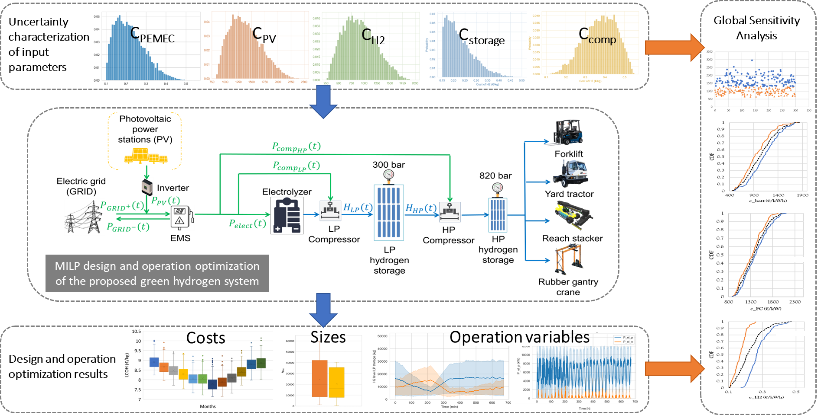
Digital models for H₂ production, storage and use
Notes:
Design and Operation optimization
We can obtain the optimum intervals of the plant design
Vengono analizzati i parametri che più influenzano l’ottimizzazione

Slide 6
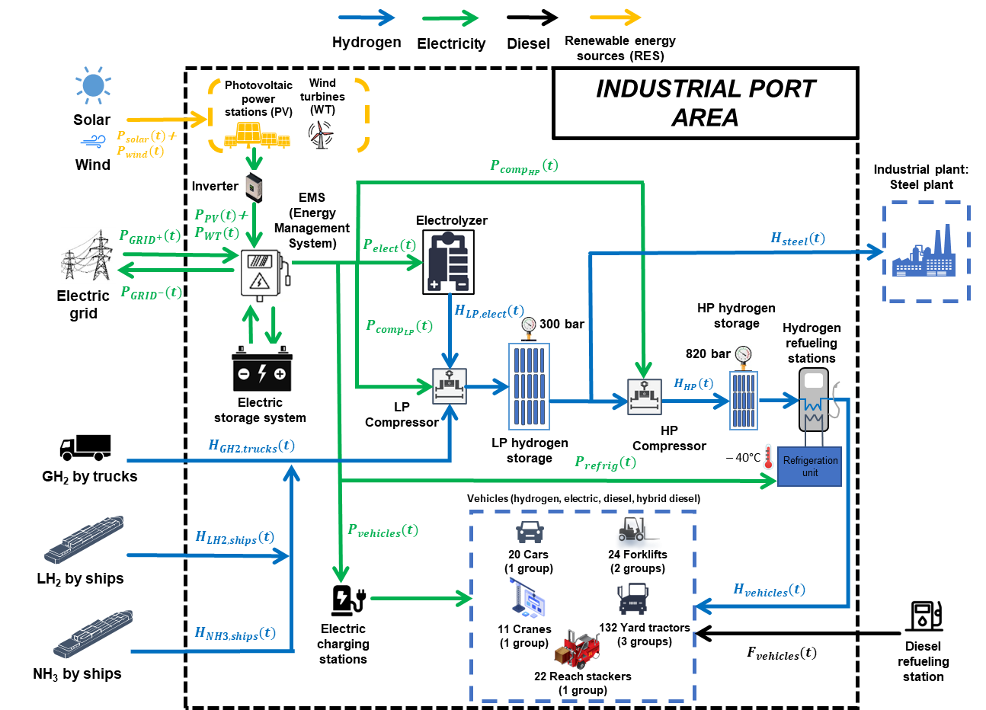
Digital models for H₂ production, storage and use
Davide Pivetta, Alessio Tafone, Stefano Mazzoni, Alessandro Romagnoli, Rodolfo Taccani, A multi-objective planning tool for the optimal supply of green hydrogen for an industrial port area decarbonization, Renewable Energy, Volume 232, 2024, https://doi.org/10.1016/j.renene.2024.120979.

Slide 7
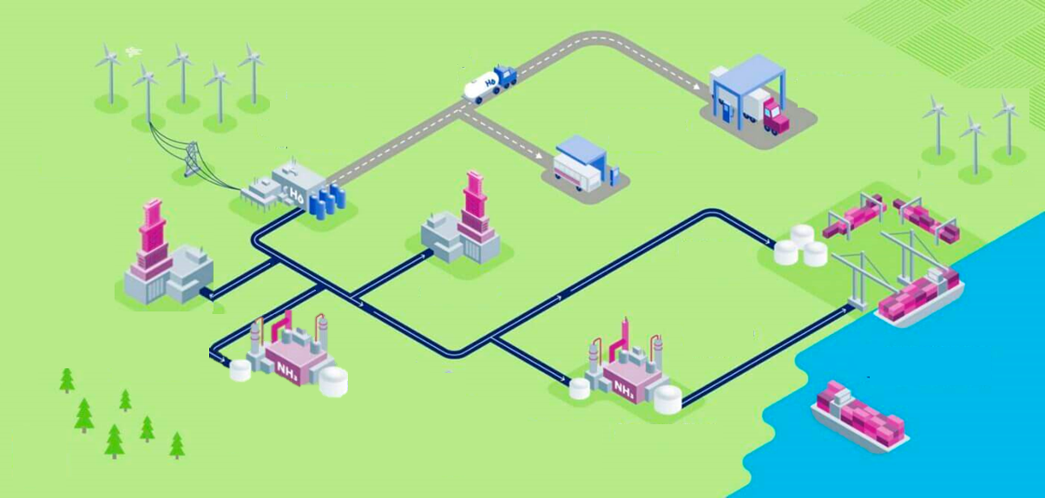


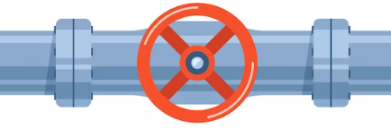




Digital models for H₂ distribution infrastructure configuration
Inland distribution of Hydrogen
Renewable electricity
H2 delivery via trucks
Off-taker
H₂ annual demand
Distance from production plant
Hydrogen production
H₂
Truck station
Bus station
Steel industry
Pipeline
Ceramics industry
Port
GH₂ truck delivery
Pipeline
LH₂ truck delivery
Fertilizer industry
Ammonia plant
Initial distribution pipeline layout
Integration
Result
Truck station
Truck station
Support of decision making in hydrogen distribution infrastructure
Producer
Bus station
Producer
Bus station
Steel industry
Steel industry
Port
Port
Ceramics industry
Ceramics industry
Fertilizer industry
Ammonia plant
Fertilizer industry
Ammonia plant
Minimum spanning tree distribution based on pipeline minimum length
F. Del Mondo ed al, Investigation on hydrogen distribution infrastructure and cost reallocation. In Press.

Slide 8





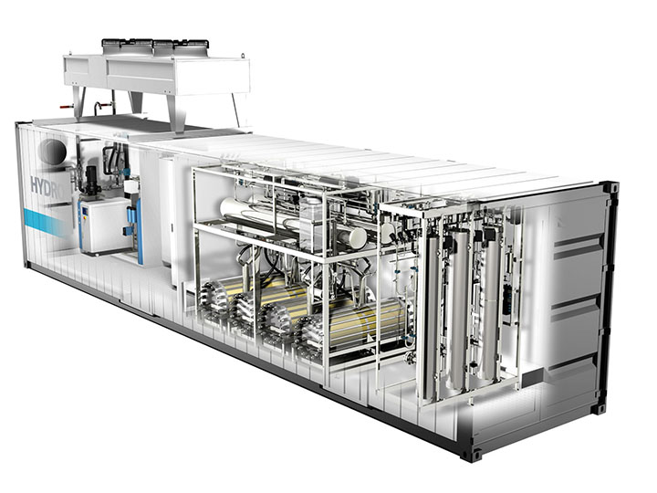
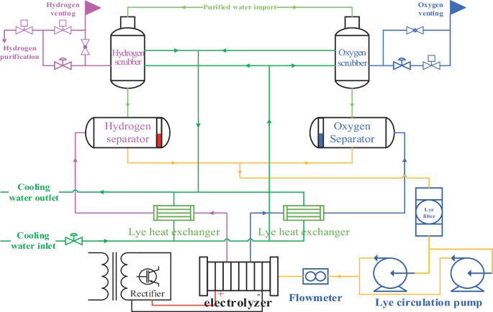
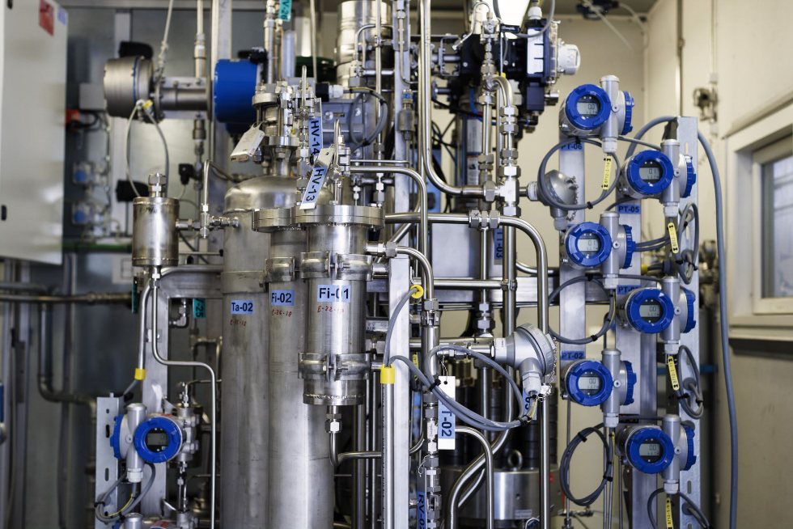
Digital models replicating systems
Digital Twins
Generation and training
The virtual model is developed based on the physical model data. Model training phases are scheduled periodically.
Control generation
Machine learning algorithms provide real-time predictions about the system operations based on the collected system data.
1
2
4
Automation feedback
Assessment of the changes on the physical system by continuos performance monitoring.
Automation control
Automated control adjusts system operations based on predictions from the digital twin and optimizing performance in real-time.
3
Feedback Exchange (Generation and training)
Control
Monitoring devices
Physical system
Digital model
Federico Del Mondo et al, Preliminary experimental data analysis for Digital Twin development of a large bore Dual-Fuel engine, 2023 J. Phys.: Conf. Ser. 2648 012075.
Notes:
which are finding increasing implementation thanks to the growing availability of artificial intelligence.

Slide 9
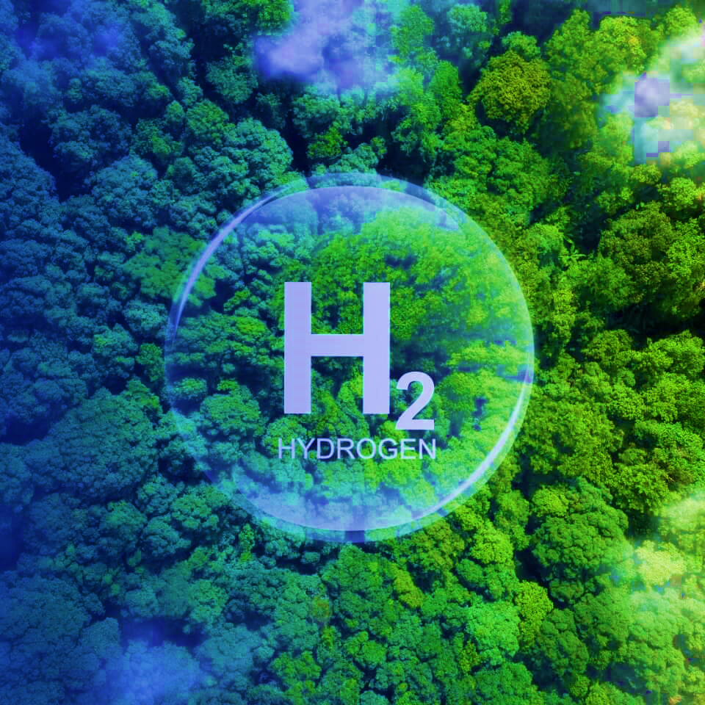

Digital models for H₂ distribution
Thank you
Federico Del Mondo
federico.delmondo@dia.units.it
Image credits: elaborated from https://www.ufihydrogen.com/it/

