Slide 1


UNLOCKING THE POTENTIAL
OF ENERGY SURPLUS
Mojca Golež, ETRA d.o.o.
14.11.2024, SI-Nova Gorica

Slide 2

PROBLEM
How to MAXIMIZE the value and utility renewable energy generation SURPLUS in the absence of energy distribution market profitability?
How to prepare the infrastructure for potential future participation in the hydrogen market?
How to store it in a safe way?
How to become, by 2030, one of the
EU's 100 climate-neutral & smart cities?

Slide 3

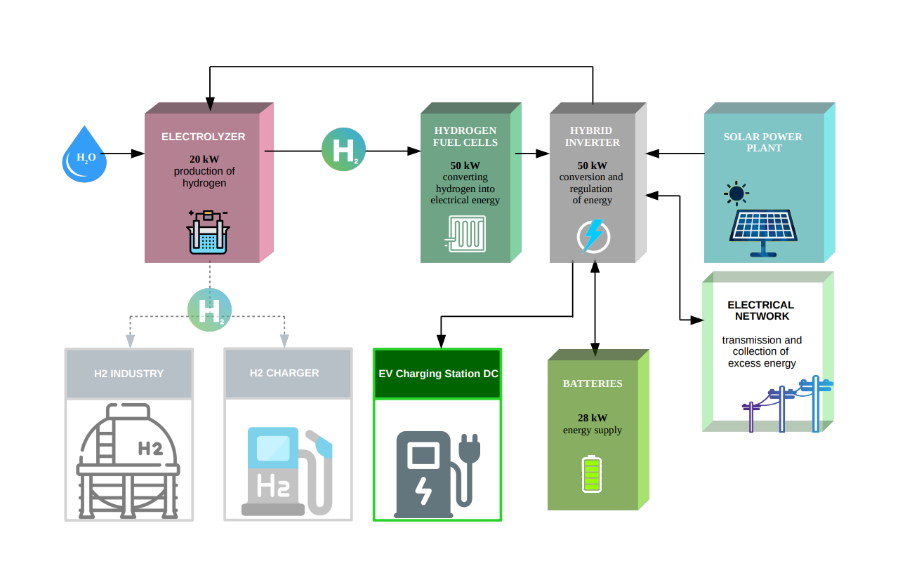

WHAT IS OUR UVP

Slide 4


WHAT IS OUR UVP

Slide 5
WHAT IS OUR UVP
We are already piloting this to TRL9
We have know-how to do it
We are creating local alliance
We will have infrastructure for demonstration
We can easily replicate technology on multiple locations
We can be independent from distribution network
We can provide feasibility study for new locations
We create an opportunity to be energy provider
We can fully customize the system to your resources

Slide 6
OUR LASTING ADVANTAGES
IP is not a problem, nobody has it!
The important is modular assembly.
All technology used is at stage TRL 9.
Energy distributors don't appreciate your energy surplus.
If you create them – they can unplug you or even bill you.
You can join with neighbours and avoid distribution.
You can make green electricity at night.
Our local alliance can offer support in all aspect.

Slide 7
WHAT IS OUR TRL LEVEL AND OUR GO-TO MARKET APPROACH
We are at TRL 6.
We will reach the market in 25 months.
There are a lot of companies that have the same problem.
  We will target all entities with green energy source.
  We will demonstrate our pilot at Velenje site.
  We will prepare real environment data for energy efficiency.
  We will participate in building of ecosystem at NAHV.

Slide 8
NACHIP PILOT IMPLEMENTATION
GOALS
Demonstrate the feasibility and efficiency of hydrogen technologies.
Develop a replicable model for sustainable urban energy management.
Position Velenje as an example in climate-neutral and smart cities initiatives.
Address the key issues of cost and capacity of Carbon Capture Utilization and Storage (CCUS) technologies.

Slide 9
WHAT COMES NEXT?
Within the NACHIP project (implementation phase)
We are looking for partners
  With new ideas on how to use the infrastructure
  For new locations to carry out a feasibility study
After the end of the project NACHIP we will need:
Partners who are interested in expanding the infrastructure.
Infrastructure users.
Project duplication locations.
Local service providers for system maintenance.
New entities for the local alliance.

Slide 10
WHO IS ON YOUR TEAM
ECUBES - is clean energy technology company developing new technologies and solutions.
ROLE: technology design layout
ETRA – manufacturer of special purpuse machines, inteligent production lines, robotic cells and logistic system.
ROLE: tehnology integrator
KSSENA – institute for energy consulting and professional support for the implementation of investment projects for energy efficiency.
ROLE: energy efficiency check
MUNICIPALITY OF VELENJE – one of 12 urban municipalities of Slovenia
ROLE: reference project, supporter, end-user

Slide 11
QUESTIONS?
THANK YOU.
_____________________
Mojca Golež, ETRA d.o.o. mojca.golez@etra.si
+386 41 992 930

