Slide 1
EU, THE GREEN TRANSITION AND HYDROGEN IN GEOPOLITICAL AND SECURITY CONTEXT: THE POTENTIAL OF ME AND AFRICA
NORTH ADRIATIC YDROGEN VALLEY
4th Conference, 13th-14th November 2024
Nova Gorica - Gorizia
MARK KOGOJ, PhD,
International Security and Geopolitical Analysis
ECUBES

Slide 2
EU as a credible geopolitical actor
WHAT IS A GEOPOLITICAL ACTOR? …an actor which exerts political, economic, military or also cultural influence in one or more geographic areas (geographic entities) – a sphere(s) of influence.
CHANGES NEEDED IN AREAS OF:
defence, energy, diplomacy, economy, migration policy, enlargement policy, neighbourhood policy
MOVING FORWARD WITH THE INTEGRATION PROCESS
CONTINUATION OF POLITICAL, FINANCIAL, ECONOMIC, MILITARY, HUMANITARIAN AND LEGAL SUPPORT OF UKRAINE
in order to prevent the defeat of Ukraine
use all the available mechanisms in order to support a peace process and achieve de-escalation of the conflict in Ukraine

Slide 3
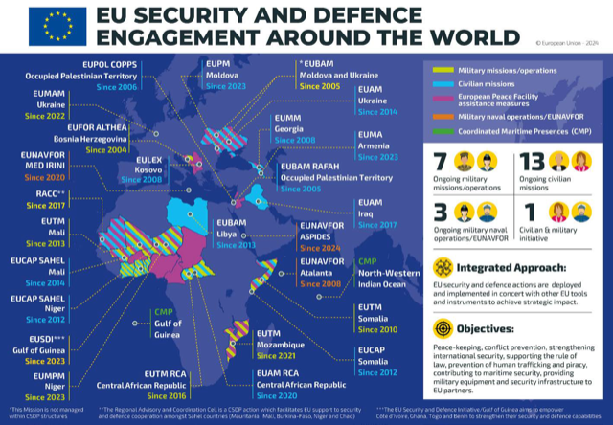
Defence sector
enhancing interoperability of armed forces of the EU member states (MS)
continuation with the build up of an integrated, innovative, competitive and resilient European defence technological and industrial base
building military capabilities (EU MS and EU battlegroups)
CSDP: strengthen and expand EU civilian and military missions in crisis areas (Ukraine, Middle-East and Africa)

Slide 4
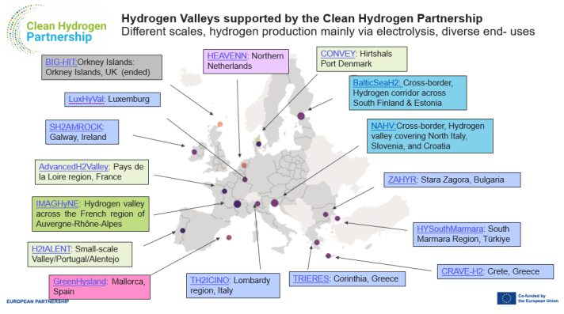
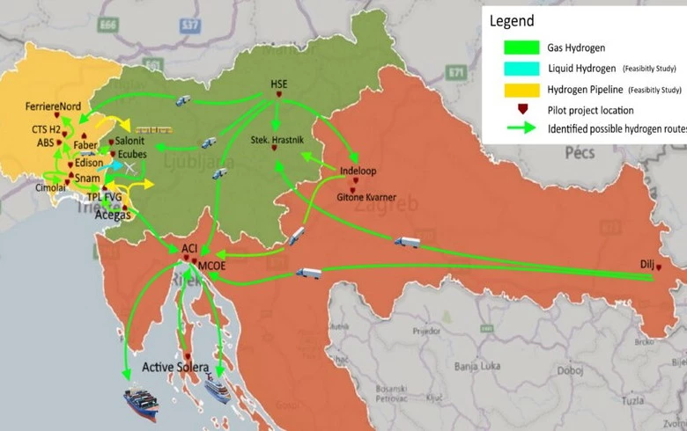
Energy sector
INCREASING THE EU'S ENERGY INDEPENDENCE
reducing energy dependence on fossil fuels
reducing dependence on external actors – imports of fossil fuels from Russia, USA and Canada
ACCELERATION OF THE GREEN TRANSITION
implementation of hydrogen infrastructure

Slide 5
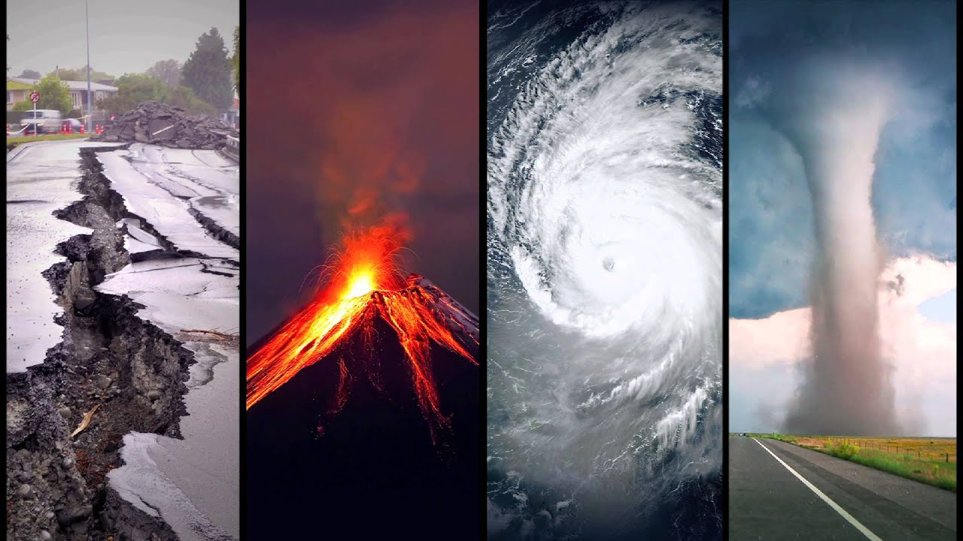
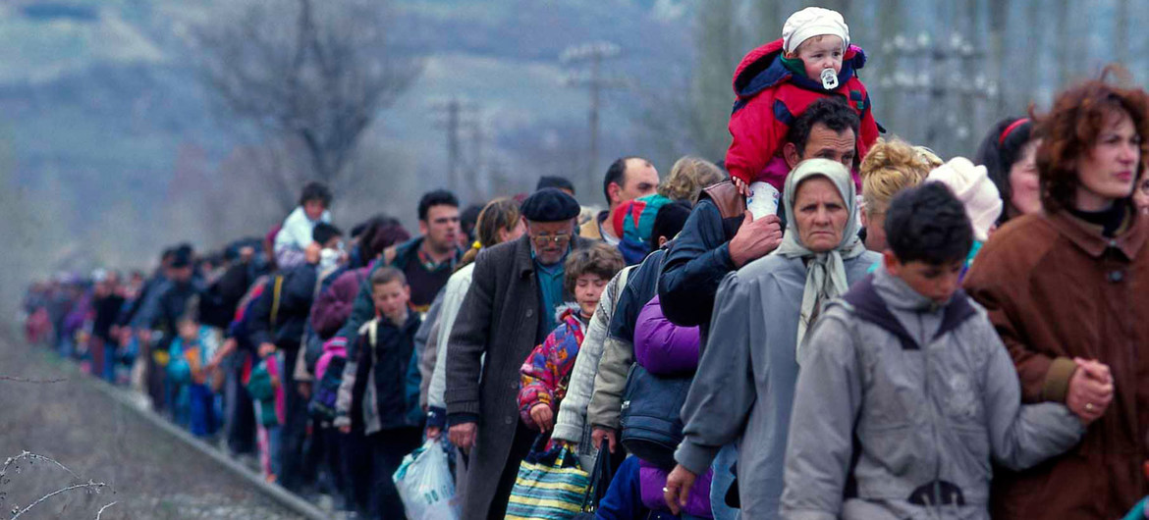
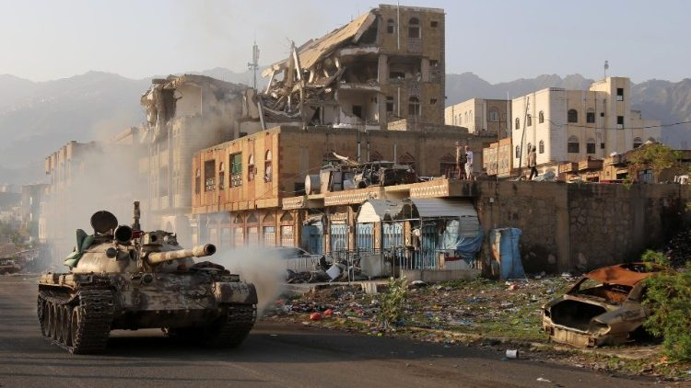
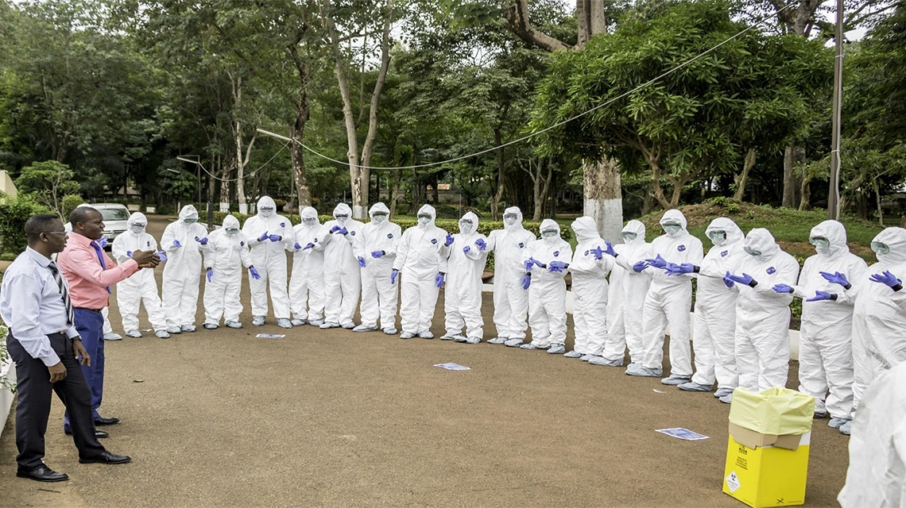
FORCED CLIMATE MIGRATIONS
NATURAL DISASTERS
SECURITY IMPLICATIONS OF CC:
FOUR TYPES OF INTERRELATED SECURITY THREATS
CONTAGIOUS, EPIDEMIC DISEASES
ARMED CONFLICTS

Slide 6
Security implications of Climate Change
CC MULTIPLY / ACCELERATE ALREADY EXISTING SECURITY THREATS or…
CREATE NEW SECURITY THREATS
most severely affect economically undeveloped societies and unstable states → most affected: Central and Latin America, Sub-Saharan Africa, South-east Africa, South Asia
security crises are in the majority of cases results (consequences) of multiple interrelated factors
economic factor → poor economic conditions are often the main direct trigger of security crises
economic factor is closely related to poverty, famine and food insecurity

Slide 7
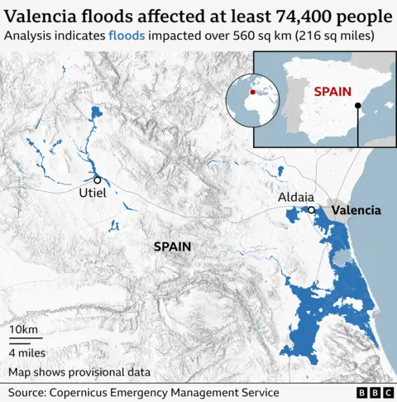
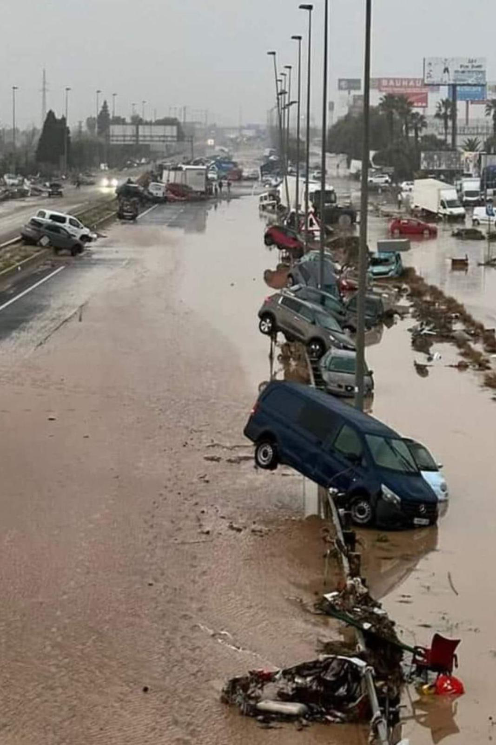
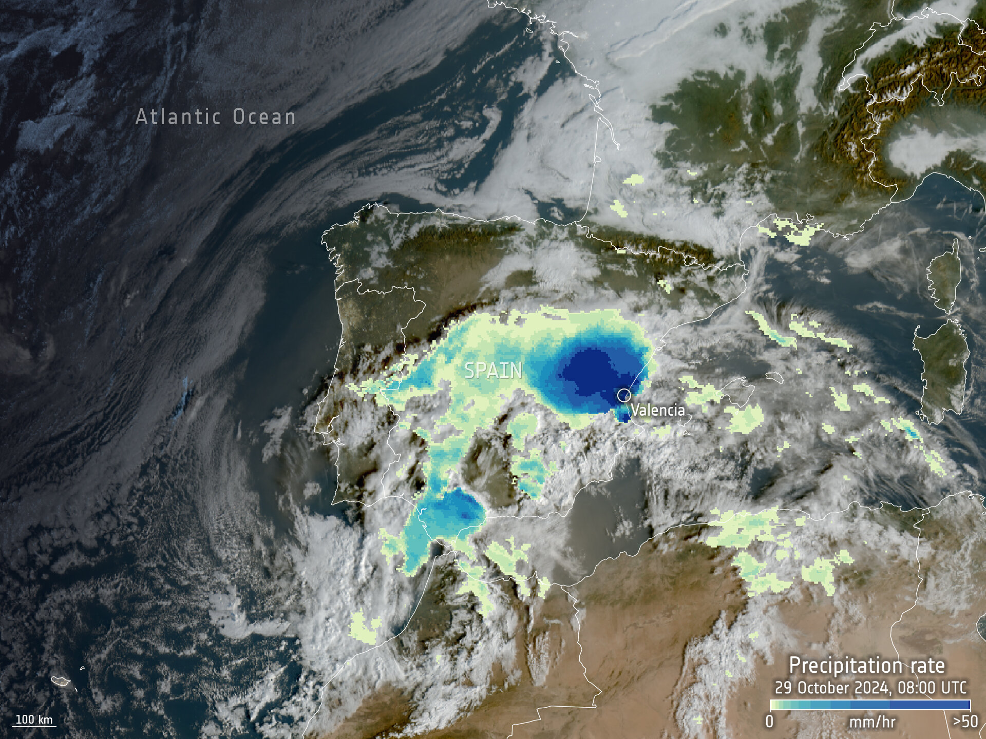
NATURAL DISASTERS

Slide 8
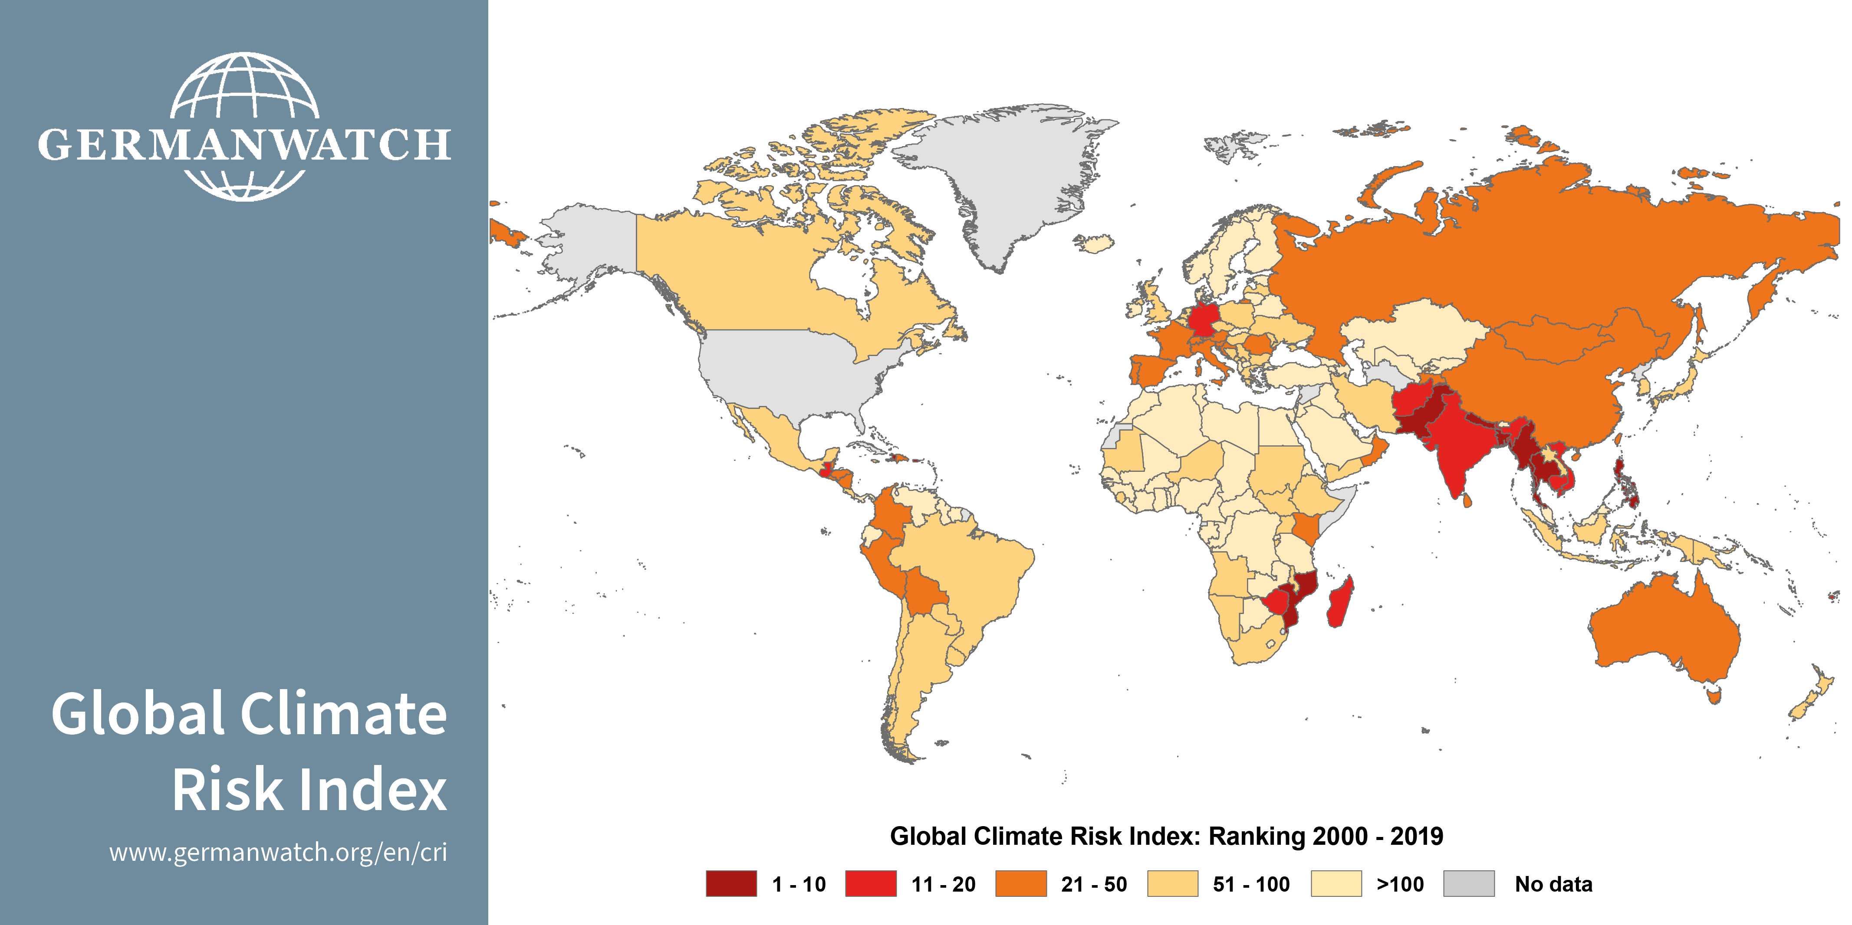
Weather Extremes and Natural Disasters

Slide 9
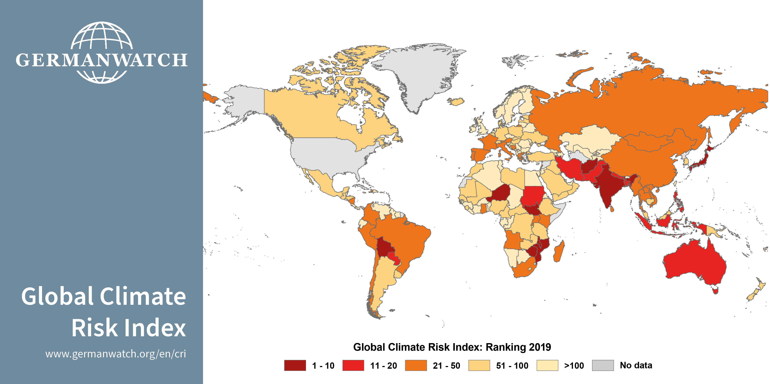
Weather Extremes and Natural Disasters

Slide 10
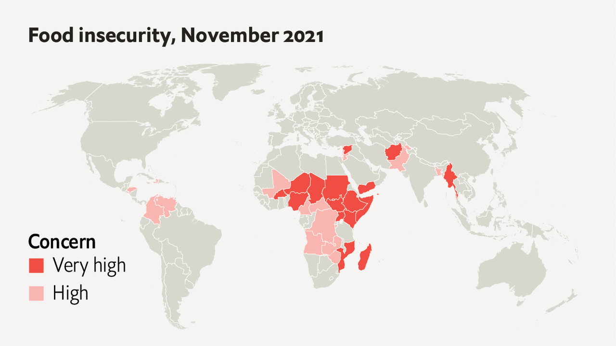

Slide 11
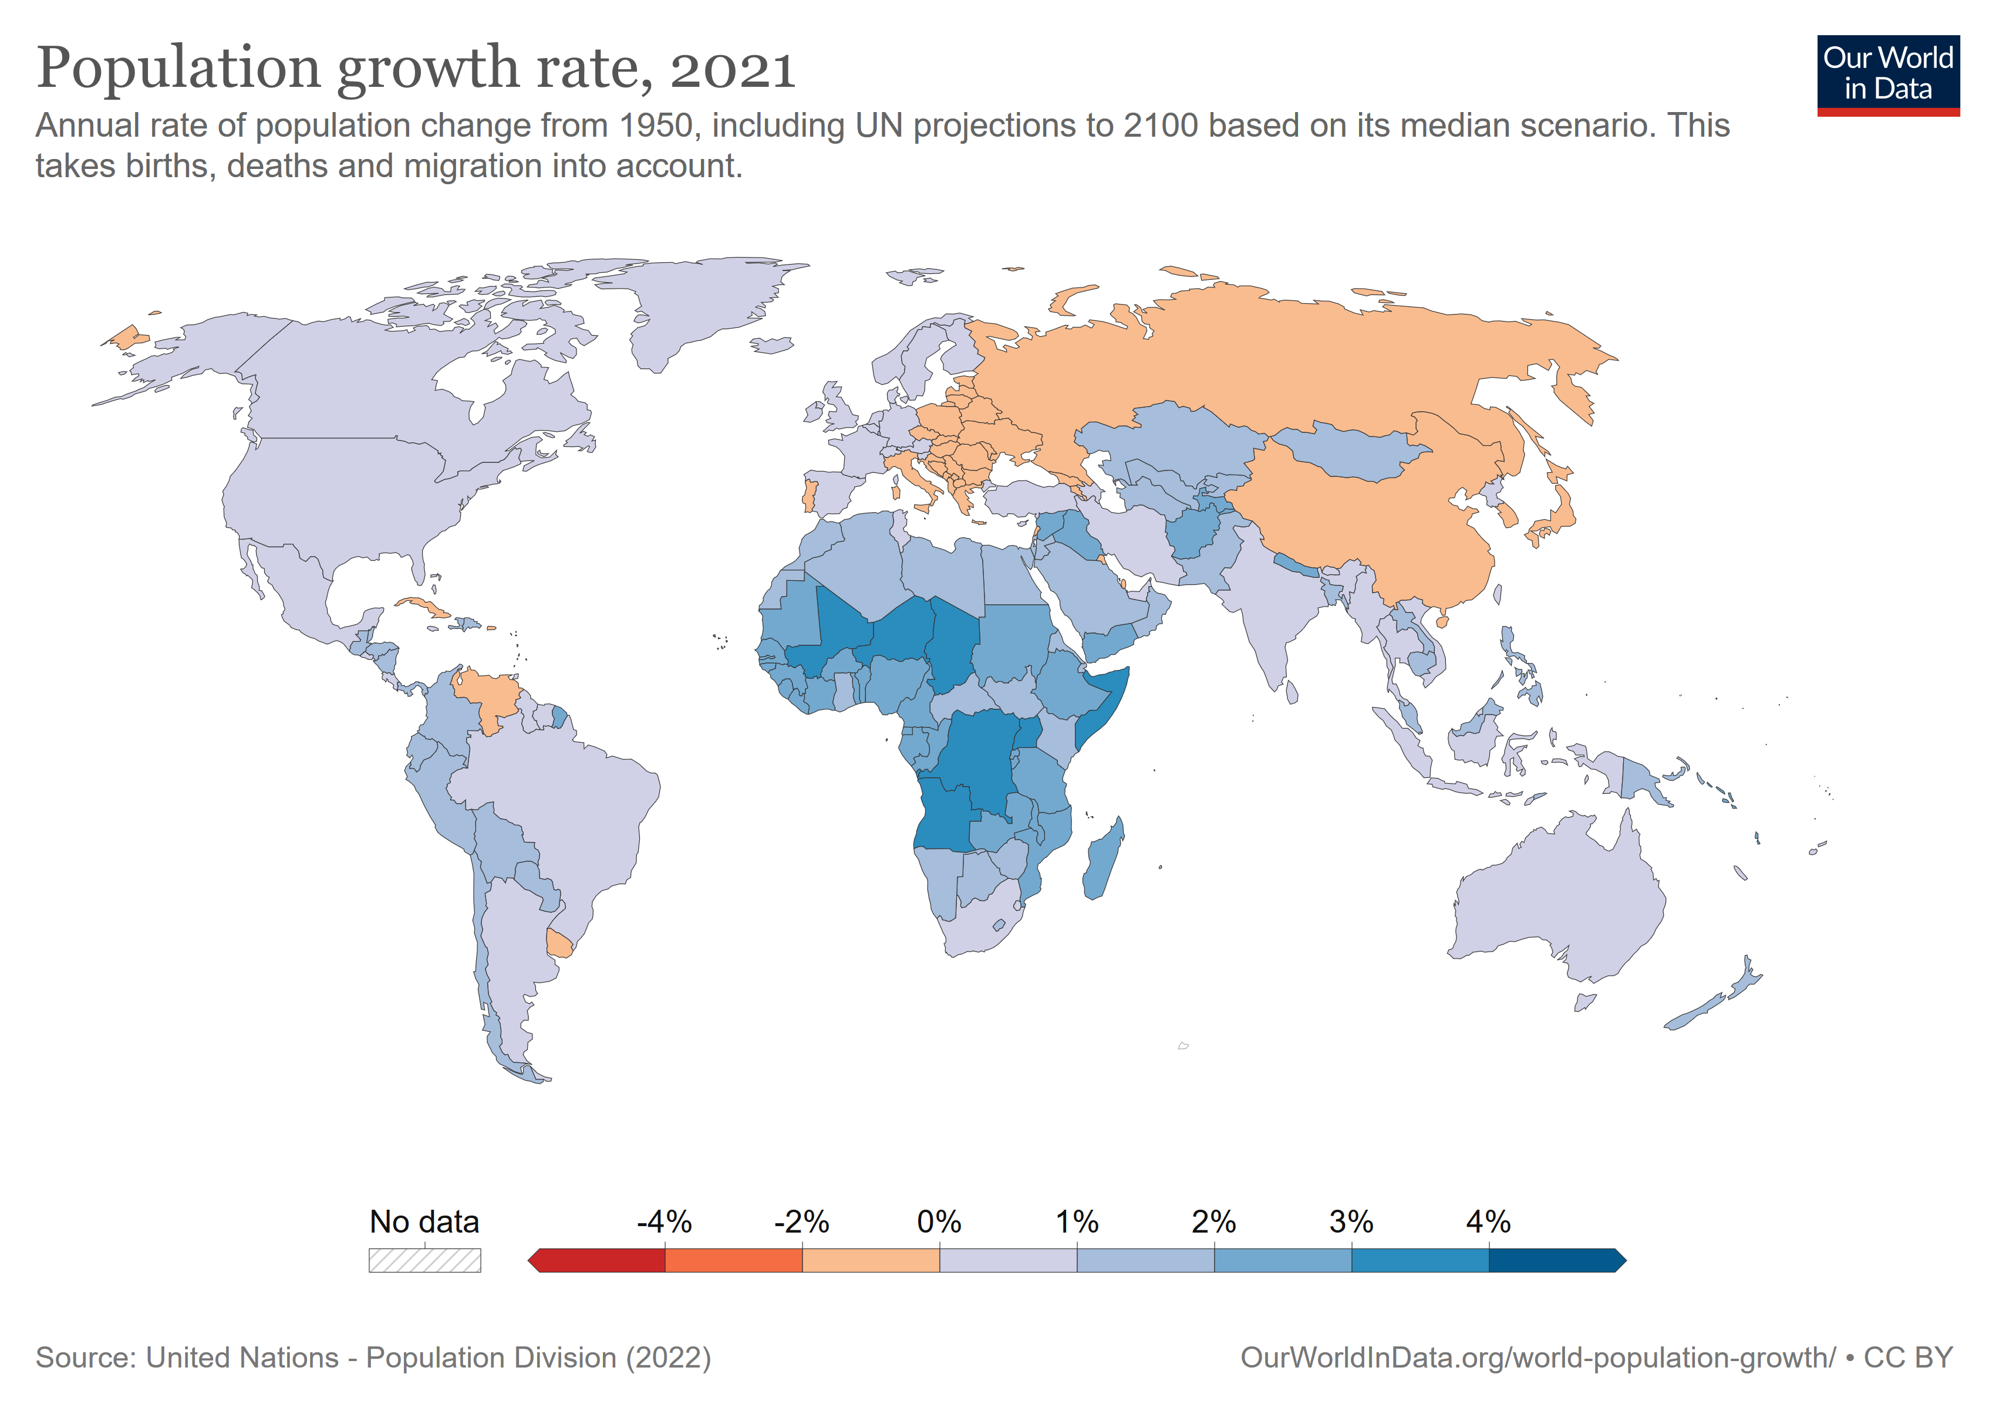

Slide 12
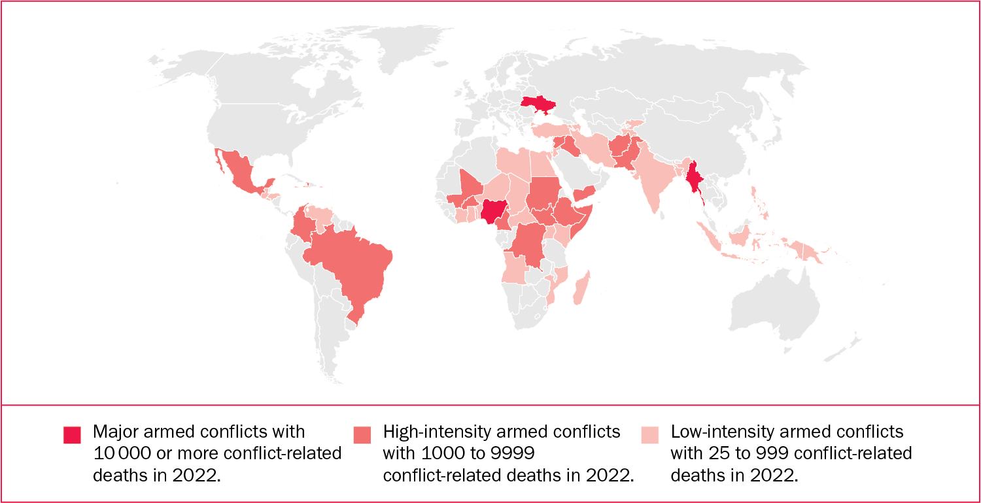
Armed conflicts in 2022 by intensity

Slide 13
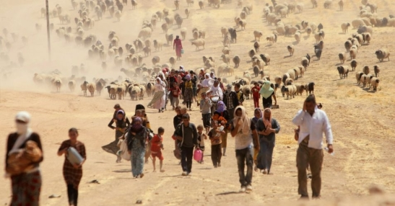
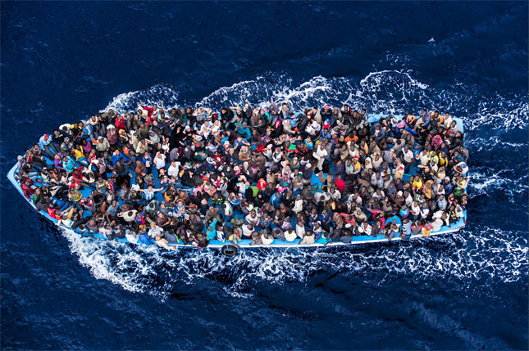
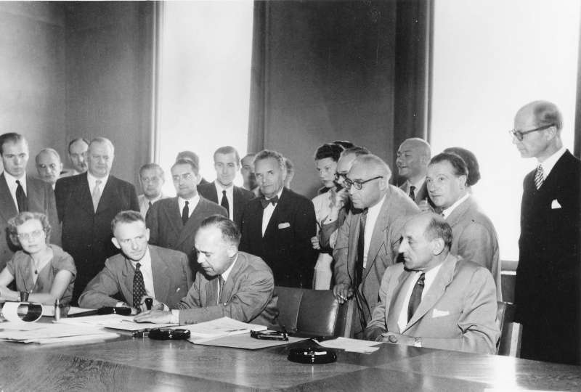
Forced climate migrations - World
as a consequence of natural disasters: 265 mil. internally displaced people around the world (2008 - 2018), more than 17 mil. just in 2018
world bank – in 2050: more than 143 mil. climate migrants from just 3 regions – Subsaharan Africa, South Asia and Latin America - as a result of CC
GENEVA REFUGEE CONVENTION 1951 + PROTOCOL 1967 → protection to displaced people → whome persecution is based upon: rase, religion, nationality, membership of a particular social group or political opinion → a refugee should not be returned to a country where they face serious threats to their life or freedom
WHAT IS PROBLEMATIC? climate migrants do not enjoy any kind of international legal protection → illegal migrations
SIGNING OF GENEVA CONVENTION RELATING TO THE STATUS OF REFUGEES, 1951

Slide 14
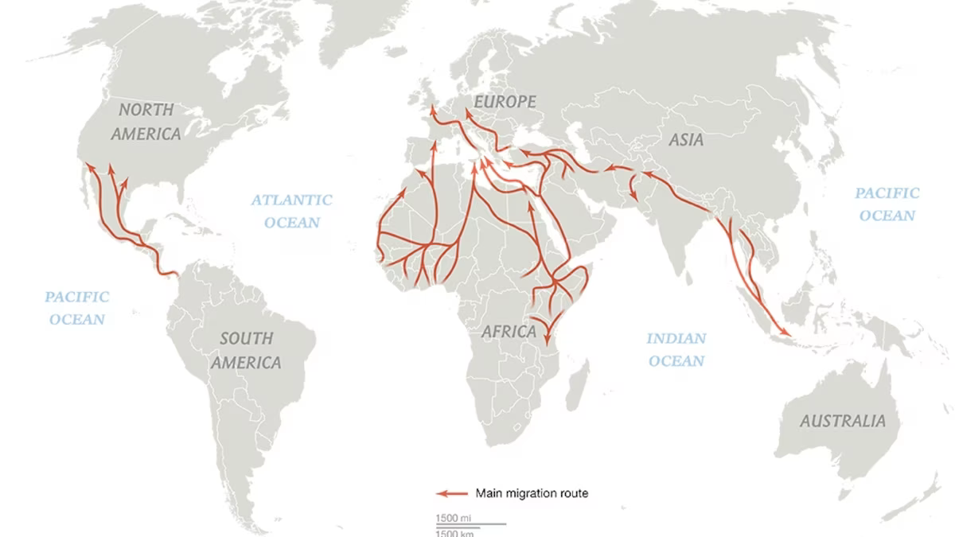
Main migration routes

Slide 15
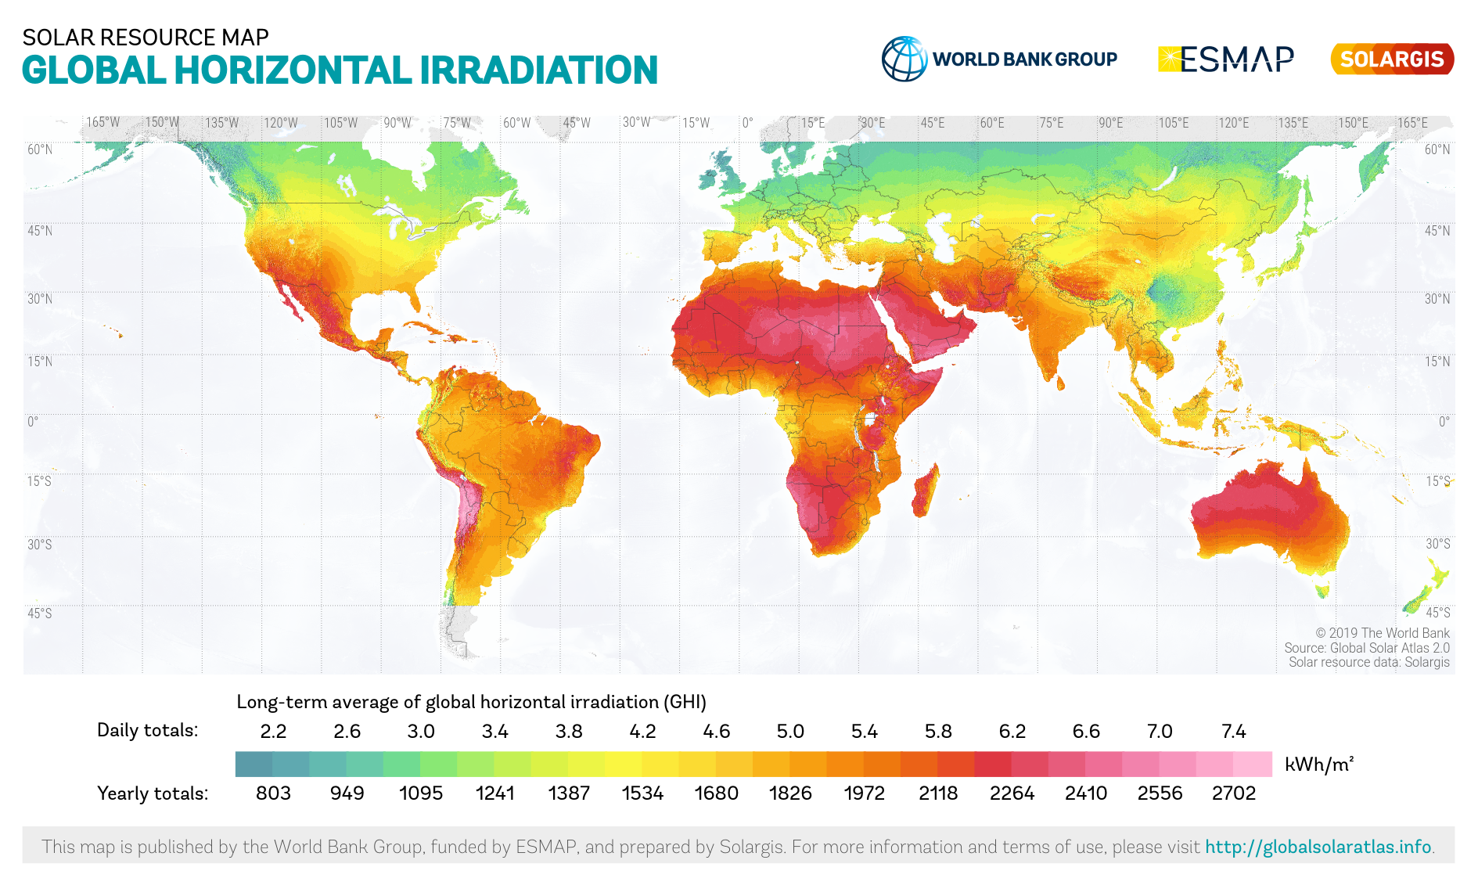

Slide 16
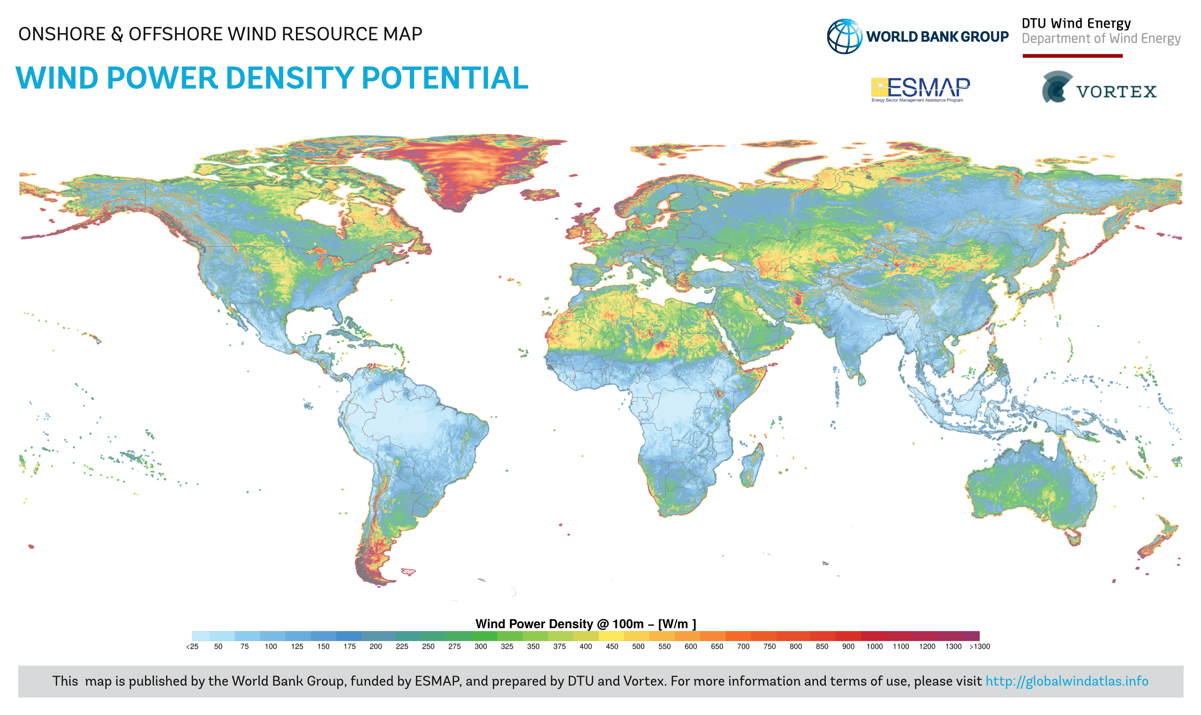

Slide 17
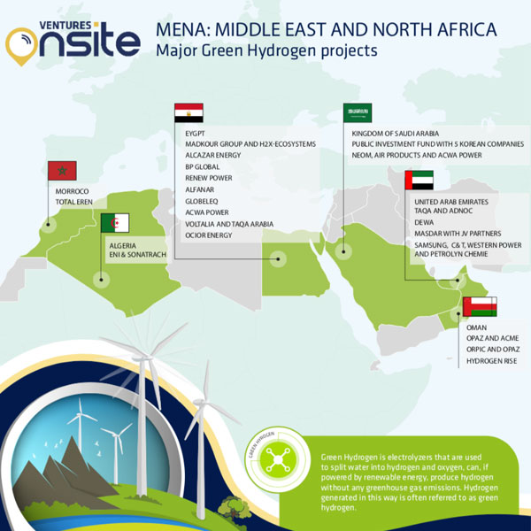
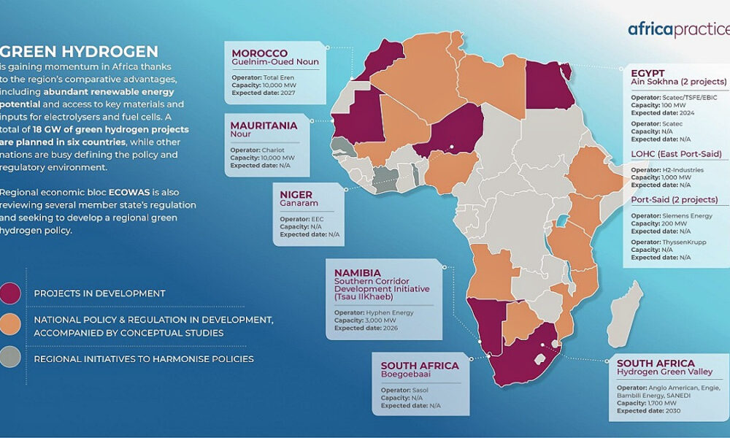
Green hydrogen production in the Middle East and Africa
contributing to the mitigation of the negative impacts of CC (weather extremes and natural disasters) through the reduction of greenhouse gas emissions
an opportunity to address concrete (specific) security threats caused or accelerated by CC → armed conflicts and migrations (most prominent)
an opportunity for the economic development of countries (including new jobs)
TASKS:
set up infrastructure for green hydrogen production
transport infrastructure
other types of support infrastructure

Slide 18
Other types of EU mechanisms
CSDP: EU civilian and military missions
strengthening national security capabilities of Middle Eastern and African countries (in line with specific political and security circumstances of each country)
strengthening social and educational institutions
support democratic processes, promote the respect for human rights and the rule of law

Slide 19
Green hydrogen production in the Middle East and Africa
the green transition will need to include all the recently mentioned elements
mutual benefits for the EU and the Middle Eastern and African countries
exploitation of the potential of renewable resources in the MENA region and Sub-Saharan Africa through the implementation of hydrogen infrastructure → crucial for the EU as well as for the global green transition
MAIN OBJECTIVE: build strategic partnerships with countries in the region
the Middle East and Africa as a sphere of influence of the EU

Slide 20
Questions & answers
For more info on International Security, Geopolitics, Armed Conflicts, Security Implications of CC, Role of Hydrogen in the Defence Sector and other related topics:
mark.kogoj@ecubes.eu
Thank you

