Slide 1
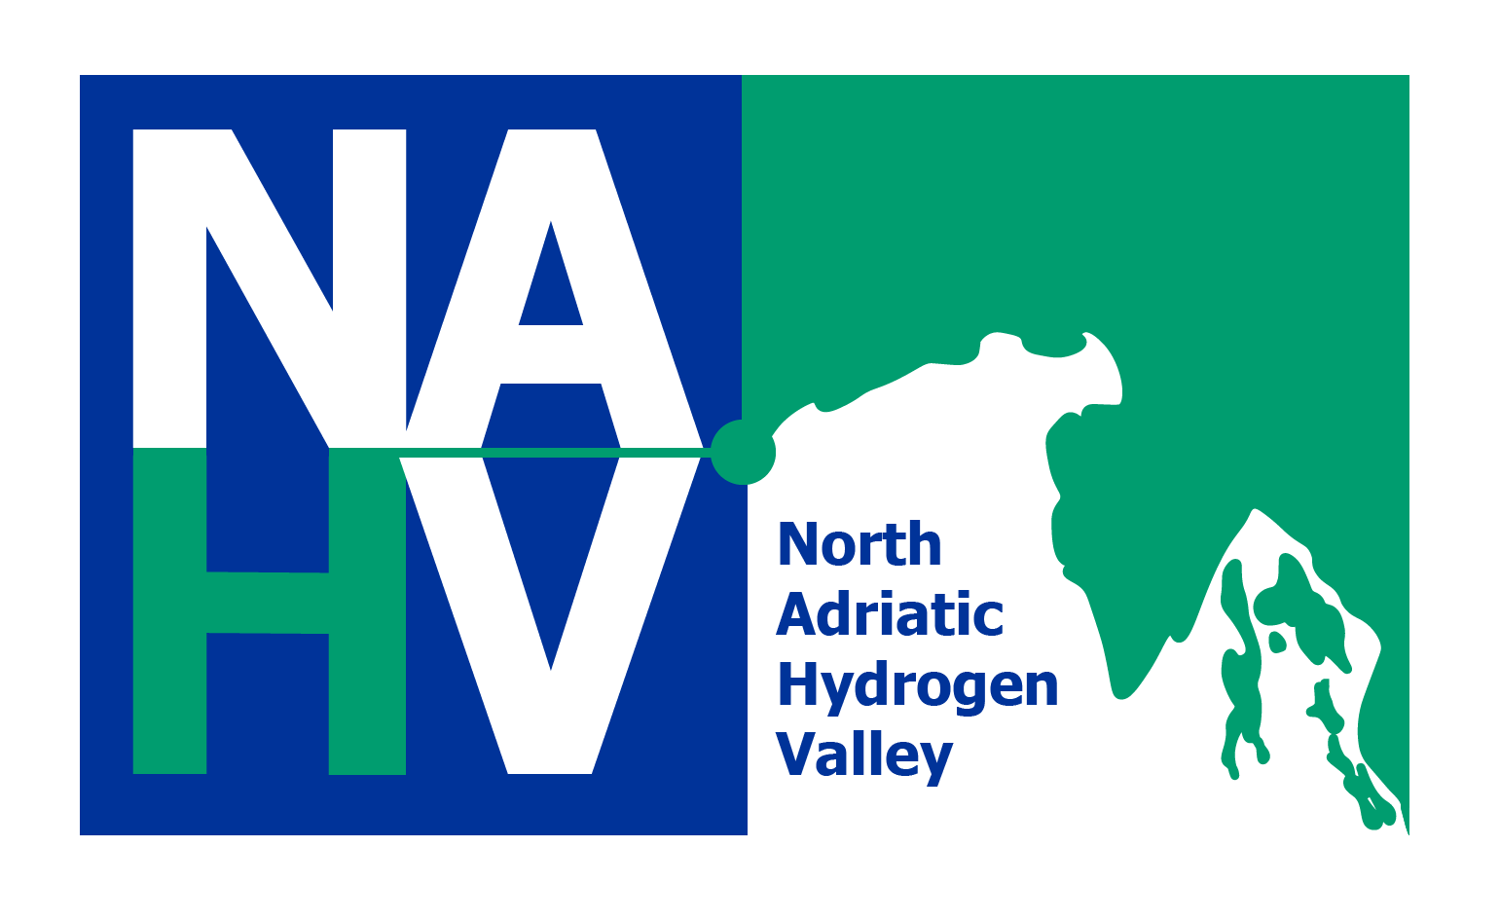
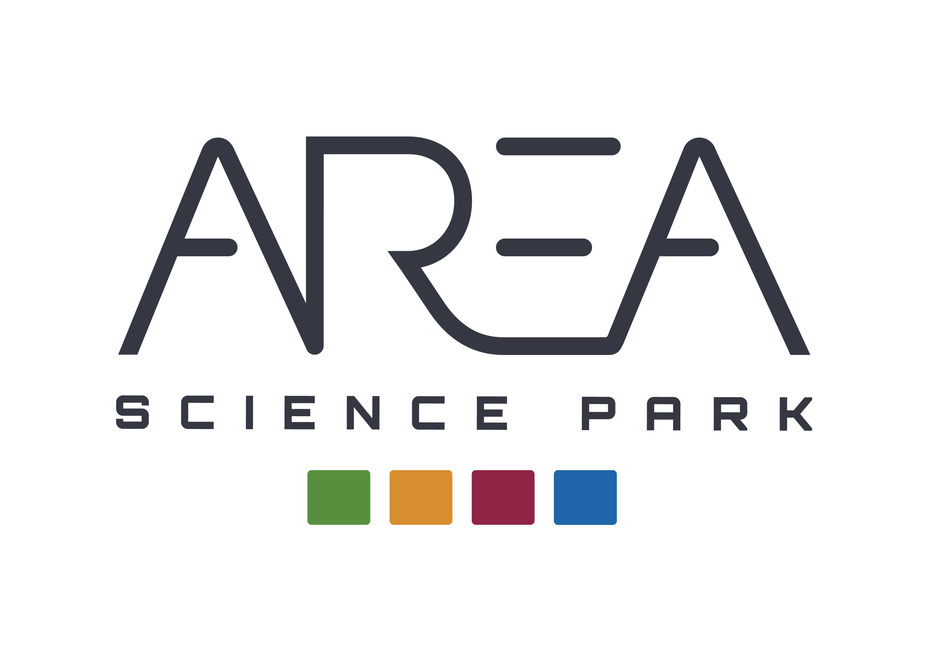
Overview of the hydrogen regulatory framework in the EU and the North Adriatic eco-system: critical issues and opportunity
Massimiliano Rudella
Hydrogen Ecosystem North Adriatic Conference

Slide 2

the question is: what is the situation of the hydrogen regulatory framework in the EU? and therefore in its Member States? the answer is quite simple: there is no European Union hydrogen regulatory framework, there is not yet an EU hydrogen market.
Let's take a simple example: if I start producing green hydrogen. who gives me the certification that it is green hydrogen? and how?
(there are several indicators that can be taken into consideration to certify "green hydrogen“) a more complex question is: if in the NAHV we have to produce at least 5000 tons of "green hydrogen" per year…
What do we do regarding the legislative framework?
In the absence of a European legislative framework, what is the situation in the 3 partner countries (Italy, Slovenia, Croatia)?
To carry out the activities, do we have to wait for the creation of the European Legislative Framework or can we start by experimenting innovative solutions such as the Regulatory Sandbox tool?

Slide 3
How do we address these sensitive issues in NAHV?
Activities & tools

Slide 4
Activities
Task 8.1 Policies analysis (Task Leader MINGOR ) TIMING: 02/2024 – M72
8.1.1 Creation of an inter-ministerial broader working group (IMWG)
8.1.2 Institution of Technical Team
8.1.3 Inclusion of NAHV in international networks
8.1.4 Comparison between Italian -Slovenian - Croatian regulations, identification of EU best practices & benchmark
WG with the involvement of the project’s stakeholders map the existing policy and regulatory framework related to H2 value chain in the NAHV countries (Italy-SLO-CRO) + policy review and a benchmarking of regulations in the other EU countries.
T8.2 Regulation revision (including sandbox): TL: FVG, PP: MINGOR, MZI, AREA
Regulatory barriers in current legal framework is not adequate. Rapid adaptation of the regulatory framework in Slovenia, Croatia and Italy is not possible in a short time. The constitution of the NAHV requires supportive framework conditions and policy harmonization.
T8.3 Policies guidelines: TL: MZI, PP: MINGOR, FVG, AREA
a) development of policy guidelines b) raise awareness and commitment among policy makers c) orient decisions towards the formulation of policies that stimulate and favor innovation and adoption of H2. d) Guidelines + suitable legal framework regarding the production, use and commercialization of H2 creation of new markets and business opportunities.
T8.4 Incentives: TL: FVG, PP: MZI, MINGOR, AREA
study a complete package of incentives to develop a sustainable renewable H2 supply chain. The WG it will have to connect with the institutional tables at ministerial level that are managing and developing the system of incentives for H2. The incentives schemes will be designed and proposed to the NAHV’s policy makers.

Slide 5
What is the situation in the 3 partner countries?

Slide 8
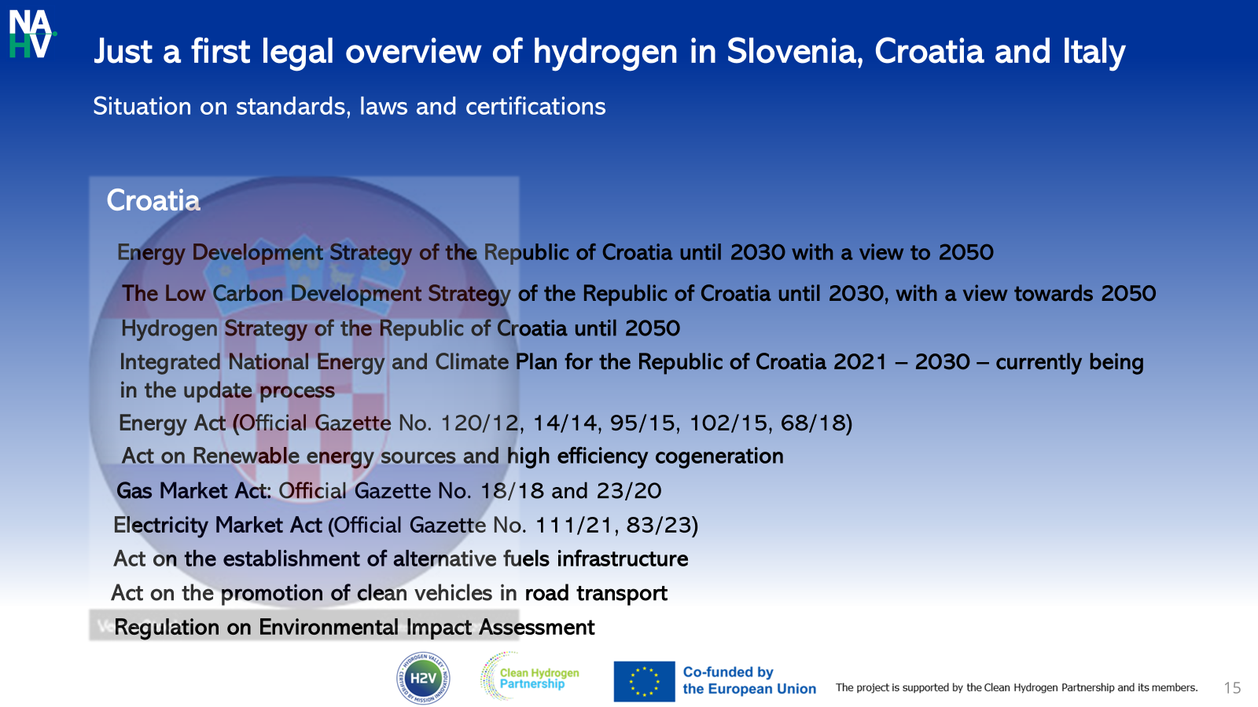
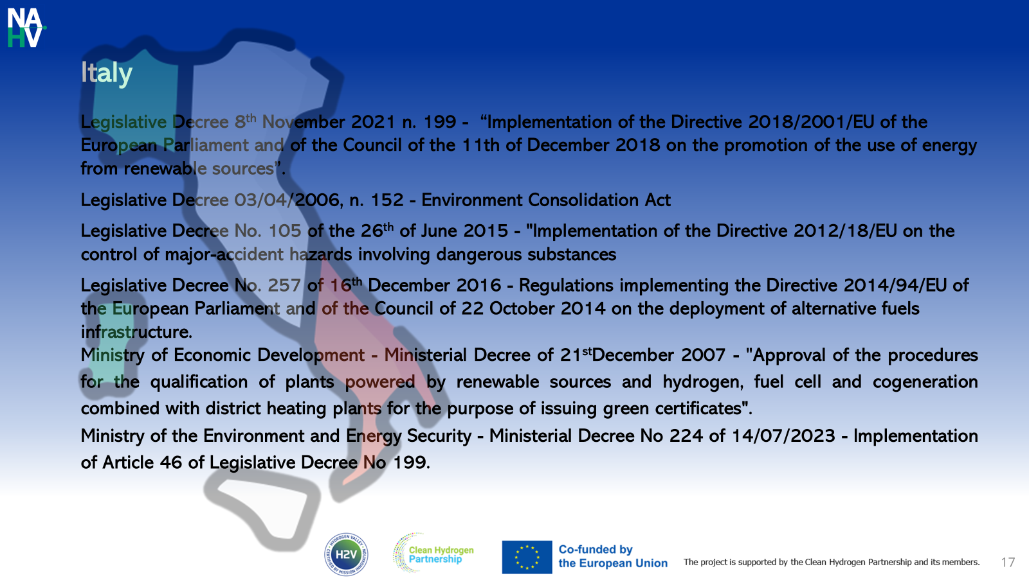
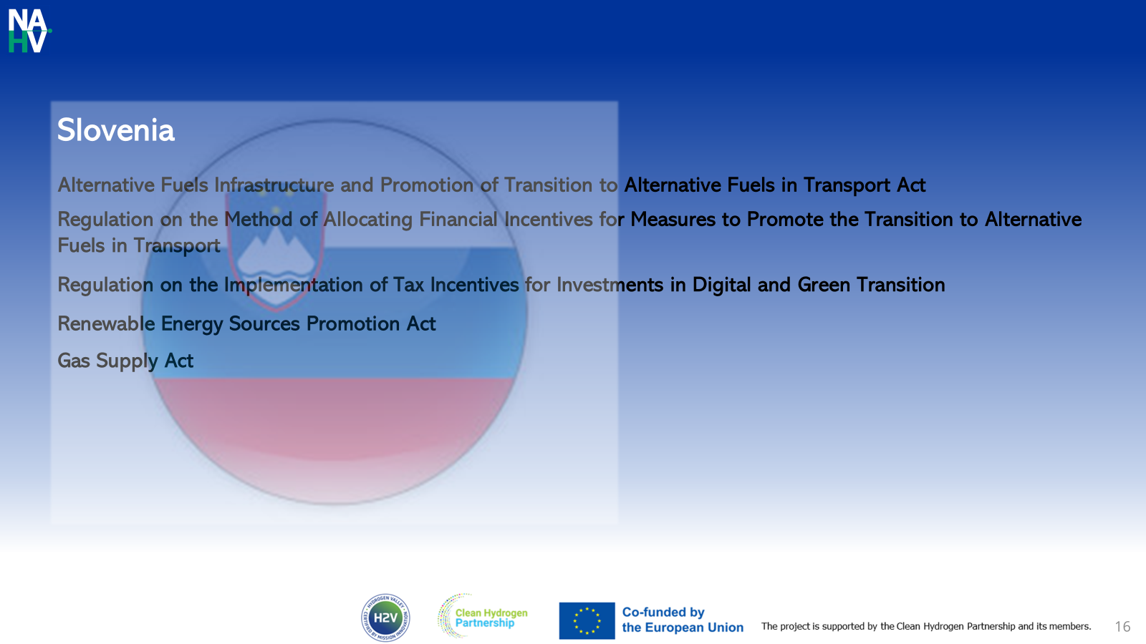
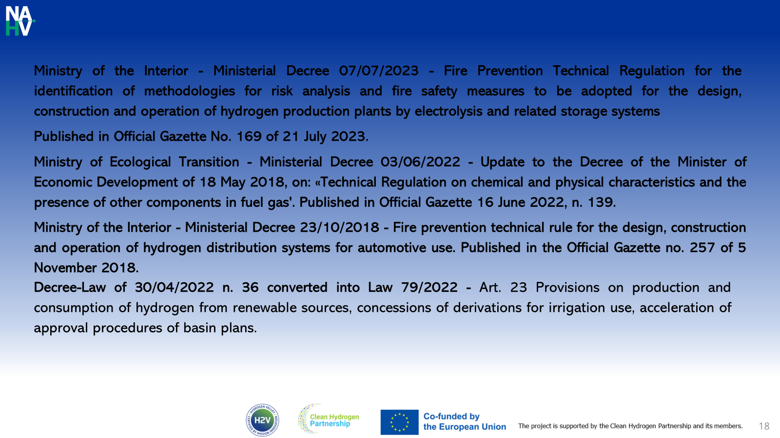
...In summary. this is the main "legislative framework"...
first consideration: only Croatia has a "National Hydrogen Strategy", Italy will publish it within this year. (But, in any case, a European legislative framework of reference will always be missing)

Slide 9
in-depth analysis and analysis of the legislation of the 3 countries and identification of potential sandboxes
First report "HYDROGEN SUPPLY CHAIN. ANALYSIS OF THE LEGISLATIVE FRAMEWORK AND REGULATORY SANDBOX PROPOSALS for Italy.

Slide 11

Why is there a need for a new legislative instrument?
standardize (Italy, Slovenia and Croatia) and create (Slovenia and Croatia) rules, certification and laws for the production, storage and distribution of liquid hydrogen (20% of production must be transnational)
test low TRL prototypes and innovative technologies to bring them to the market (Italy), not only in the hydrogen sector...
…there is a technical and legal solution: the Regulatory Sandbox
some hypotheses....
lack of sector legislation: 1 sandbox in Slovenia and 1 in Croatia lasting 3 years, to produce guidelines to be proposed to policy makers covering the hydrogen production, distribution and storage sectors
1 sandbox in Italy (Friuli Venezia Giulia Region) to test low TRL technologies in the green hydrogen production, distribution and storage sector (also through the creation of a Demonstrator)
1 sandbox to define a set of indicators (for future certification) on a green hydrogen production plant...
…but at the moment…
the analysis already started must be deepened
the benchmark between the 3 legislations must be developed
the experimental sector must be found by involving the private sector
…and we need the involvement of the national and European Union policy makers...

Slide 12

but if you are a partner of NAHV you must remember…
"Always look on the bright side of life"

Slide 13



TOOLS
Regulatory sandbox: what exactly is it?
RS provide a controlled environment to live test new products, technology, or business models under the watchful eye of a financial institutional regulator.
In the legal dimension, the sandbox is a space, virtual or physical, within which it is possible to test innovative projects from a technological point of view for a limited period of time, with the possibility of derogating from sector regulations in order to allow promoters to carry out the tests in the most exhaustive, complete and efficient way possible.
the results of the various tests and experiments can be used as a basis for a subsequent and possible regulatory change.
The procedure behind the institute is quite simple: a proponent proposes an innovative project to the public body that supervises the experimentation, to evaluate whether the project can be admitted on the basis of predetermined requirements or whether the application should be rejected.
The architecture of the institute is based on the fact that one or more public bodies (depending on the scope of the project) allow a private actor to test their innovative idea even temporarily suspending the relevant legislation in order to allow the best possible development of experimentation.
The administration takes charge of any proposal for a regulatory change in order to contribute to the development of the sector and ensure that it can be stable, grow and bring benefits for the whole of society.
The Sandbox is intended not only to facilitate the development of new technologies, but also as a functional tool for collaboration between administration and private sector.

Slide 14
TOOL
The NAHV HANDBOOK FOR REGULATORY SANDBOXES
Tool for the creaton of regulatory sandboxes
we set up a methodology to develop Sandboxes based on existing success stories and contextualize them in the NAHV

Slide 15
Design NAHV Regulatory Sandbox - methodology

Slide 18
Who did we take inspiration from? (Success Stories)
Northern Germany Regulatory Sandbox
Hamburg, Schleswig-Holstein and Mecklenburg-Western Pomerania
The Northern Germany Regulatory Sandbox is one of the sandboxes for the energy transition funded by the Federal Ministry for Economic Affairs and Energy.
Instrument within the framework of the Federal Government’s Seventh Energy Research Programme.
The funding provided by the Federal Ministry for Economic Affairs and Energy is used to support companies and research institutions that are developing tangible solutions for the energy transition.
The project partners participating in the Northern Germany Regulatory Sandbox will seek solutions for a holistic development of the local energy system. With a focus on four geographical centres across Hamburg, Schleswig-Holstein and Mecklenburg-Western Pomerania. Includes participants from the private sector, government and science center covering the entire energy value chain – including generation, transport, storage and consumption.
Over a period of five years, the Federal Ministry for Economic Affairs and Energy will provide more than €52 million for the Sandbox
Northern Germany Regulatory Sandbox explore the prospects of converting the gas distribution system to hydrogen. Also using waste heat from a waste incineration plant and an industrial plant in oder to feed it into an existing district heating pipeline
Focusing on hydrogen technologies
How can large quantities of hydrogen be produced using green electricity and stored - at an affordable price?
What conditions are required for gas to be marketed commercially as a fuel for cars with fuel cell engines?
What is the best way to network factories and private households and supply them with power and heat?
How can transport be as low-polluting as possible in city centres?
Possible solutions are being jointly worked on and tested out in the regulatory sandboxes by, for example, municipalities, industrial companies, teams of scientists and IT specialists. The Federal Government’s "regulatory sandboxes for the energy transition" focus on energy-optimised urban neighbourhoods, large-scale electricity storage, and especially on hydrogen technologies.

Slide 19
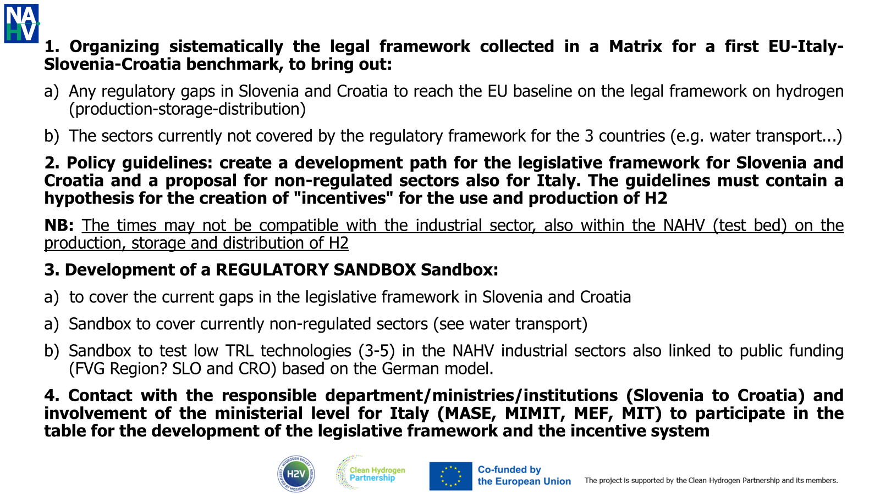
Next steps

Slide 20

Massimiliano Rudella
massimiliano.rudella@areasciencepark.it
AREA SCIENCE PARK
PADRICIANO 99, TRIESTE-ITALIA
WWW.AREASCIENCEPARK.IT

