Slide 1

Angel Investing
Luigi Amati
Honorary chairman
INNOVATION, TECHNOLOGY AND PARTNERSHIP IN ACTION
4th Conference
13th - 14th November 2024
Nova Gorica - Gorizia

Slide 2
What is a business angel
Individuals who invest directly their own money
Mostly late career entrepreneurs and professionals, but more and more young exited entrepreneurs, the “Next Gen” of Angels
From Super Angels (visible) to Syndicates (invisible)
First private money in startups in the very early phase when there is no traction
Contribute with their expertise, experience and network
Therefore: Wise/Smart money

Slide 3


Business Angels
3 types in the iceberg
Business Angels -
little visibility in the market
Individual “Super Angels”
  Invest individually;
  Can invest high tickets themselves;
  Profile themselves conspicuously (online);
  Feature prominently within data reports.
Syndicates
  Pooling resources to reduce risk;
  Happens on a “case-by-case” basis;
  Growing trend in the UK and Germany.
3. Business Angels Networks
  Membership based organizations with a 2-5 FTE;
  Consistent high quality deal flow for investors;
  Consistent high quality investors for startups.

Slide 4
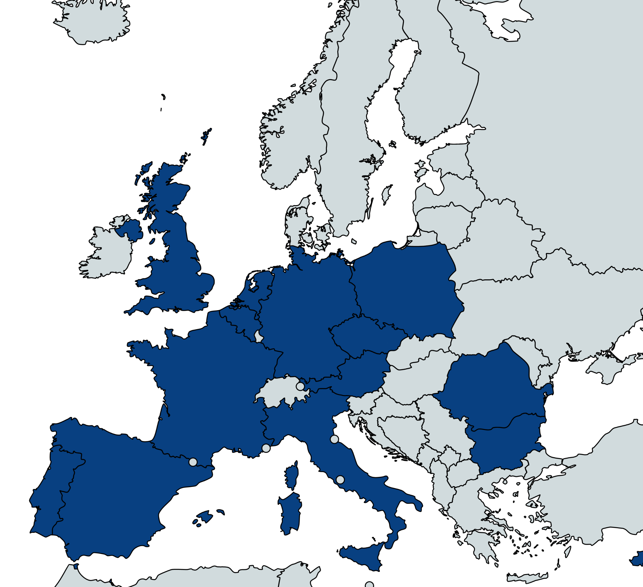
Our Association
11 Full Members
National Business Angel Associations
Legitimate Voices or mature Markets
Full voting rights for the Association
45000+ business angels
250+ business angel networks
€5-10 billion invested per year
19 “BAE Club” Members
Leading Angel Networks in Europe
Minimum of €1.5m invested per year
No voting rights
3000+ business angels
360+ startups funded in 2023
€160 million invested in 2023
8 Affiliate/Associate Members
Key Ecosystem Players
No voting rights

Slide 5
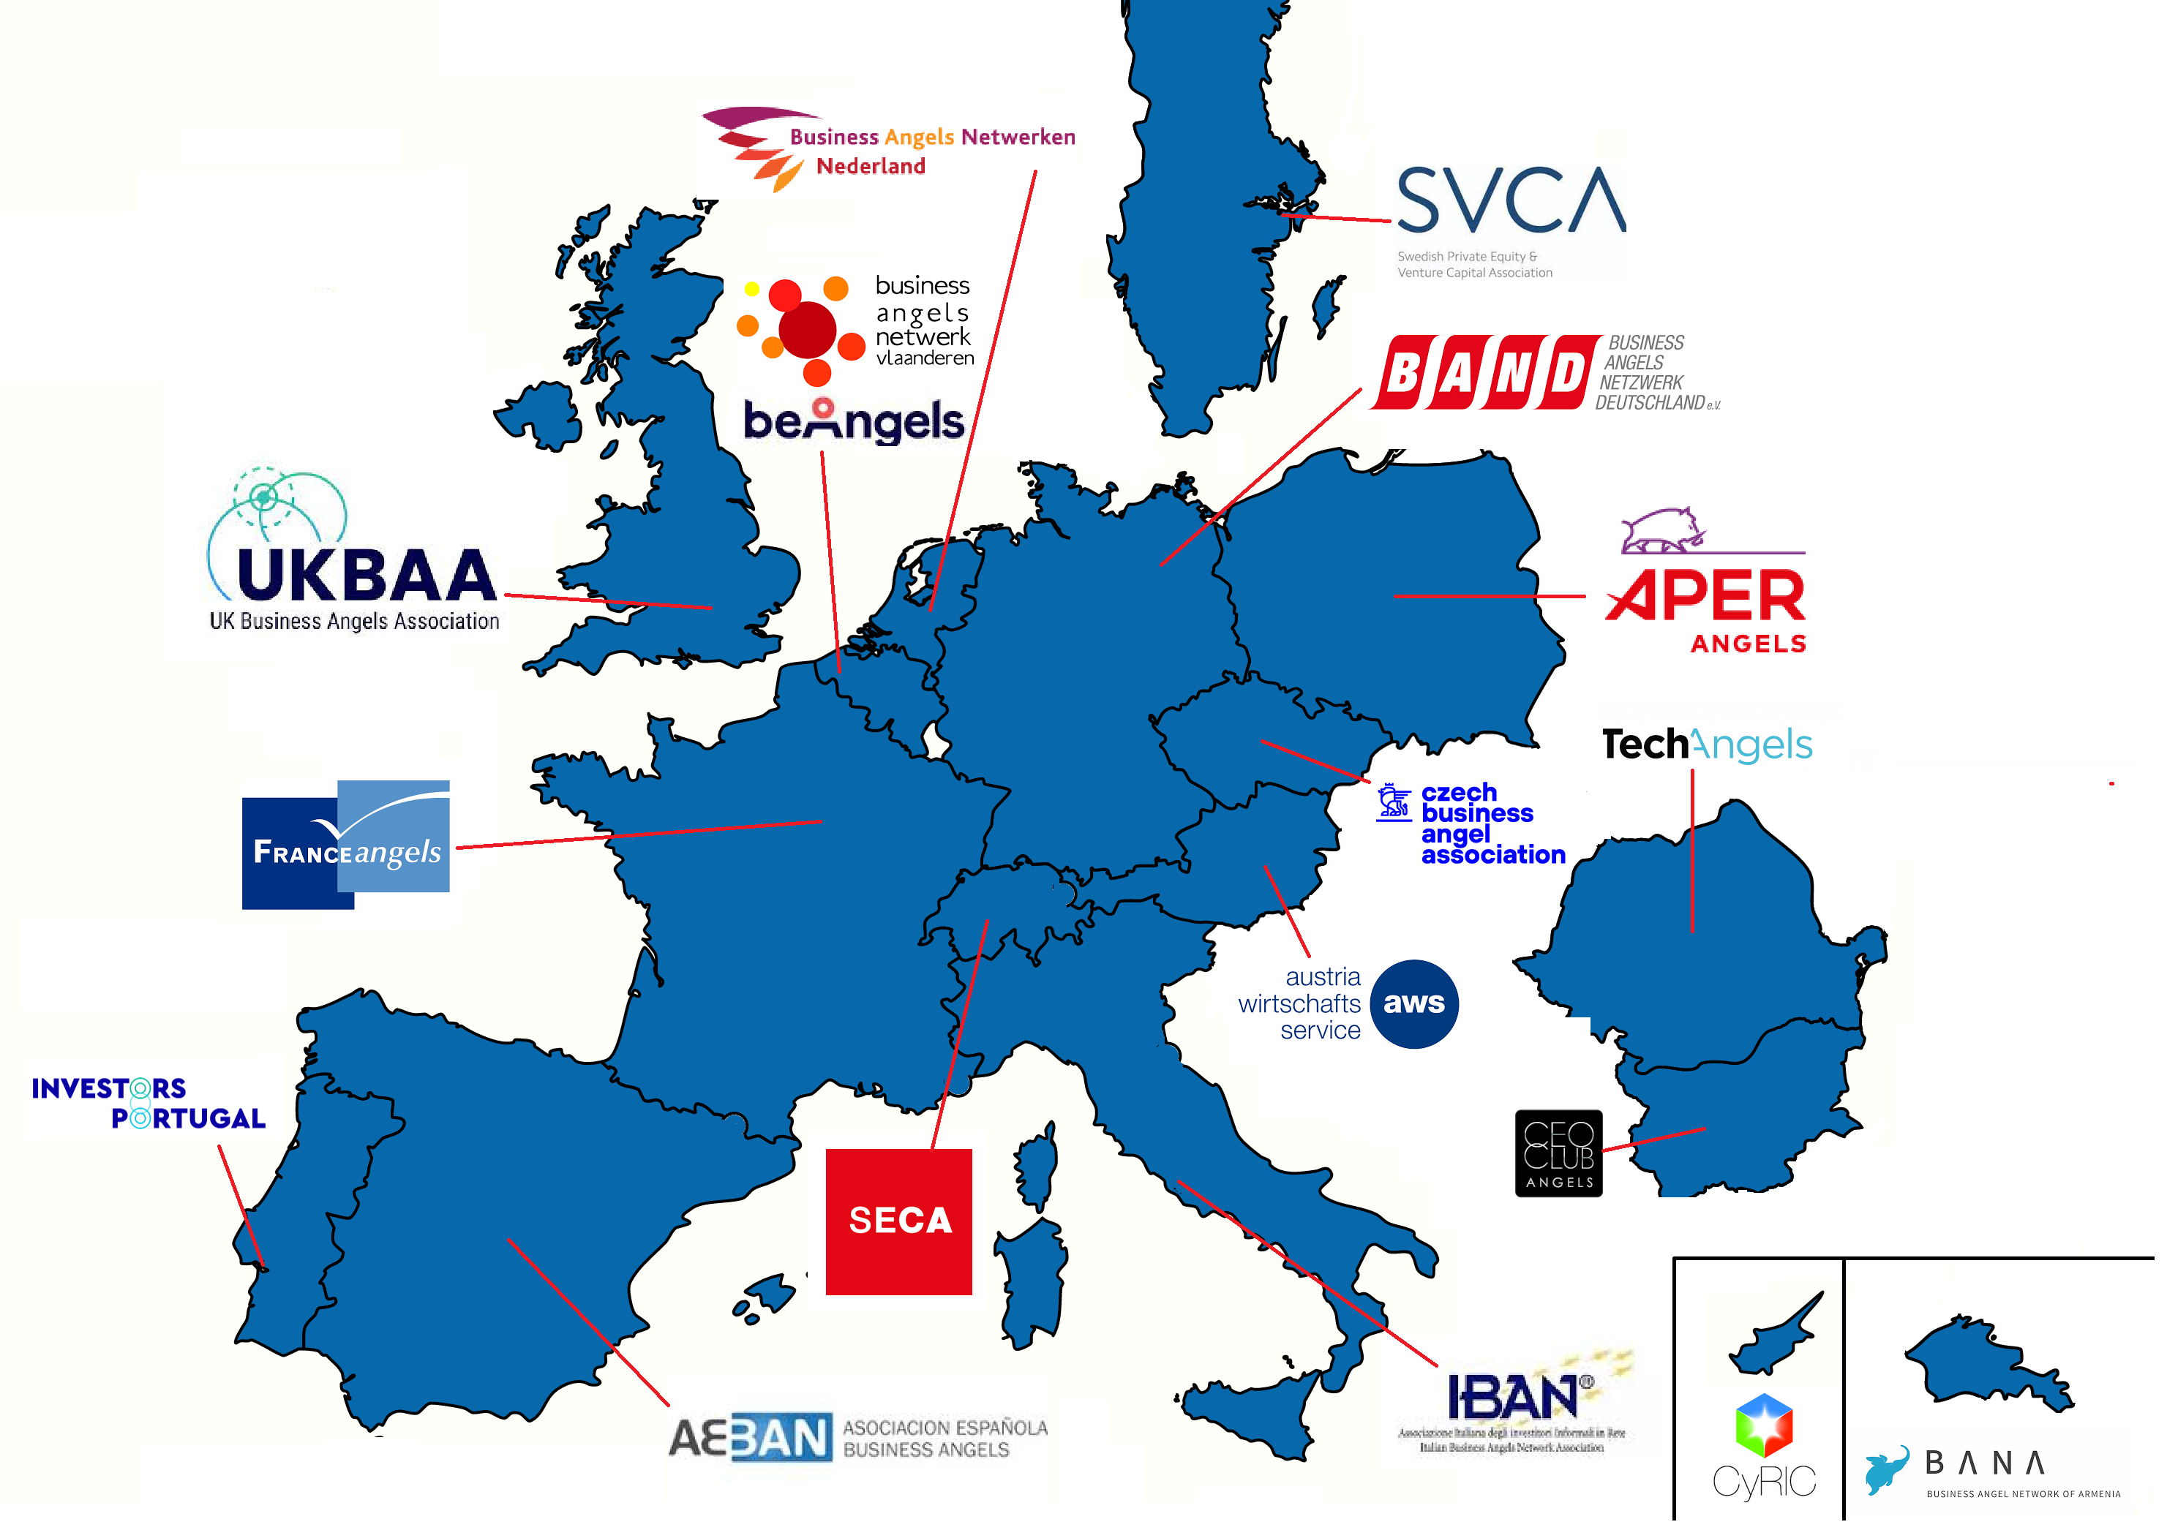
BAE Members

Slide 6
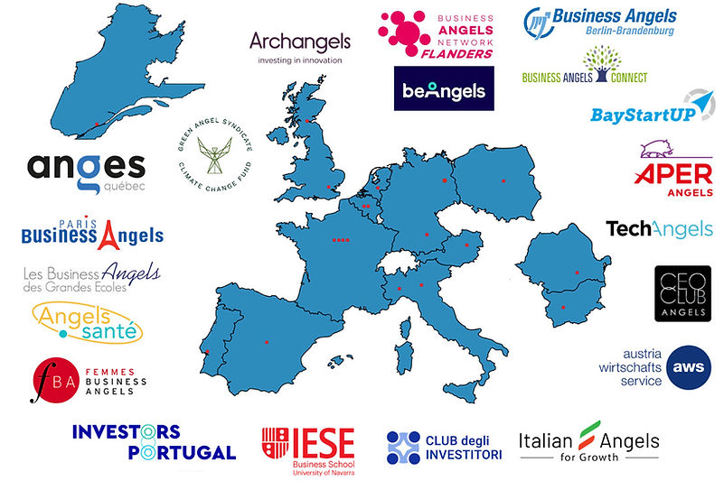

The BAE Club
20 Leading European networks

Slide 7
Business Angels funding
Without BA’s – no Scale Ups
Business Angels provide crucial funding during the profit/loss “Valley of Death” – between product/idea launch and customer traction
Founders,
Family &
Friends
Profit/Loss
Business Angels
Crowdfunding
Venture Capital
Prizes & Grants
Banks
Customers & Suppliers
SEED
UP TO €200K
START-UP
€200K - €2M
SERIES A & B
€2M TO €5M
EXPANSION
Greater than €5M
Product Timeline: Launch Traction

Slide 8
Our Objectives
High Level w/ our Full Members
Be the voice of angel investing to European institutions and market;
Be the resource of research and intelligence on the European angel market;
Promote professional, ethical standards and best practices;
Ensuring a supportive fiscal and regulatory framework;
Promote diversity in angel investing.
Practical Level with our BAE Club Members
Creating Cross Border funding opportunities
Intensive cooperation and knowledge sharing.

Slide 9


An investment and capacity building programme for business angel ecosystems in over 30 countries, with;
  Creating pan-European community of investors;
  Webinars, workshops, investor dinners and study visits;
  Access to Research & Knowledge centre.
Join us in Zagreb 9 and 10 December!
www.europeanesil.eu

Slide 10
Thank you!
Luigi Amati
Honorary chairman
INNOVATION, TECHNOLOGY AND PARTNERSHIP IN ACTION
4th Conference
13th - 14th November 2024
Nova Gorica - Gorizia

