Slide 1
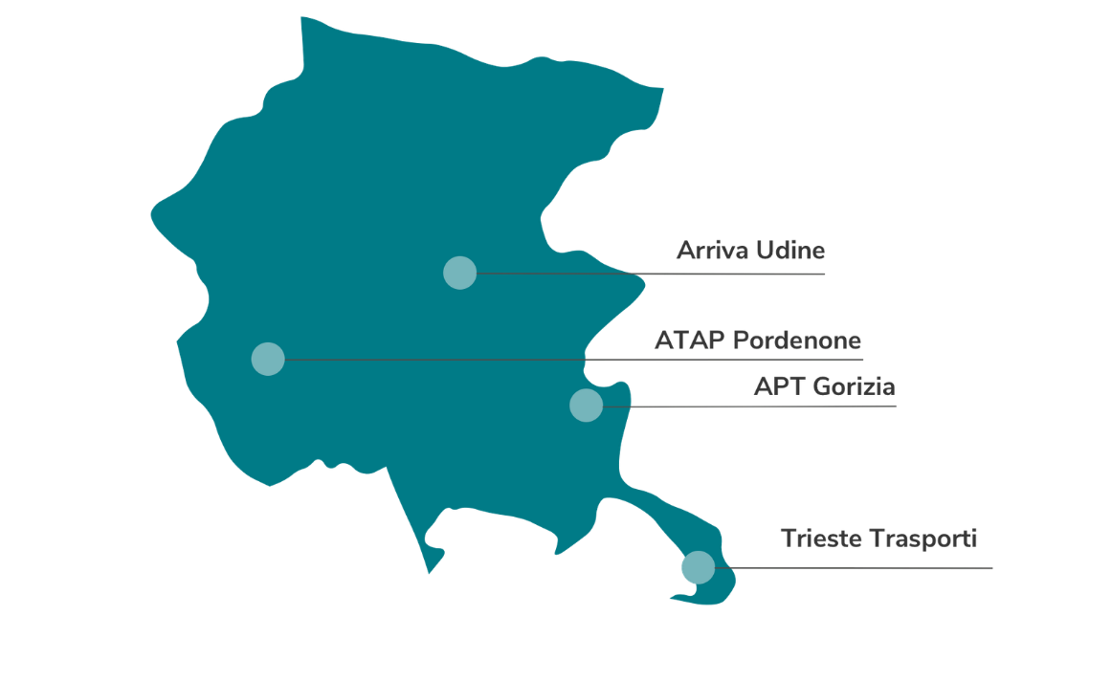
The Project of TPLFVG S.c.a r.l.
4
companies
43,5
Mln km/year
950+
vehichles
Luca Di Benedetto and Giuseppe Zottis

Slide 2
The project objectives
TPL FVG S.c.ar.l. is a partner in the NAHV project by virtue of two projects of the consortium members APT S.p.A. and Trieste Trasporti S.p.A., which intend to acquire hydrogen-powered buses through two different infrastructure pathways
APT
TRIESTE TRASPORTI
Construction of a new depot equipped with a workshop and a hydrogen production, storage, and refueling facility
First purchase of 8 buses (biennium 2025-2026)
Second purchase of 7 buses (triennium 2027-2029)
Use the hydrogen produced by the new AcegasApsAmga plant to refuel up to 10 hydrogen buses
Construction of a refueling system consisting of the following facilities: storage, chiller (cooling), compressor and two refueling lines

Slide 3
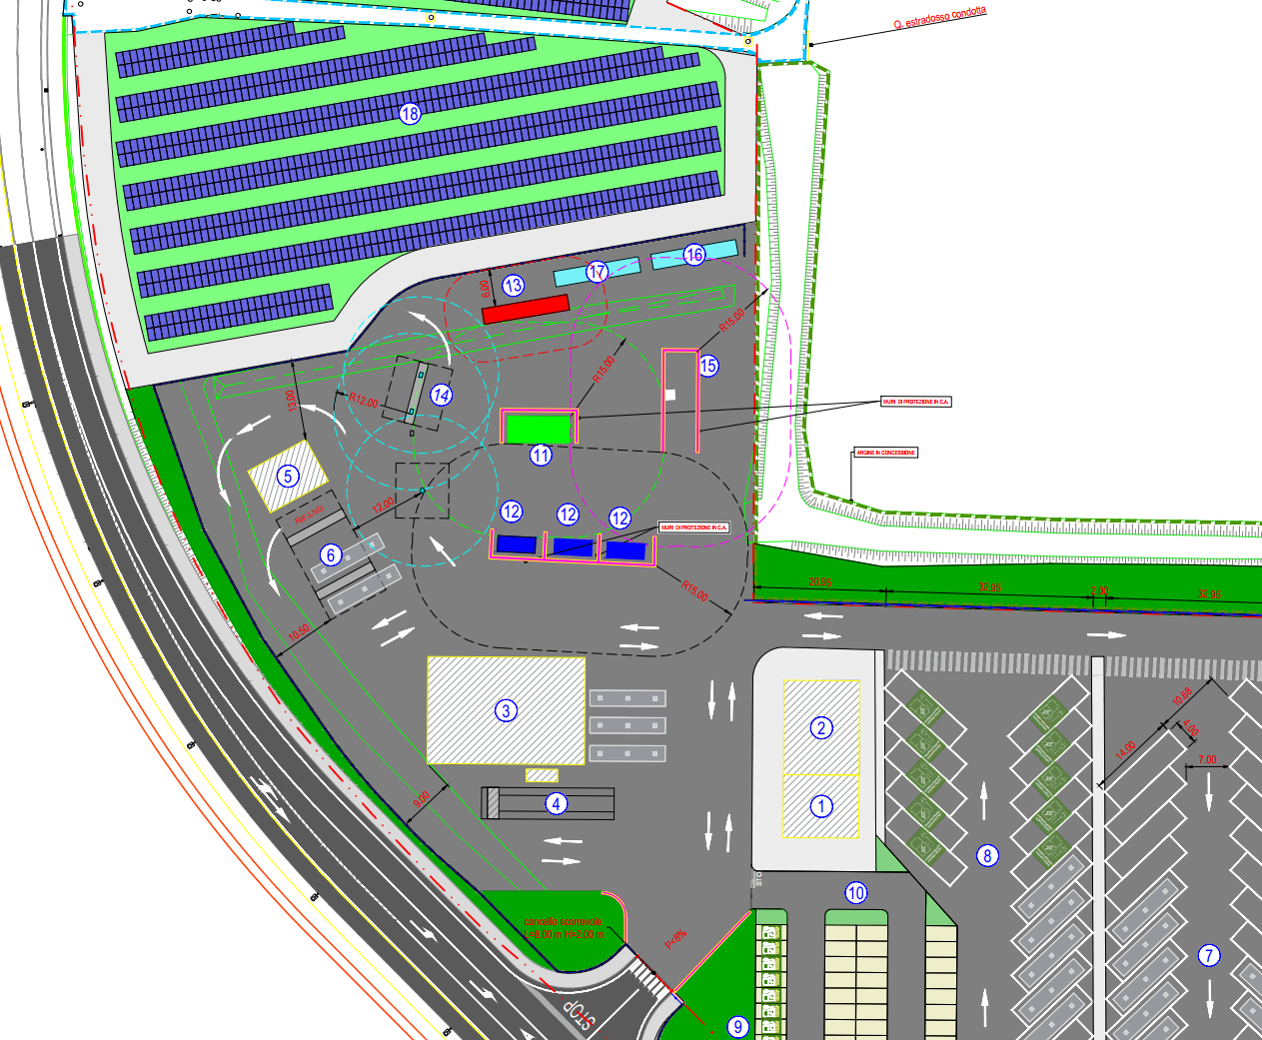
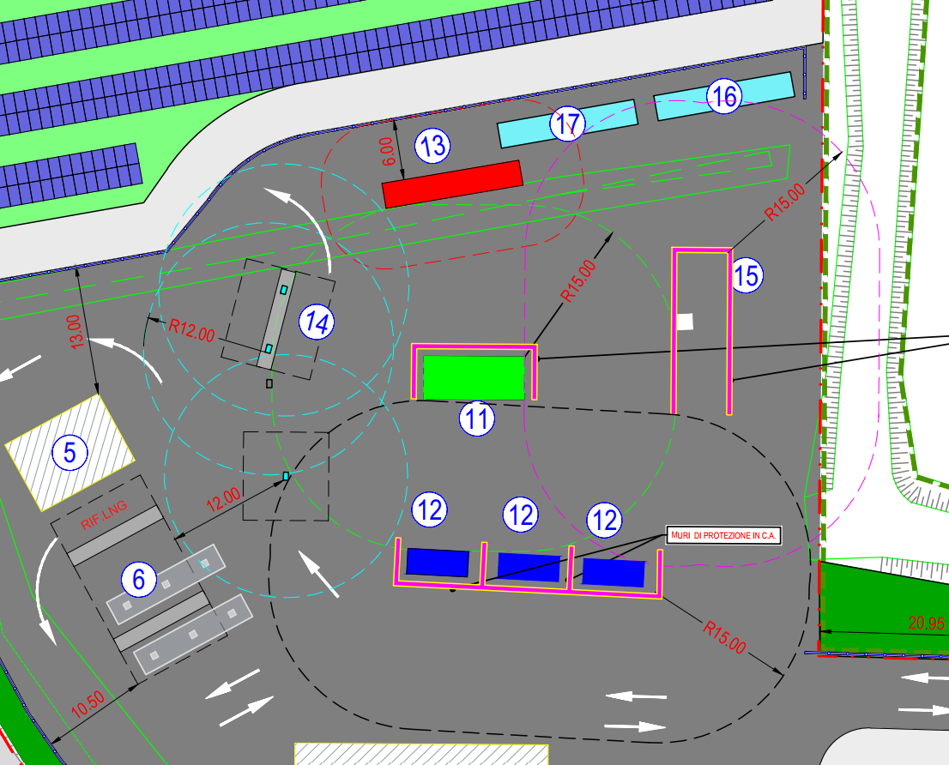
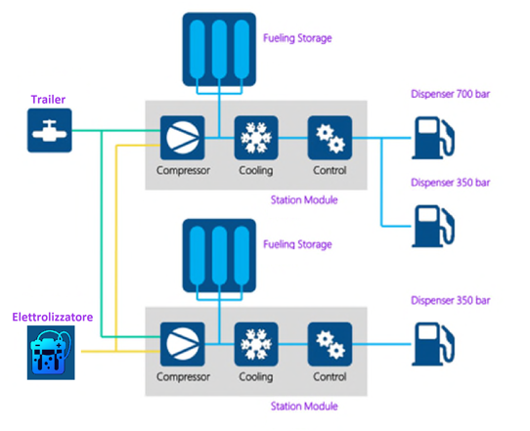
Project by APT S.p.A.
The hydrogen production plant has a surface of 3150 sm, with a maximum power of 1 MW and a daily production capacity of 400 kg. The refueling station is suitable for refueling buses and trucks at 350 bar (HDV: heavy duty vehicles) and light vehicles at 700 bar (LDV: light duty vehicles), with respective refrigerated dispensers.
In case of anomalies, the system will be powered by a 500 bar trailer, with a dedicated loading/unloading bay
The plant includes the electrolyzer, compressors, storage tanks at various pressures, and cooling systems for refueling. It will be managed and maintained locally and remotely, in compliance with current fire safety regulations

Slide 4
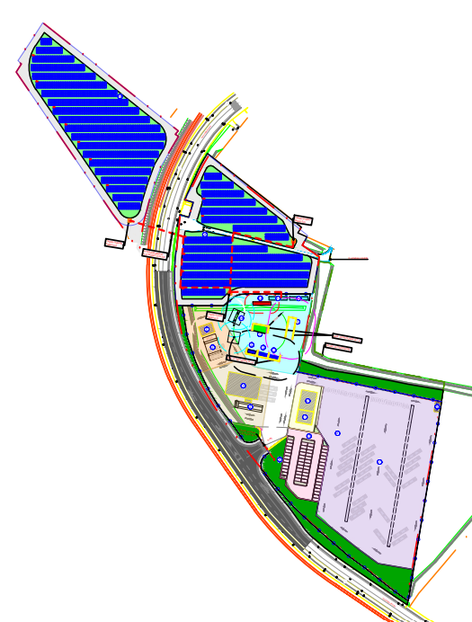
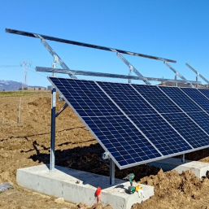
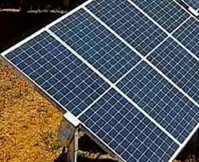
Project by APT S.p.A.
The Hydrogen production and refueling Plant is powered from a photovoltaic park based on 17.000 sm. Estimated annual production is ca 1,6 MW which can cover the full need which is functional to refuel the first 8 urban buses. The whole project will be completed with another 1,4 MW of power supplied by the photovoltaic panels positioned over the buses shelters in the new Depot. This will be usefull to guarantee total refuel for all the 15 buses of urban fleet.
17.000 sm
parallel photovoltaic panels
2.880 modules of 580 Wp
annual production 1,6-1,4 MW

Slide 5
Project by APT S.p.A. - Timelines
Design Phase
Authorization Phase
Executive Design Phase
TENDER
Start of Works
End of Works
Start on 01/01/2025
Completed during the second semester of 2024
Called and awarded
End by 30/06/2026
Completed in December 2023
From now on

Slide 6
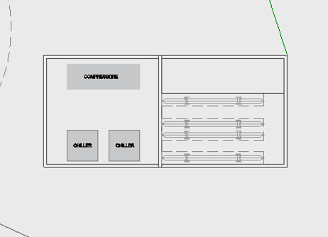
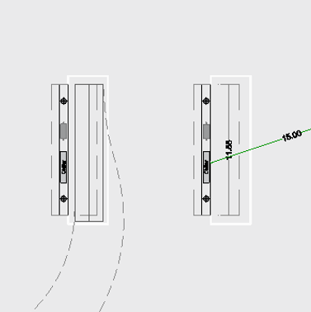
Project by TT S.p.A.
Trieste Trasporti will use the hydrogen produced by the new AcegasApsAmga plant and will build a storage and distribution facility to refuel up to 10 buses
The refueling system will include storage, cooling, compressors, and two refueling lines.
Site inspections for the infrastructure have already been conducted, and contacts have been made with AcegasApsAmga
The next steps involve purchasing the land and starting the authorization and project design procedures
REFUELING STATIONS
CHILLER

Slide 7
Project by TT S.p.A. - Timelines
Development of the Business Plan (with AcegasApsAmga)
Identification and acquisition of an area for storage and refueling
Authorization Phase
Executive Design Phase (Integrated Contract)
Tender
End of Works
Awarded by 03/2027
Start on the second quarter of 2025
Started in 2023, end by first quarter of 2025
End by 10/2028
From now on

Slide 8
Thank you.

