Slide 1
North Adriatic Hydrogen Valley (NAHV)
Dr. Jerneja Sedlar
Head of Development and Investment department HSE
Coordinator NAHV Horizon Europe

Slide 2
NAHV ambition
The goal of NAHV is to establish an economic, social, and industrial ecosystem based on renewable hydrogen as an energy source, carrier, and storage medium, derived from the integration of knowledge and capabilities within the framework of Quadruple Helix.

Slide 3
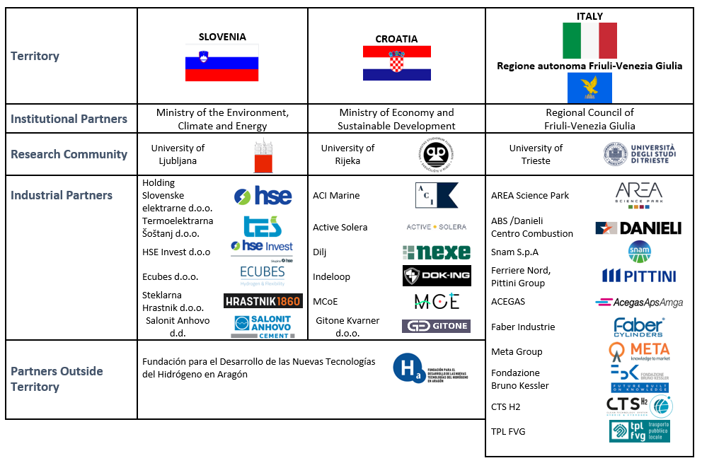
Consortium partners of NAHV
Občina Cres

Slide 4
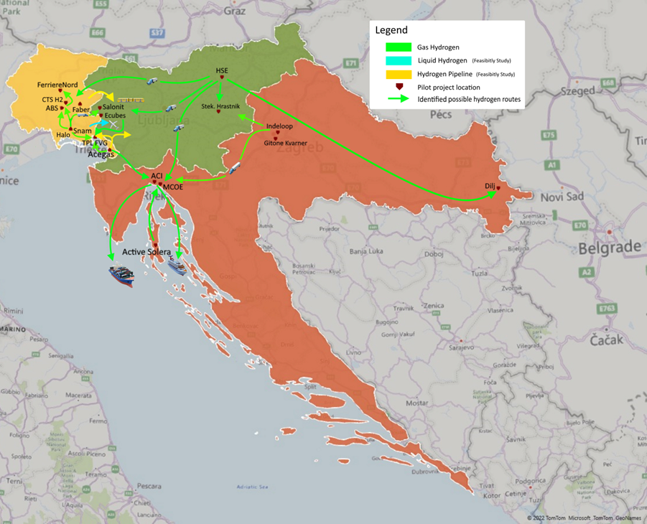
Key aim of the NAHV: creating a cross-border market for renewable hydrogen
The key aim of the initiative is to create a market for green (renewable) hydrogen on both the demand and supply sides, making it a competitive energy source for the future. Key industry players from all three countries will develop pilot projects to produce up to 5,000 tonnes of renewable hydrogen per year from renewable energy sources, destined for energy storage, distribution and use.
It is expected that some 20% of the produced renewable hydrogen will be exchanged between the participating countries, thus creating a primary regional market for hydrogen.

Slide 5
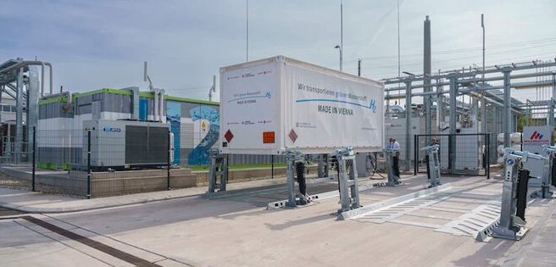
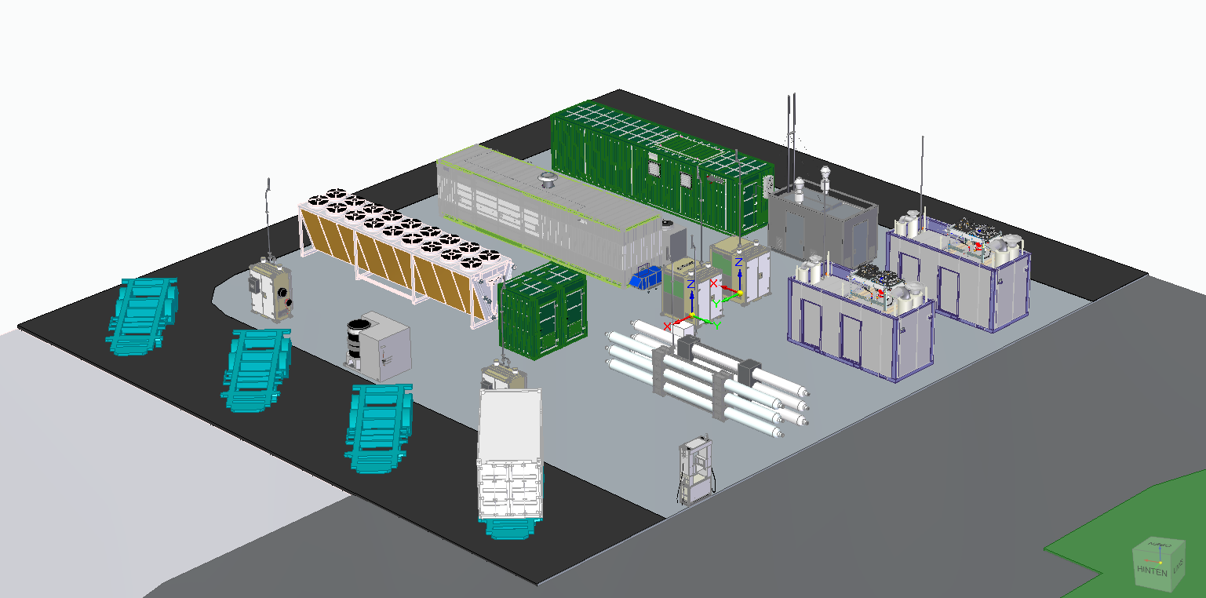
HSE goals on hydrogen
Šoštanj Thermal Power Plant:
Phase 1:
up to 3 MW electrolyser (PEM), production capacity min 300 t H2/a,
HRS on site
Spatial planning completed
Feasibility study: Q2/2024
Building permit: planned in Q2/2025
Planned start of operation: Q4/2026
Phase 2:
up to 20 MW electrolyser, production capacity min 2.700 t H2/a,
HRS on site, 4 t H2 storage on site
Start of Feasibility study Q3/2024
Start of Spatial planning Q3/2024
Building permit: planned in Q2/2026
Planned start of operation: Q4/2027

Slide 6
Other projects in renewable energy
by 2030
Solar energy: up to 800 MW
Wind energy: up to 50 MW
Hydro power plants: 100 MW until 2035
Geothermal energy: 11 MW

Slide 7
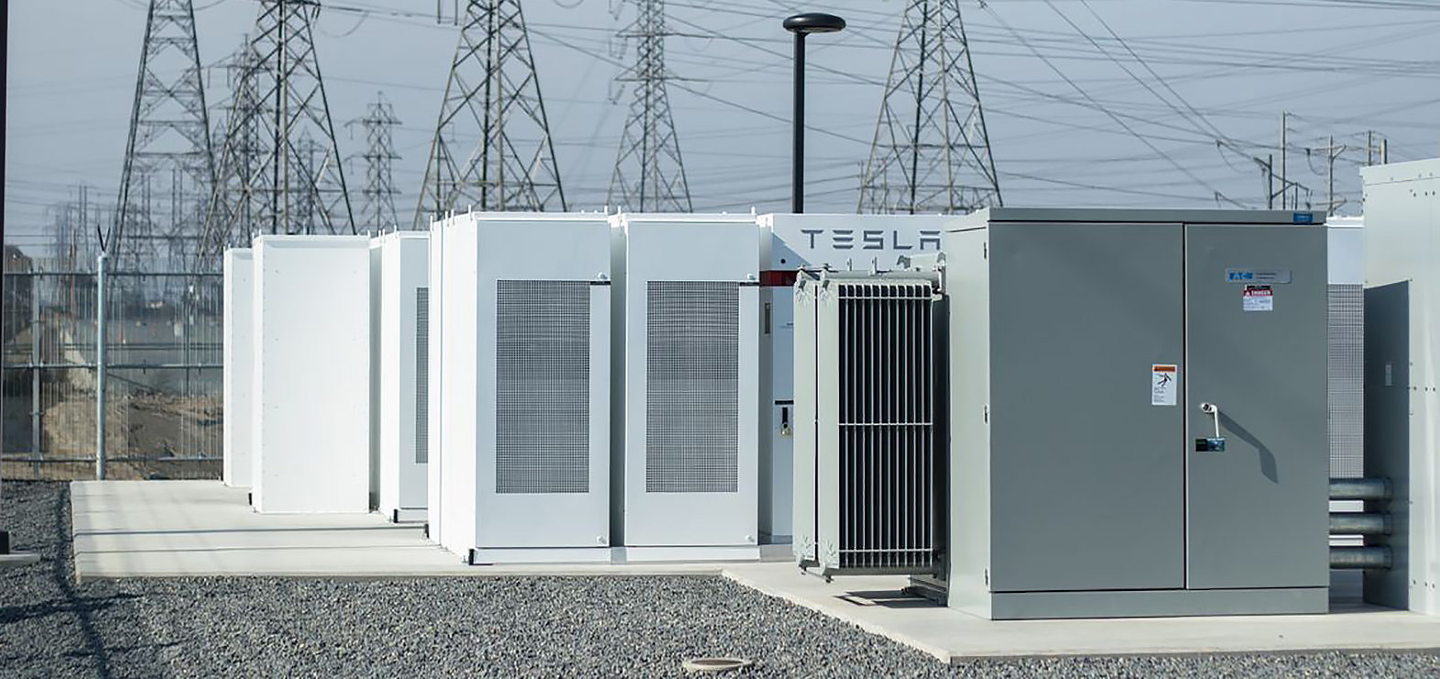
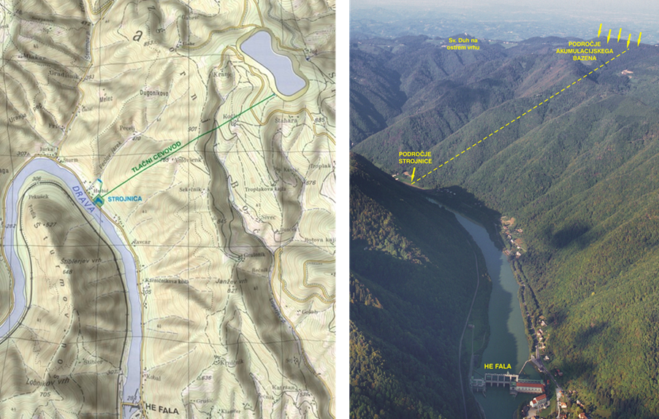
Other projects in renewable energy
Battery Storage up to 70 MW:
purpose: system storage
valid Building permit (since Q2/2023)
purpose: PV production shifting and peak shaving
valid Building permit (since Q2/2024)
Hydro Pumping Plant 440 MW:
Basic design finished
Spatial planning completed
Environmental survey in progress
Building permit: planned Q4/2026
Start of construction: planned 2027
Planned start of operation: 2031

Slide 8
NAHV exploitation and knowledge transfer to other hydrogen project
Connection to the Hydrogen Backbone
Connection to the Japanese NEDO agency
Connection to new hydrogen valleys in the region and beyond

Slide 9
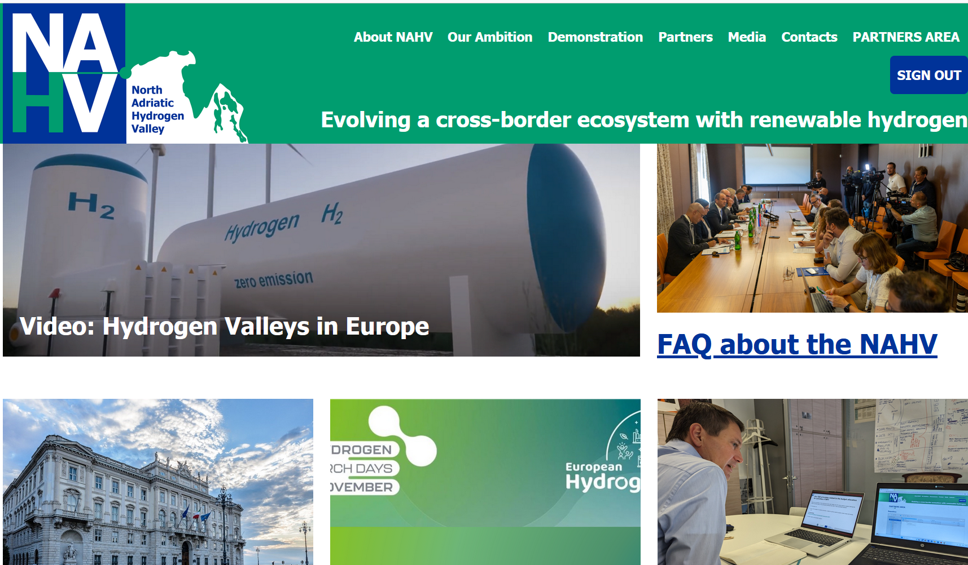
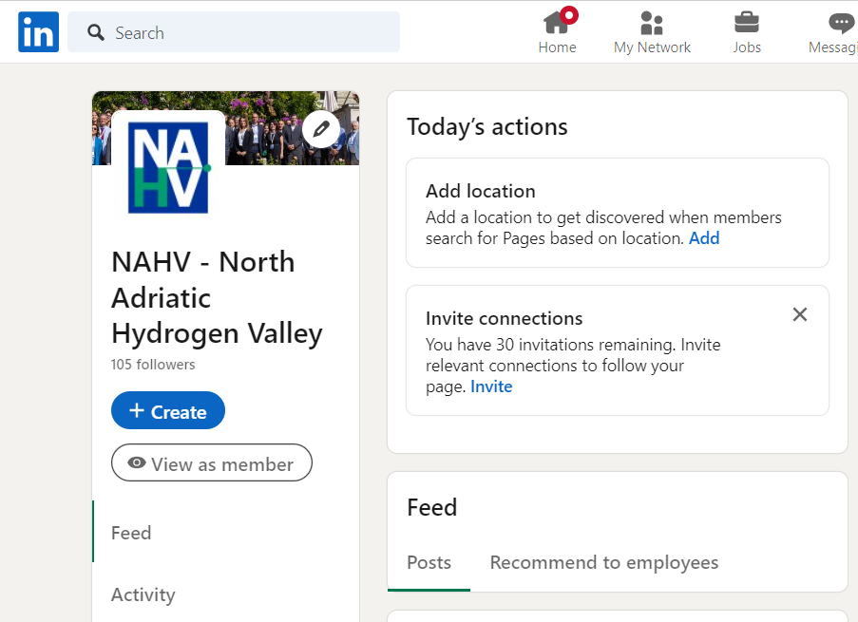
Spremljate lahko NAHV
Spletna stran NAHV: https://www.nahv.eu/
Email: nahv@hse.si
Prijavite se na
Glasilo NAHV
tukaj:
NAHV je na Linkedinu:
https://www.linkedin.com/company/nahv/
..In nam pišite: communication@nahv.eu

Slide 10
Thank you.

