Slide 1
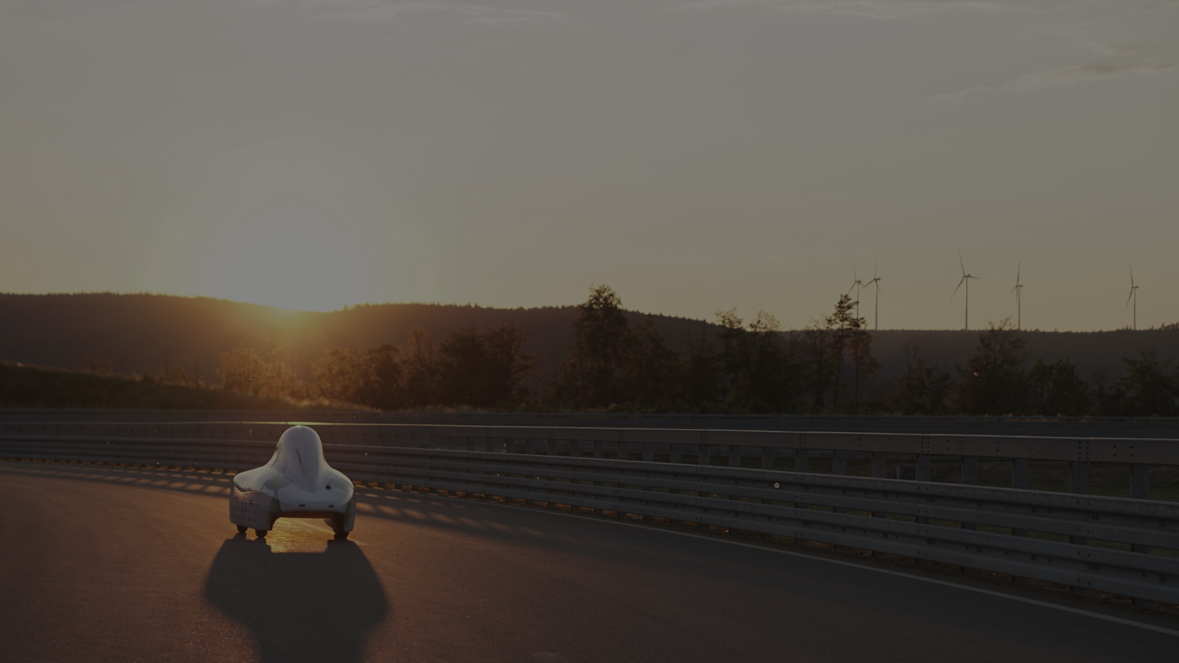

TEAM DELFT

Slide 2
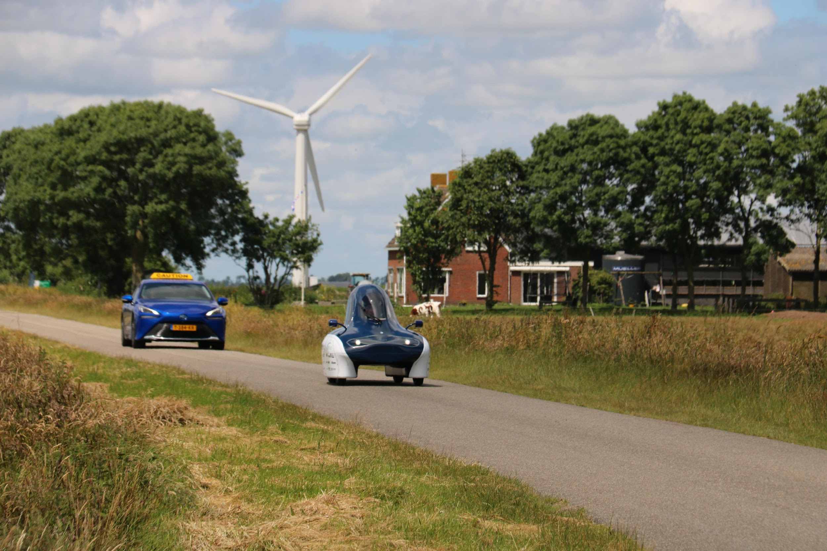

Slide 3
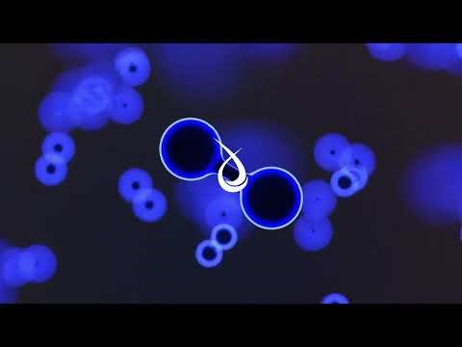

Slide 4
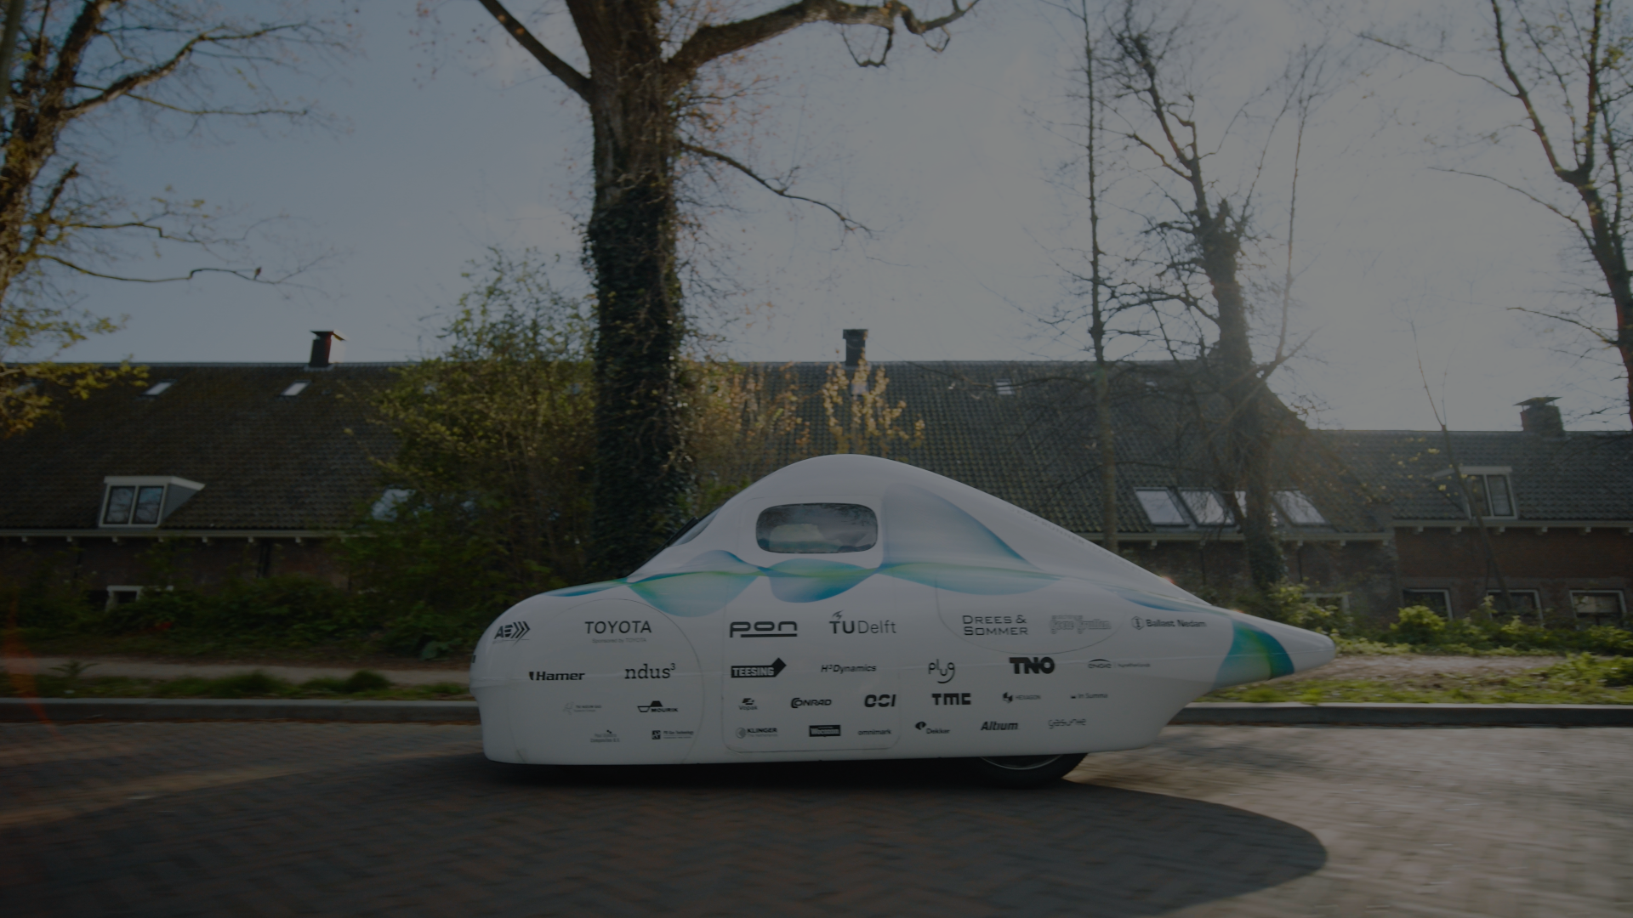


ECO-RUNNER
TEAM DELFT
Nova Gorica
13 November 2024
Bart de Waart

Slide 5
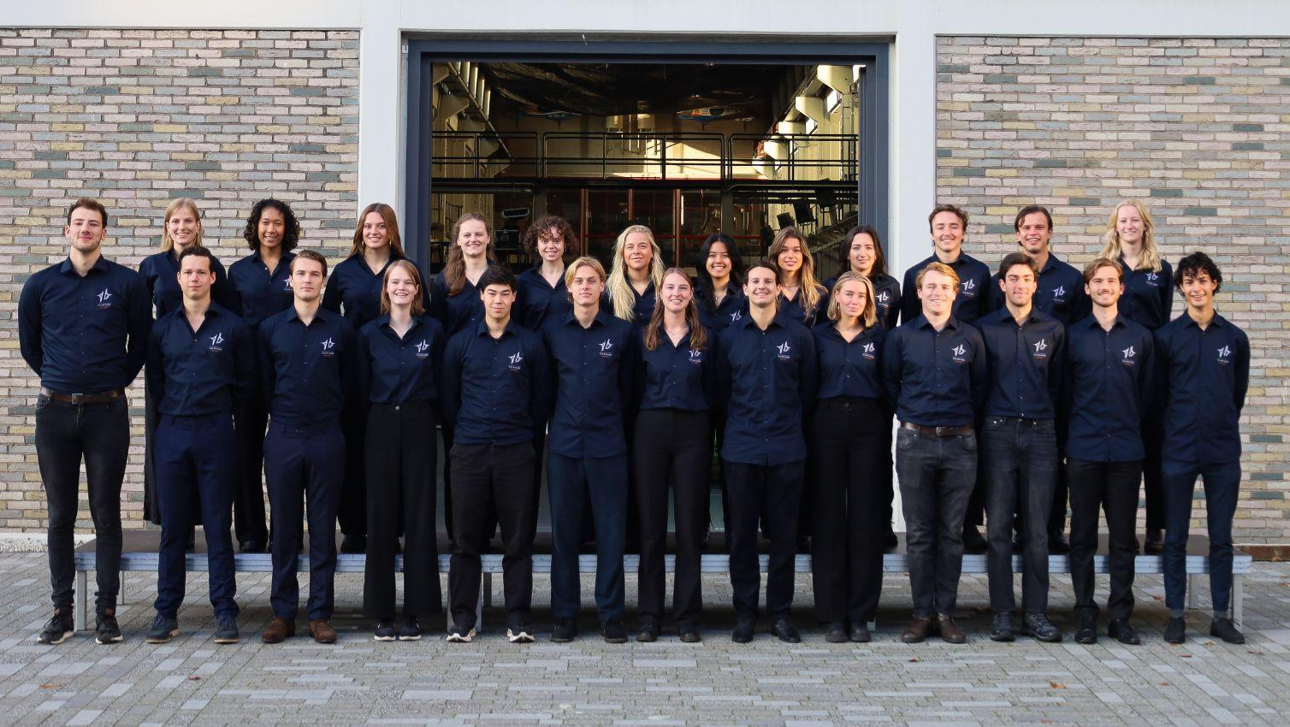
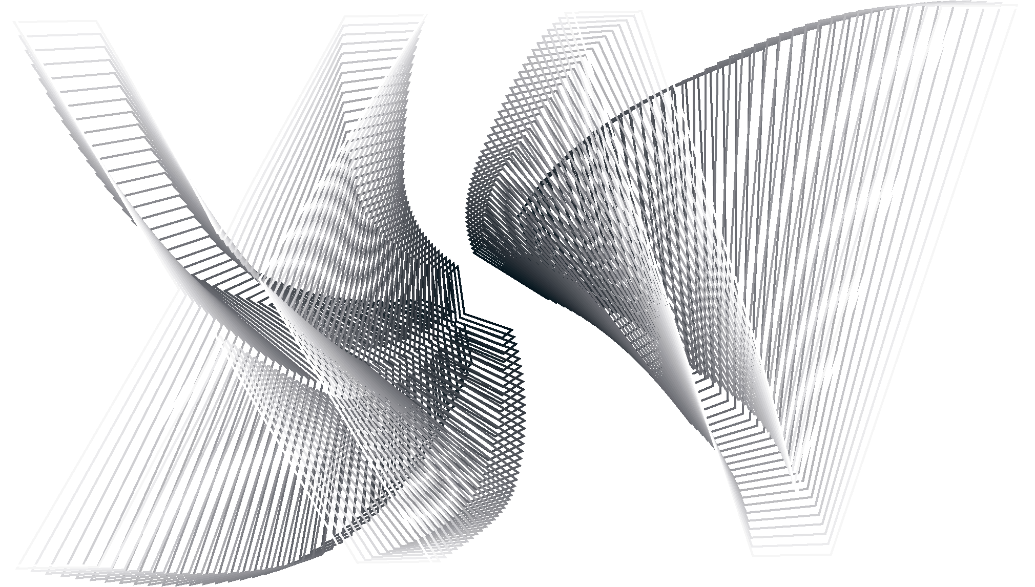
TEAM FOTO

Slide 6
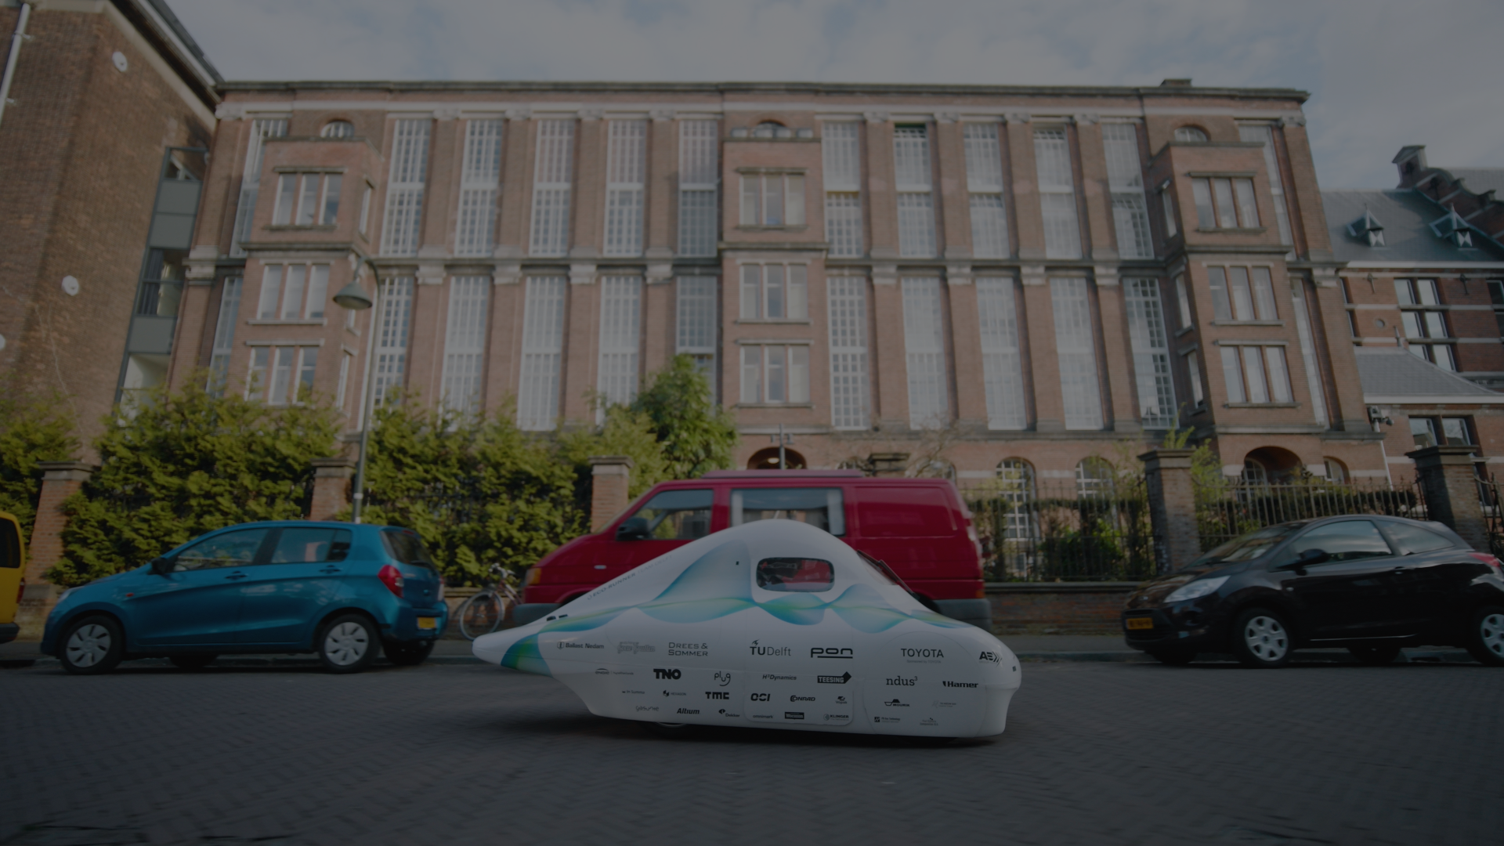

VISION
“TO INSPIRE THE WORLD TOWARDS
SUSTAINABLE MOBILITY”

Slide 7
HOW DO WE INSPIRE?
WHY DO WE NEED TO INSPIRE
WHO ARE WE
WHAT HAVE WE ACHIEVED

Slide 8
WHY DO WE NEED TO INSPIRE

Slide 9
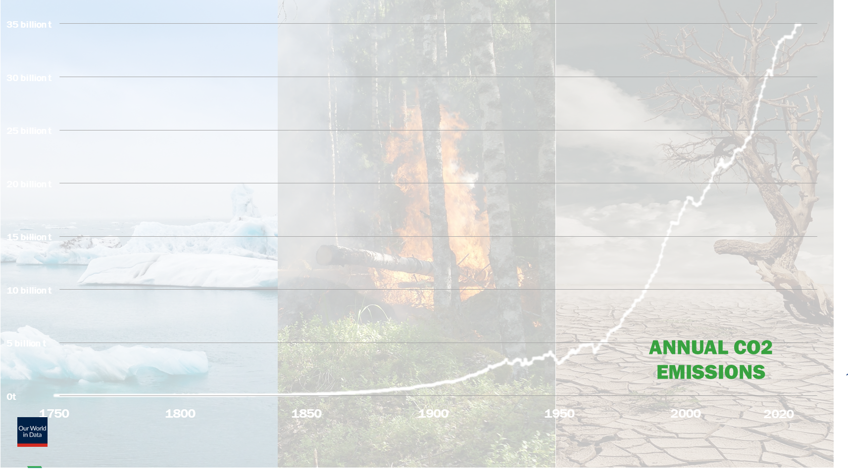

Slide 10
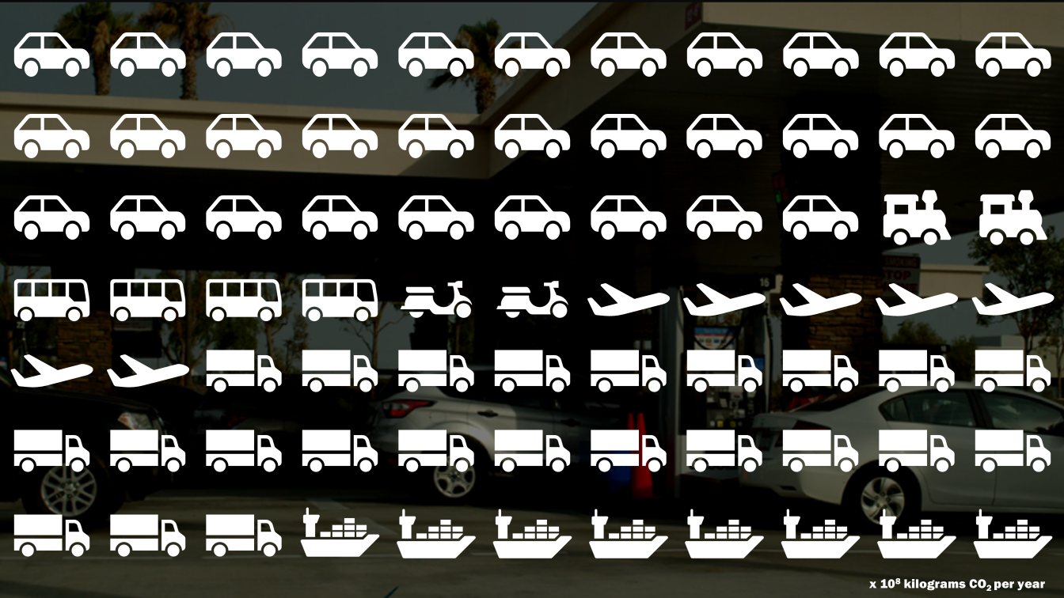
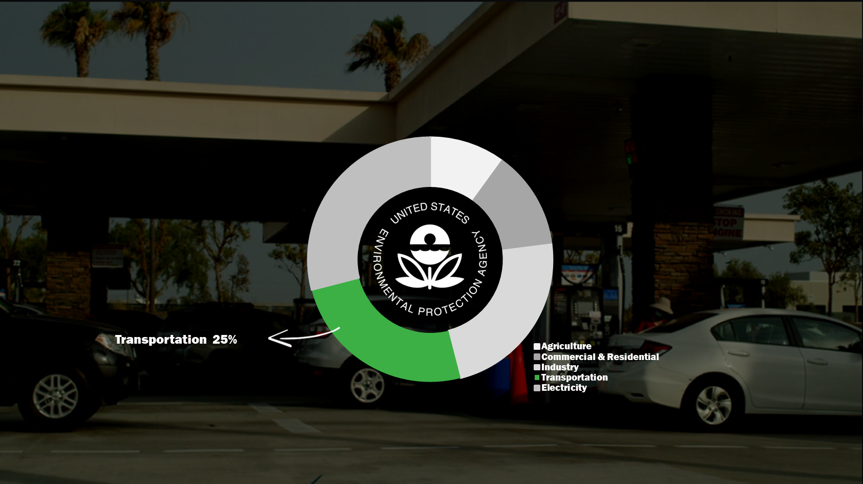
WHY DO WE NEED TO INSPIRE

Slide 11
WHY DO WE NEED TO INSPIRE

Slide 12
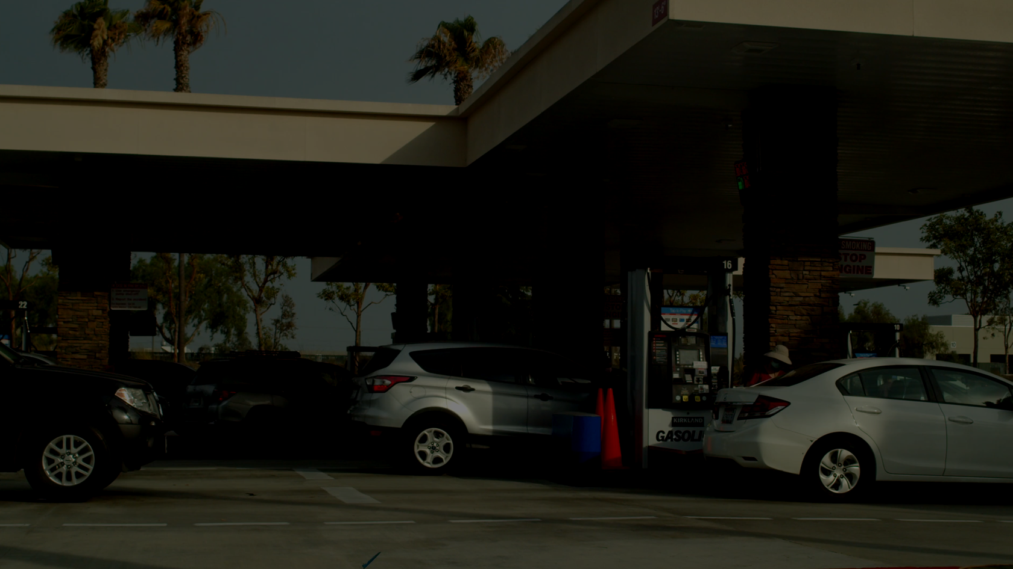
SUSTAINABLE SOLUTIONS
WHO AREd WE

Slide 13
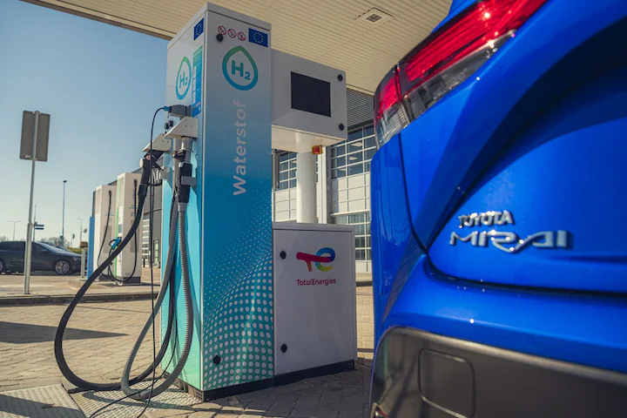
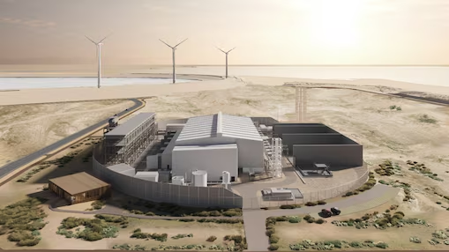
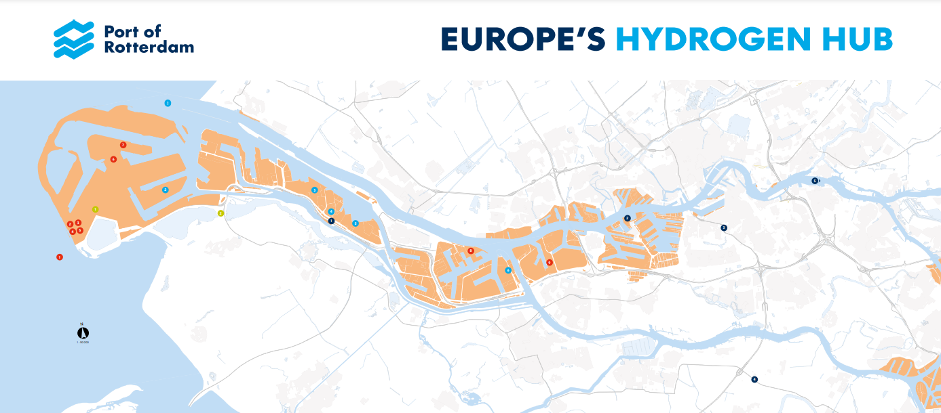

Slide 14
WHO ARE WE

Slide 15

7
NATIONALITIES
9
STUDY
PROGRAMS
13
MEN
50%
13 WOMEN
50%

Slide 16

4
MANAGEMENT
2
VEHICLE DYNAMICS
4
BODY
7
POWERTRAIN ELECTRONICS PROCESS
9 OPERATIONS

Slide 17
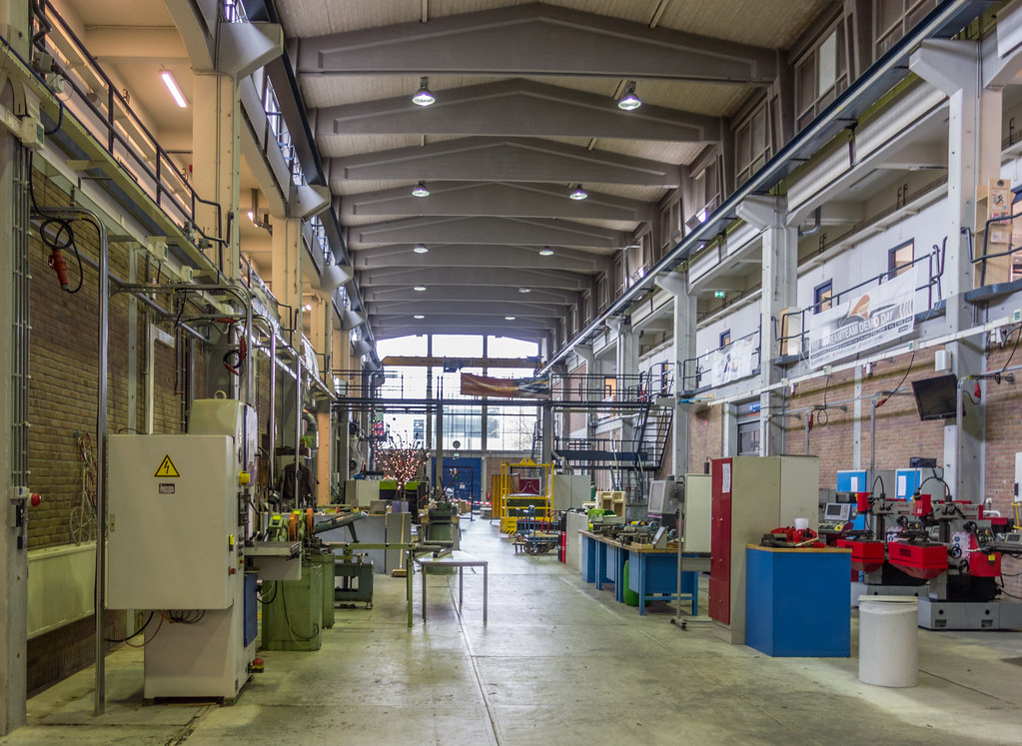
Dream Hall

Slide 18
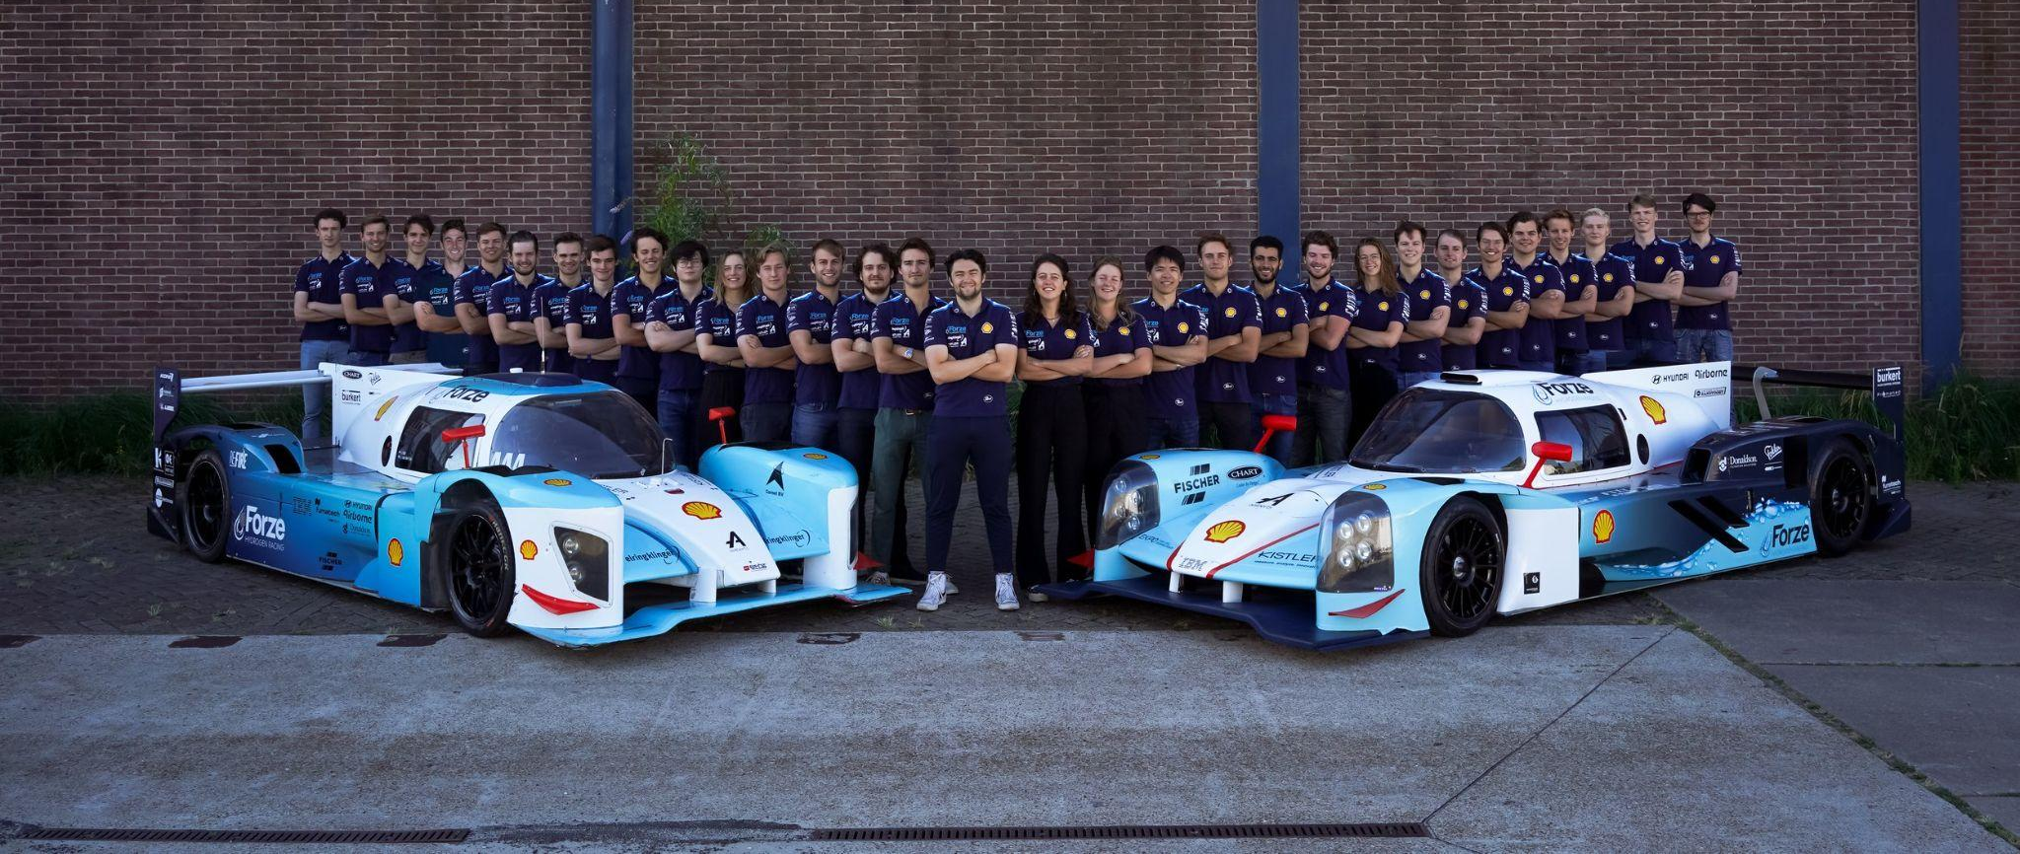
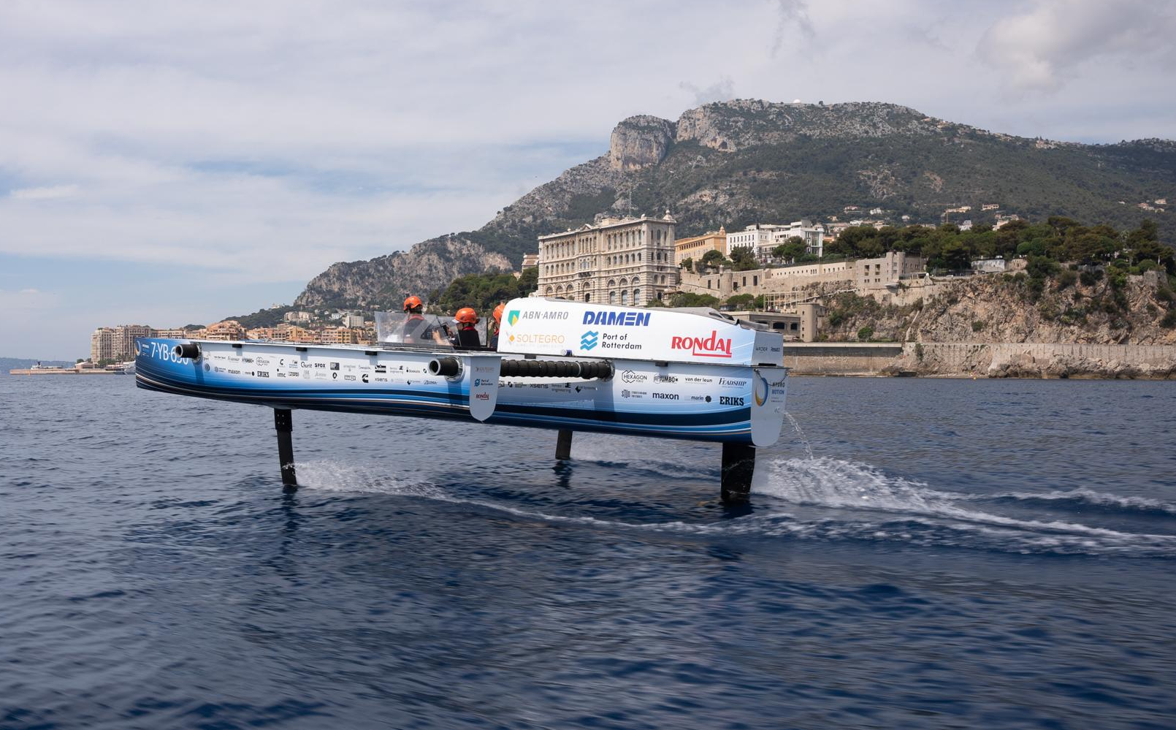
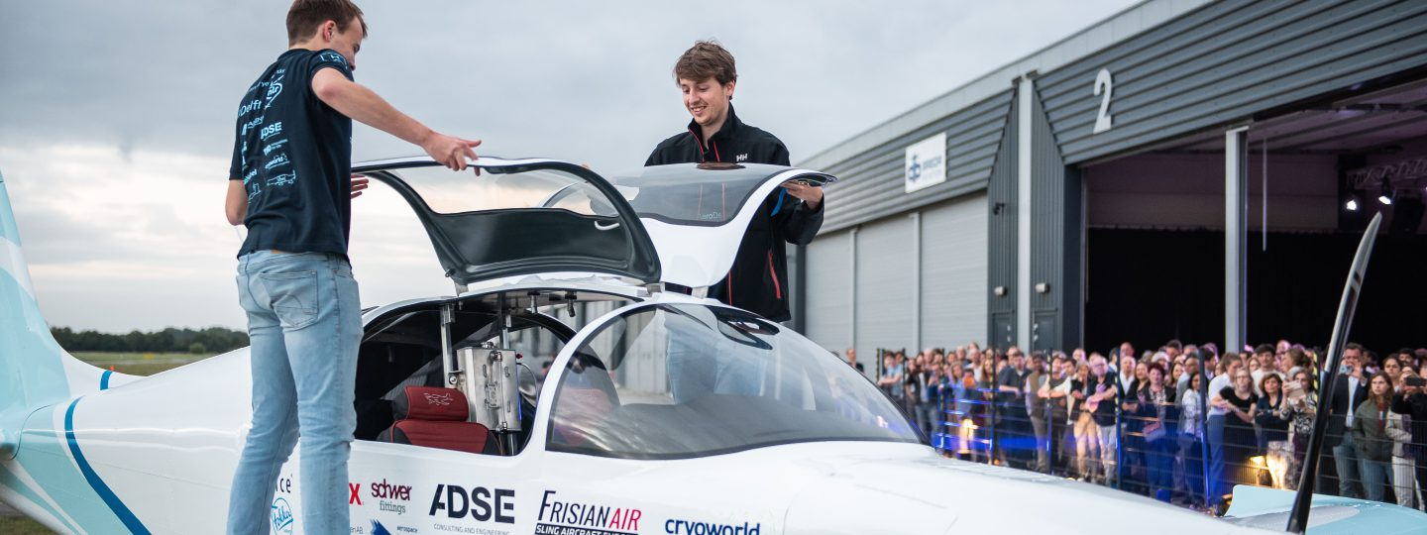

Slide 19
WHAT HAVE WE ACHIEVED

Slide 20
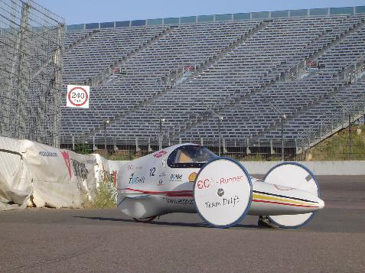
ECO I - 2005

Slide 21
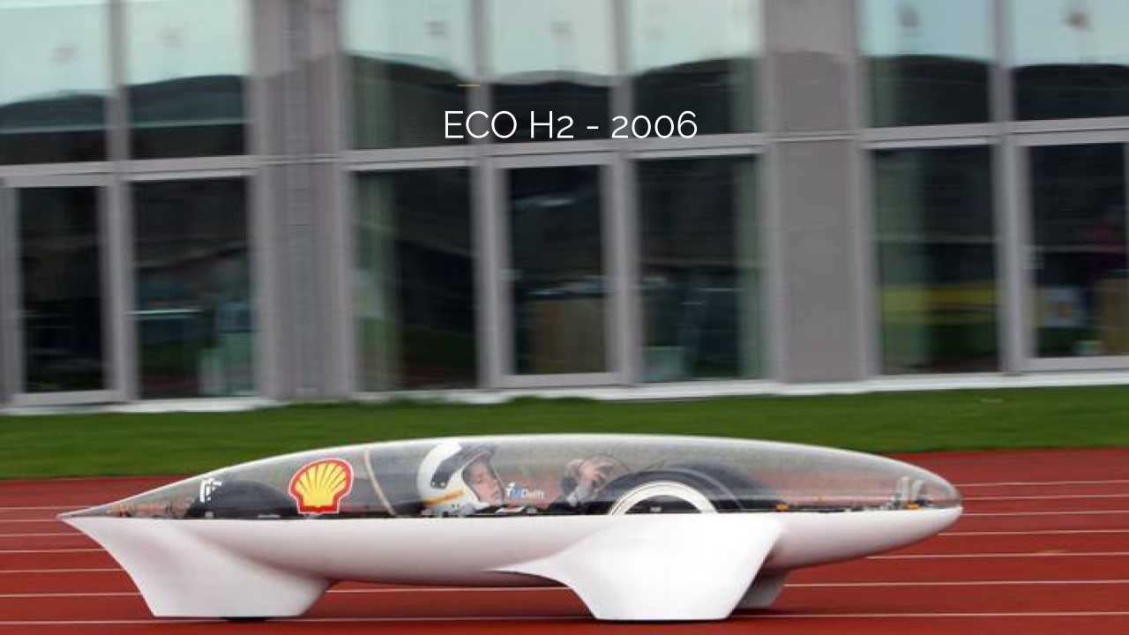
ECO I - 2005
ECO H2 - 2006

Slide 22
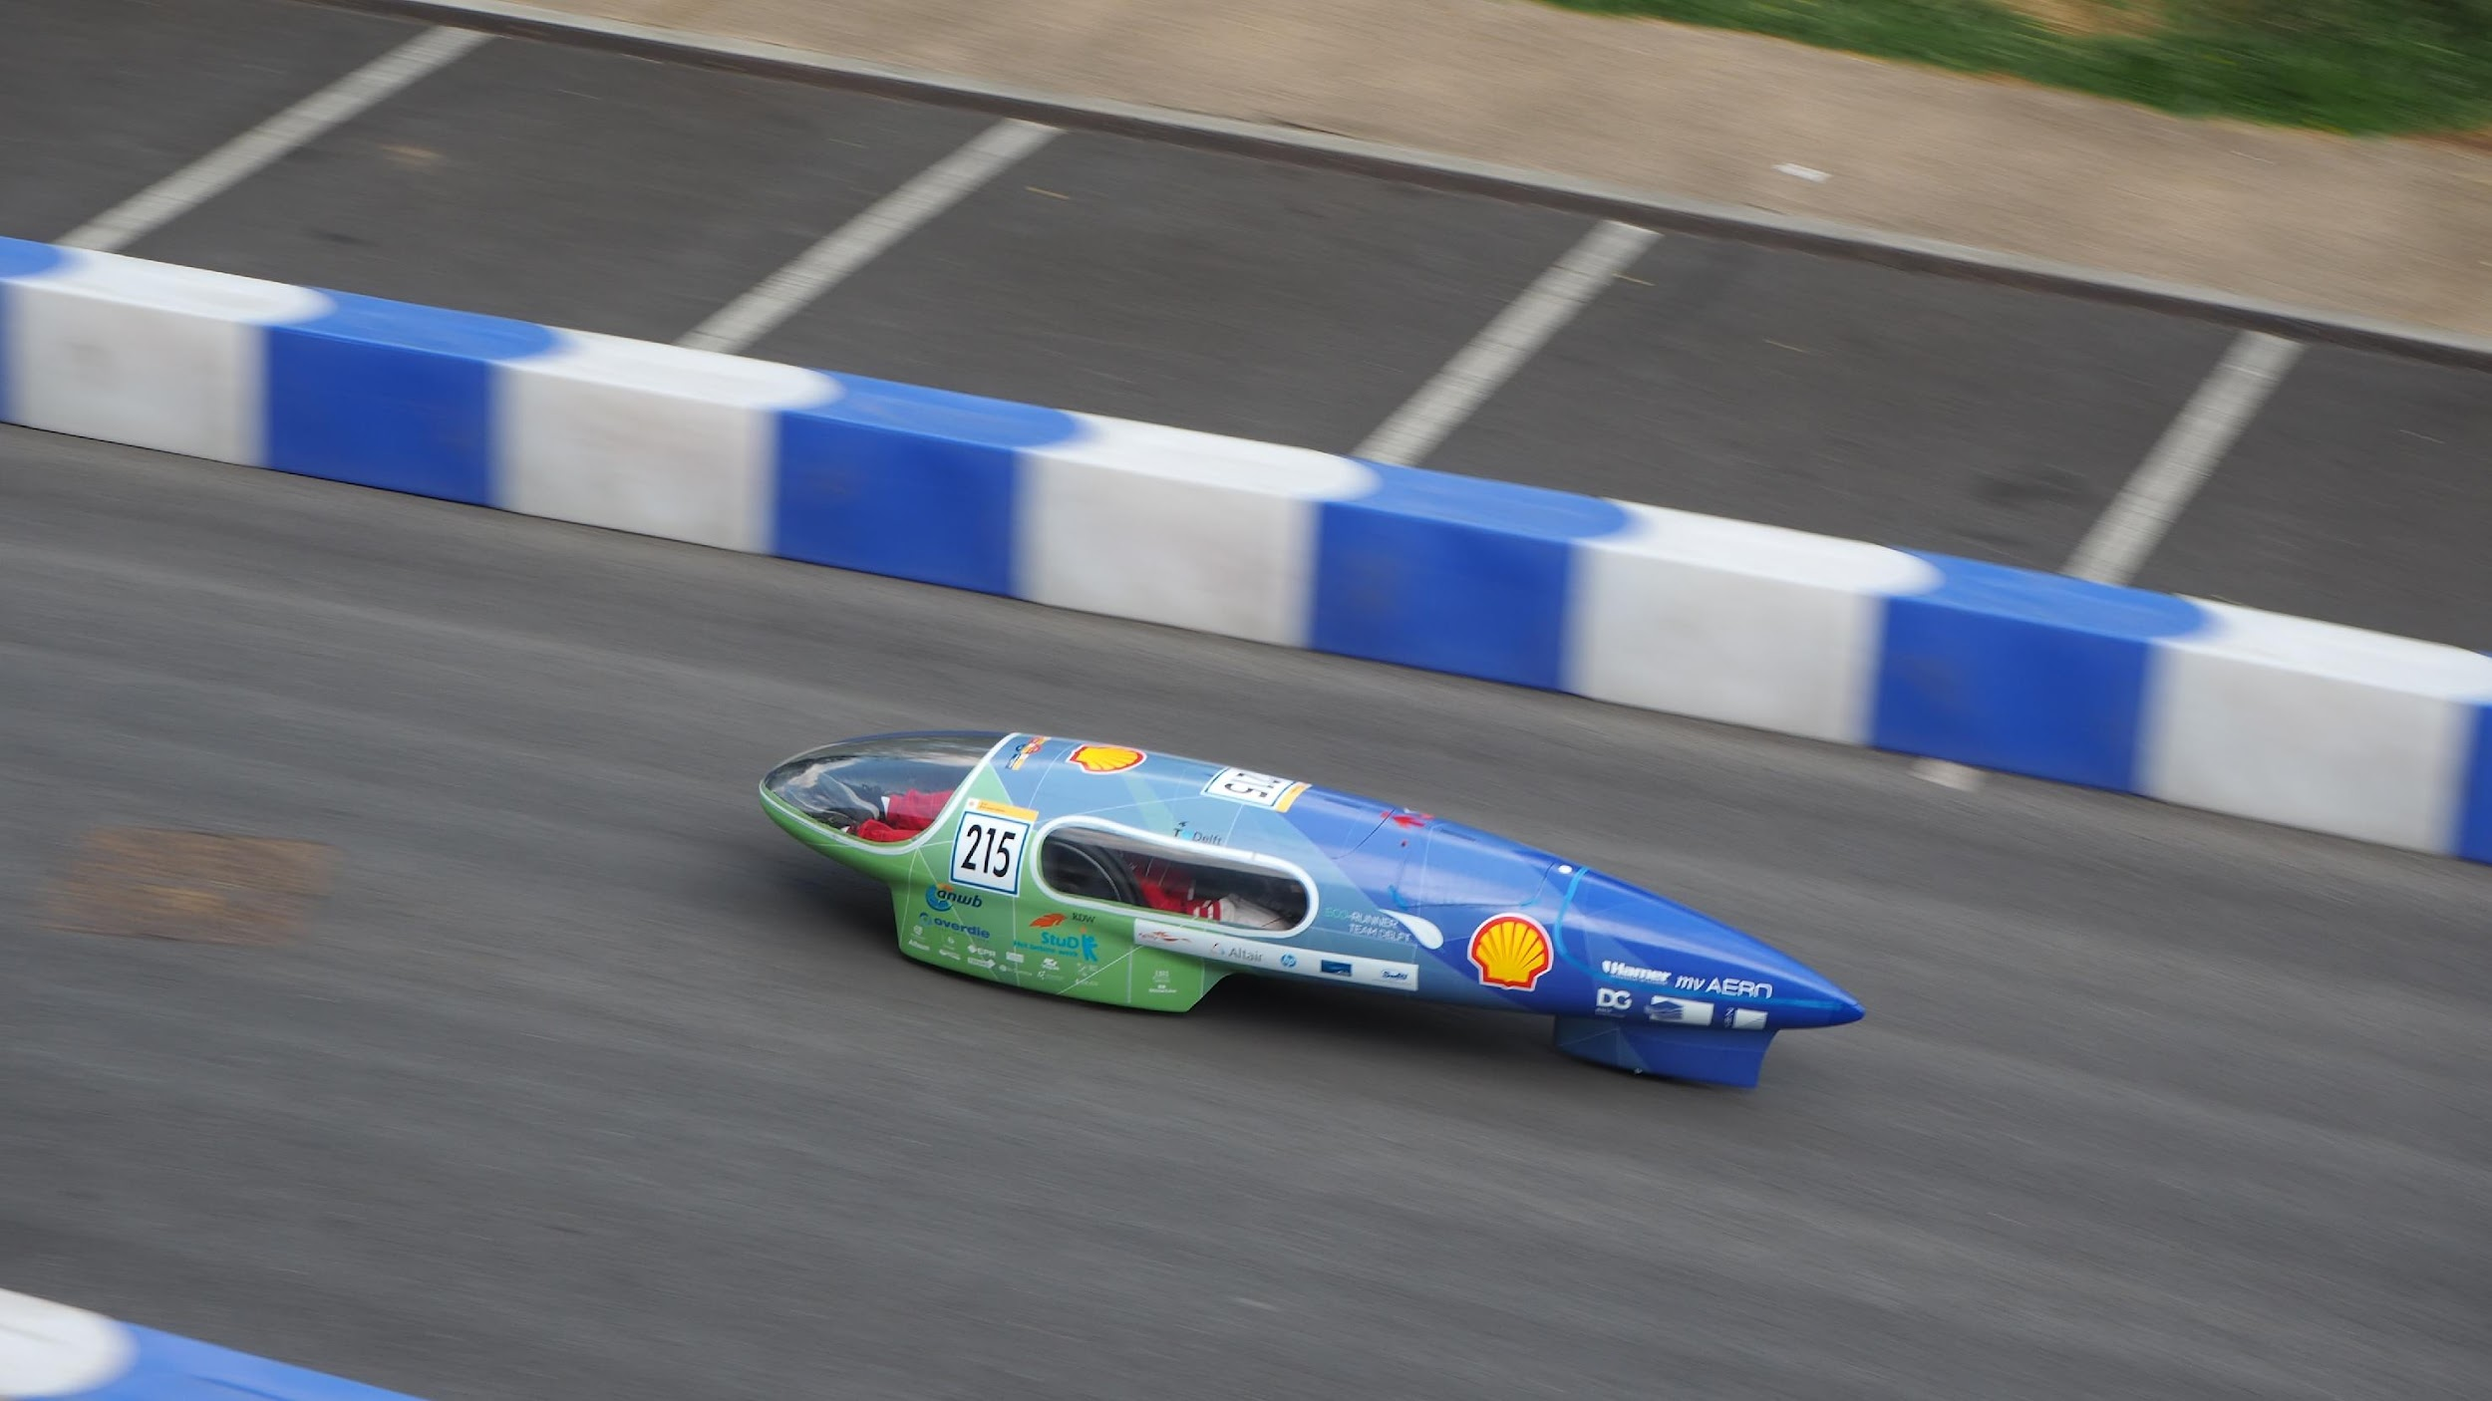
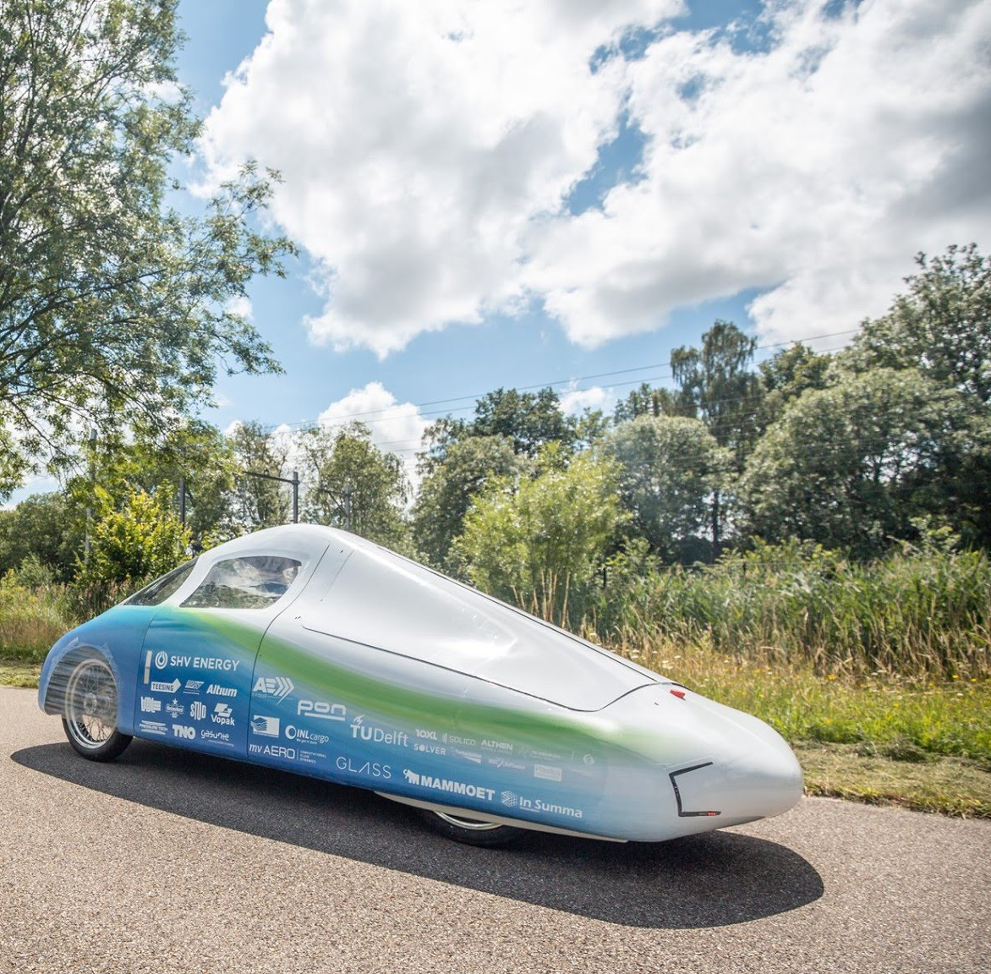
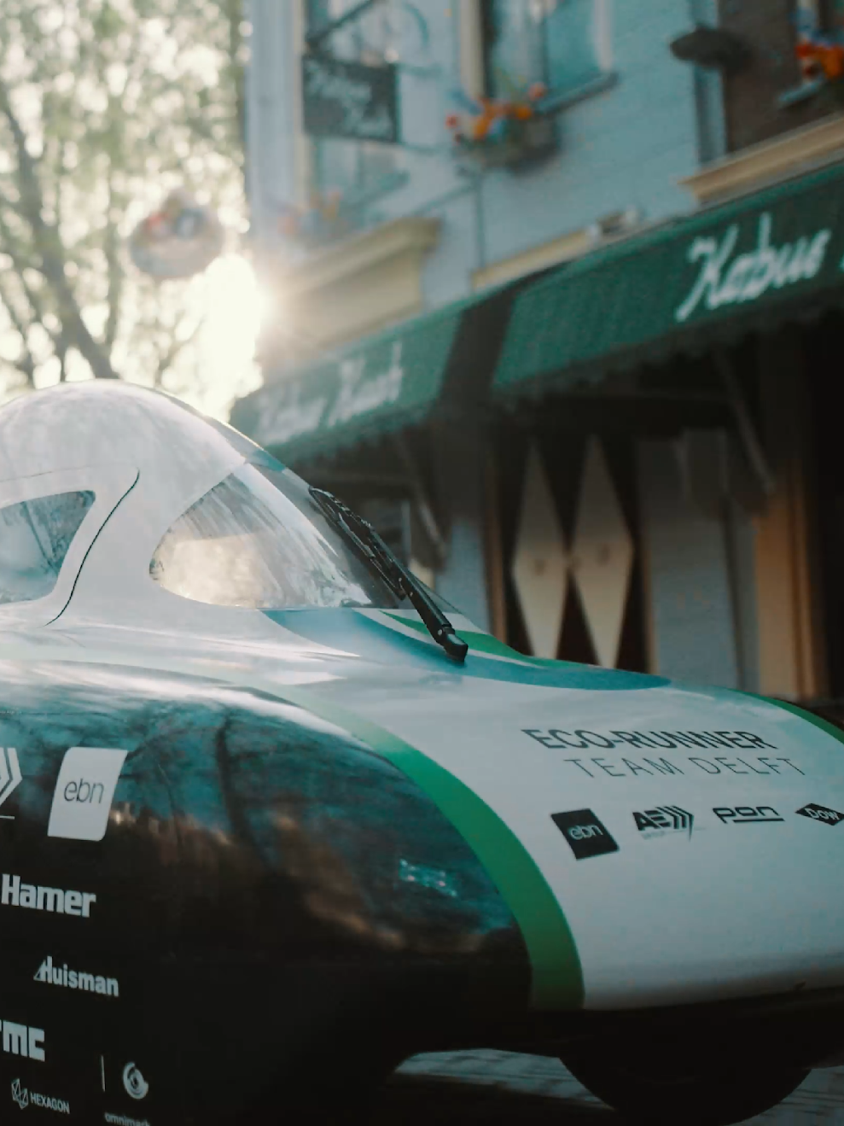
ECO VIII - 2018
ECO X - 2020
ECO XII - 2022
BUILDING EFFICIENT HYDROGEN-POWERED CARS

Slide 23
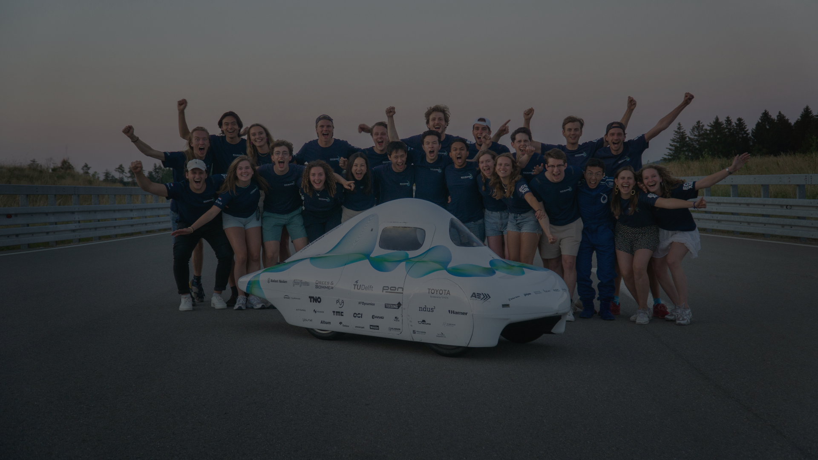

Guinness World Record Holders
2488 KM ON 1 KG OF HYDROGEN
ECO XIII - 2023

Slide 24
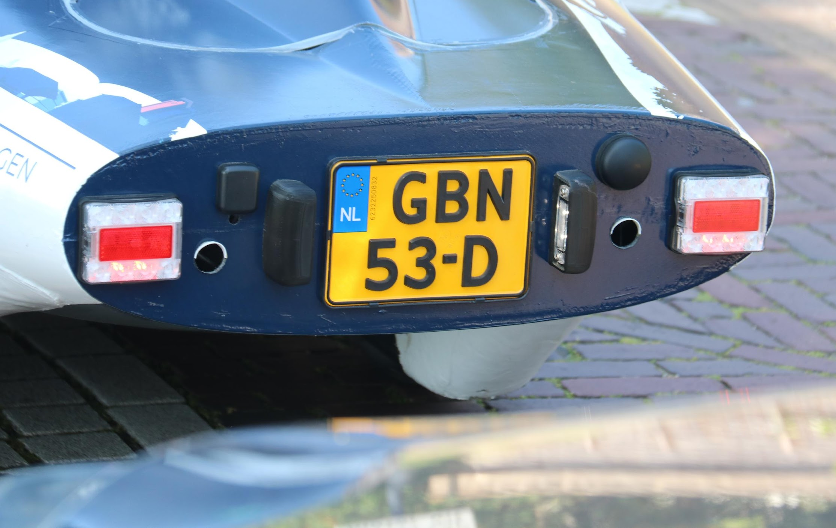
1273 KM ON 1.45 KG OF HYDROGEN ON THE ELFSTEDENTOCHT
FIRST STREET-LEGAL HYDROGEN-POWERED CAR BUILT BY STUDENTS
ECO XIV - 2024

Slide 25
HOW DO WE INSPIRE?
WHY DO WE NEED TO INSPIRE
WHO ARE WE
WHAT HAVE WE ACHIEVED

Slide 26
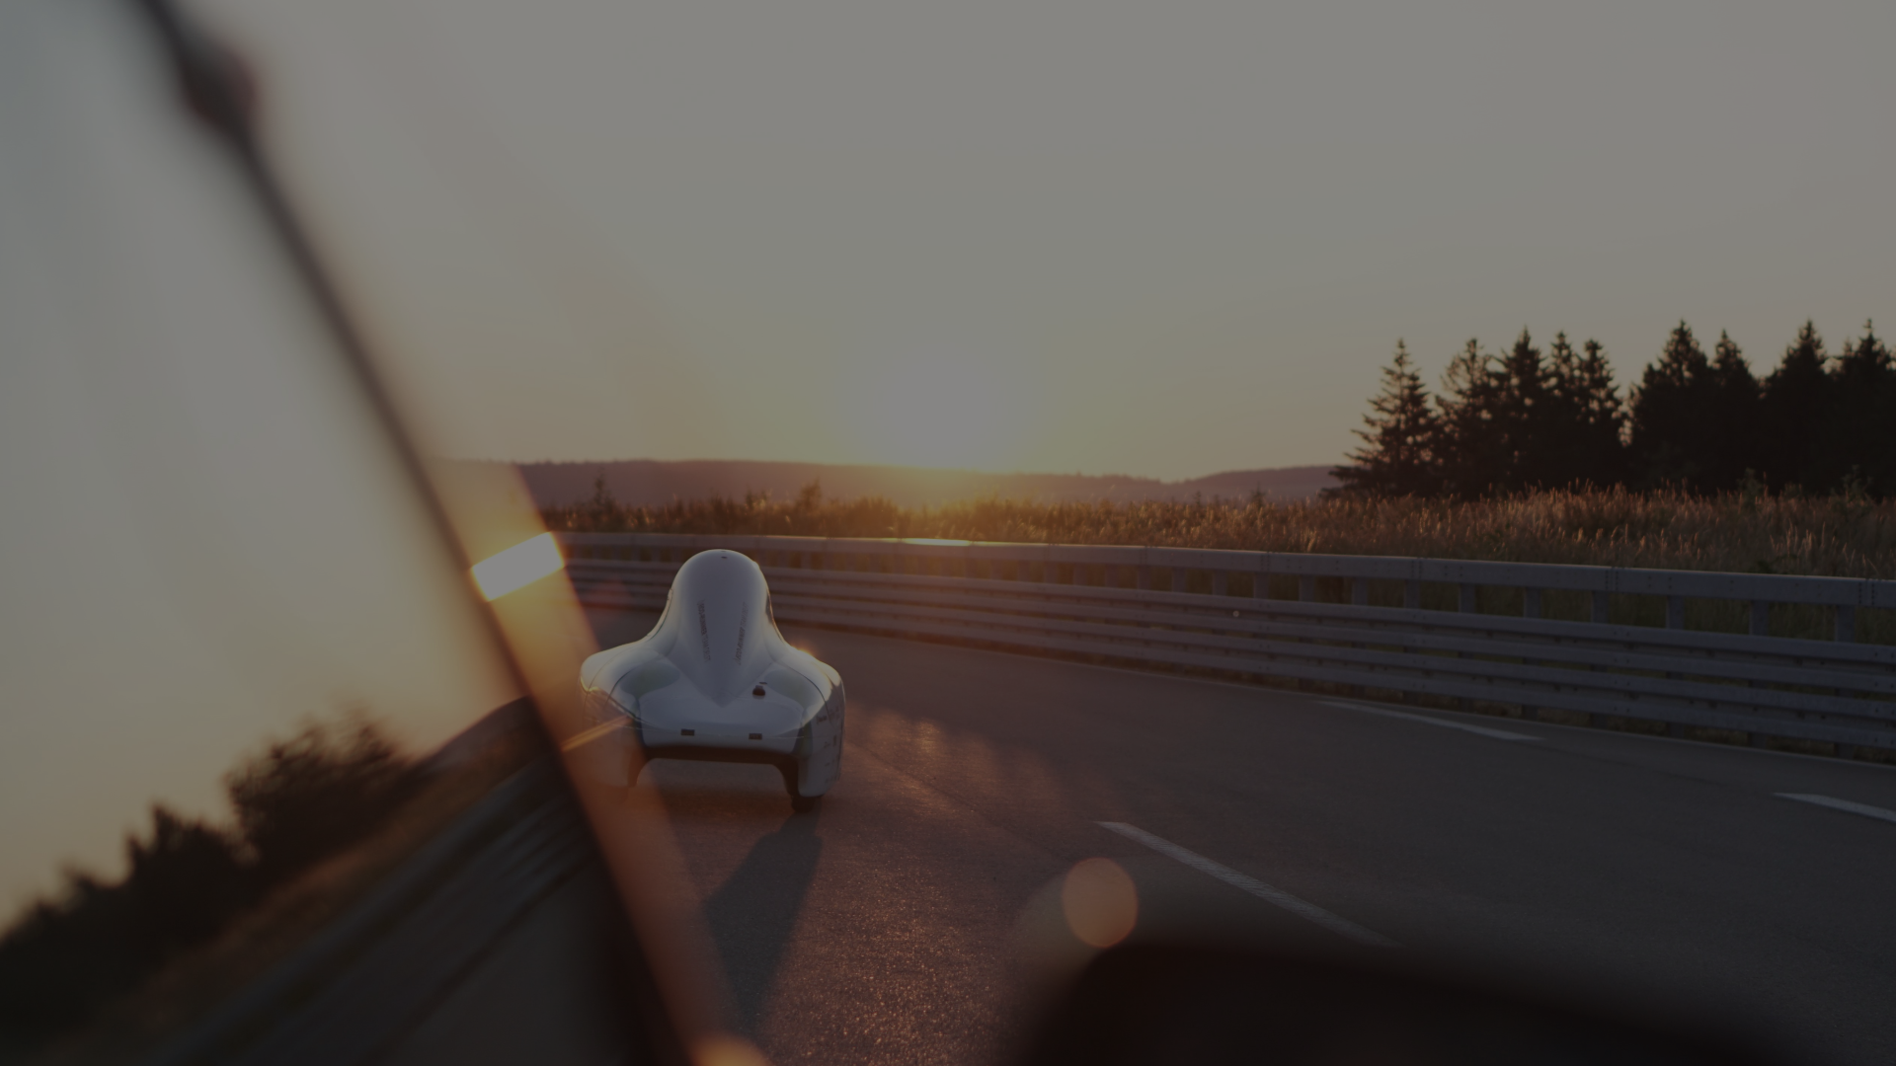
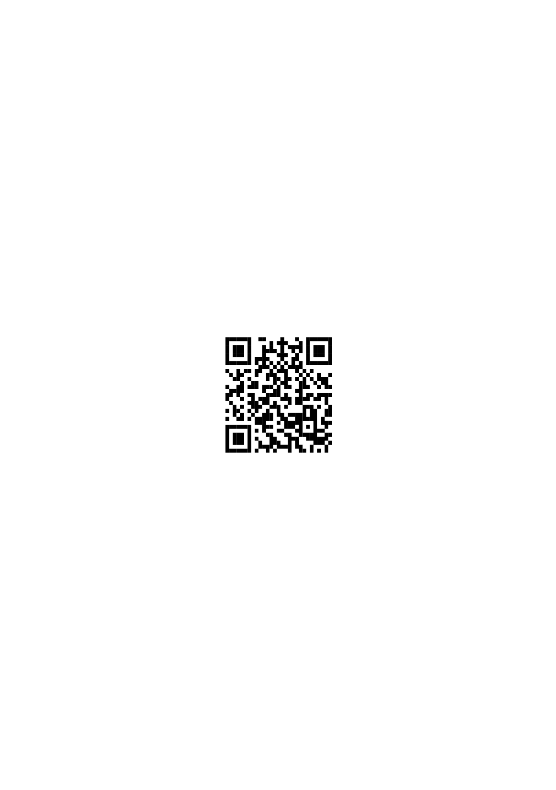
ECO-RUNNER TEAM DELFT
ecorunner.nl
info@ecorunner.nl
Follow us!
Notes:
Voeg LinkedIn toe etc

